Slide 1
Fans, Ducts and Air Handling Systems:
Design, Performance and Commissioning Issues
Ducts
David Sellers
Senior Engineer
Facility Dynamics Engineering

Slide 2
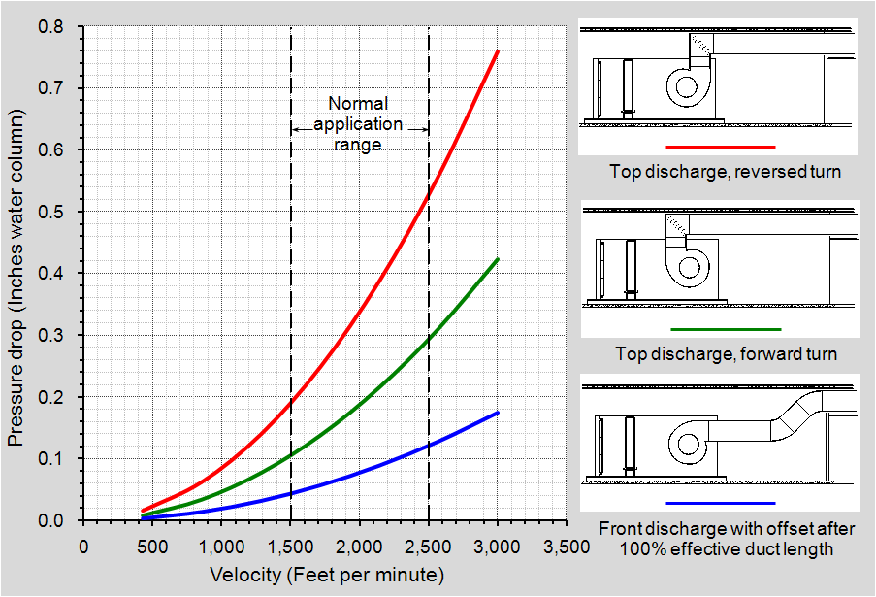
Fan to System Interface;
A Critical Point of Interaction
Notes:
Changing the dimension of a duct in the elbow can have significant pressure losses associated with it as compared to making the turn at a constant size and then transitioning. This is illustrated in the graph in the slide, which was based on ASHRAE and verified by (bitter) experience.
This configuration is quite common in the field because the elbow is often used to solve a geometry problem with out considering the pressure drop implications.
Story – Outdoor Air Intake Elbow Expansion – In which a young engineer inadvertently does a science experiment that verifies the ASHRAE data for an expanding elbow.

Slide 3
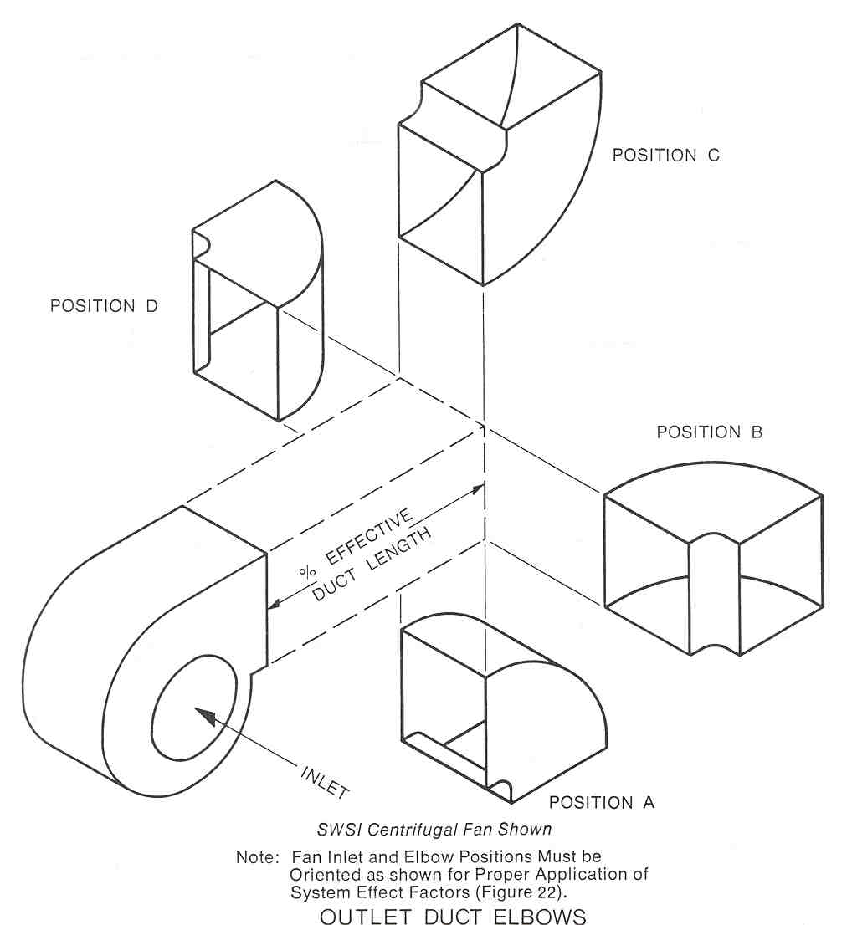
System Effect Varies with Configuration
Fitting placement and/or lack of a discharge duct has the same effect as adding static pressure
.55 in.w.c. at 0% effective duct length
.18 in.w.c. at 50% effective duct length
System effect assessed at 2,500 fpm and an outlet area to blast area ratio of 70%
.20 in.w.c. at 0% effective duct length
.05 in.w.c. at 50% effective duct length
Notes:
For a fan with a 2,500 fpm outlet velocity and a outlet area to blast area ratio of 70%:
1. Added pressure drop at 0% Effective duct length:
Position A - .20 in.w.c.
Position C - .55 in.w.c.
2. Added pressure drop at 50% Effective duct length:
Position A - .05 in.w.c.
Position C - .18 in.w.c.

Slide 4
Where you think you will be if you don’t know about system effect

Slide 5
Where you actually need to be due to system effect

Slide 6
Where you will end up because you didn’t know about system effect (6% short of design flow)

Slide 7
Fan Energy is Directly Related to Flow and Fan Static Pressure
Flow rate – 25,000 cfm
Unnecessary static pressure burden – 0.50 in.w.c.
Fan static efficiency – 72%
Brake horsepower used - 2.8 bhp

Slide 8
Motors Come in Standard Incremental Sizes
Fan brake horsepower requirement is typically less than the incremental motor horsepower supplied
Motor service factor provides some margin for error
  For our example:
    Brake horsepower at design is approximately 18 bhp
    Brake horsepower required if system effect is accommodated is approximately 21 bhp
    Horsepower available from a 20 hp motor with a service factor of 1.15 is 23 hp

Slide 9
This Problem is Often Solved by Throwing Energy at It
For our example:
    Speed the fan up and everyone wins!

Slide 10
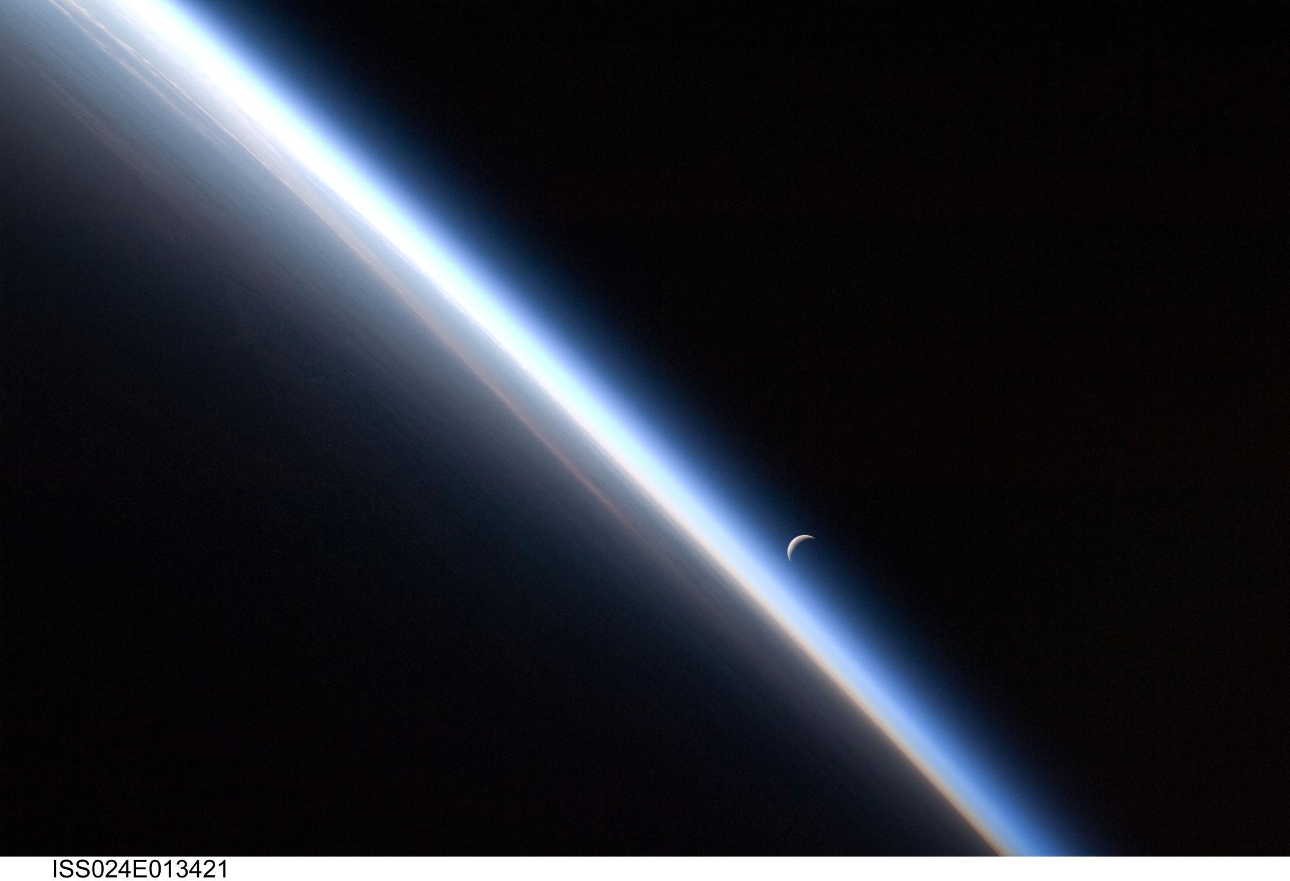
This Problem is Often Solved by Throwing Energy at It
For our example:
    Speed the fan up and everyone wins!
    (Except the planet)
    "If I could use only one word to describe the earth as seen from the moon, I would ignore both its size and color and search for a more elemental quality, that of fragility. The earth appears "fragile," above all else. I don't know why, but it does.”
    Michael Collins, “Carrying the Fire”
Image Courtesy NASA ISS Image Archives

Slide 11

This Problem is Often Solved by Throwing Energy at It
    We don’t inherit the world
    from our ancestors;
    We borrow it from our children
    Unknown

Slide 12
Remember …
Simply using “Best Practices” could save significant fan energy
  “Best Practices” are things we already know how to do

Slide 13
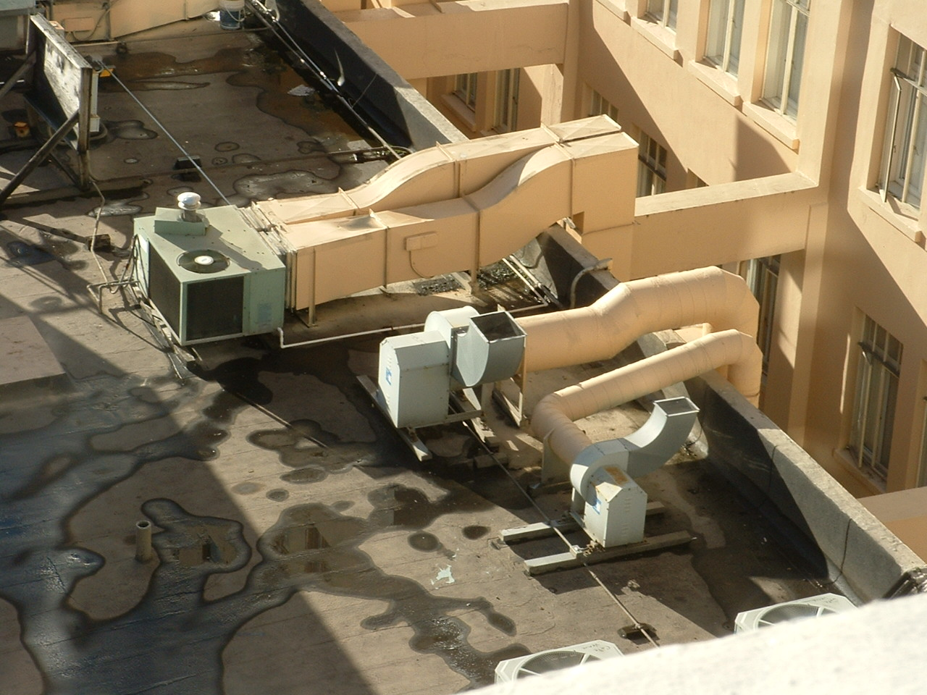
Field Report
Making progress …
… but still room for improvement

Slide 14
Effective Duct Length

Slide 15
Rectangular Duct Equivalent Diameter
ASHRAE Basis

Slide 16
Rectangular Duct Equivalent Diameter
AMCA Basis

Slide 17
Flat Oval Duct Equivalent Diameter
ASHRAE Basis

Slide 18
Hydraulic Diameter

Slide 19
Darcy Equation for Friction Loss in Duct

Slide 20
Reynolds Number

Slide 21
Relative Roughness

Slide 22
Nikuardse’s Experiment

Slide 23
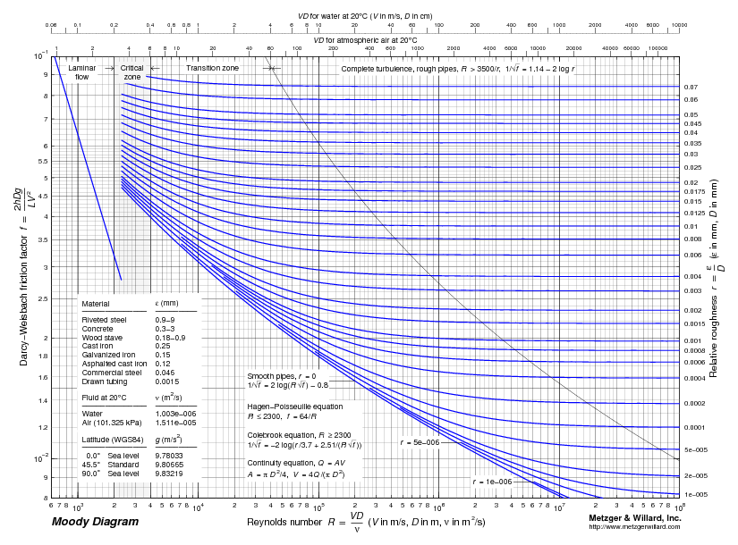
Moody Diagram

Slide 24
Duct Friction Chart

Slide 25

Turbulent vs. Laminar

Slide 26
Fully Developed Laminar Flow Average Velocity
Fully Developed Turbulent Flow Average Velocity
The vectors typically shown to represent the velocity profile in a pipe are usually an indication of the average velocity for a given fluid particle over time not the streamlines
The actual motion of any given particle could be laminar (parallel lines) or turbulent (swirling lines)
Laminar flow will tend to have a parabolic average velocity profile shape
Turbulent flow will have a flatter, fuller velocity profile shape
Fully developed flow exists when the average flow profile does not change as the fluid moves down the conduit

Slide 27
The Square Law:
Common to both Air and Water Systems
Roots in the Darcey - Weisbach equation
Applies to fully developed turbulent flow

Slide 28
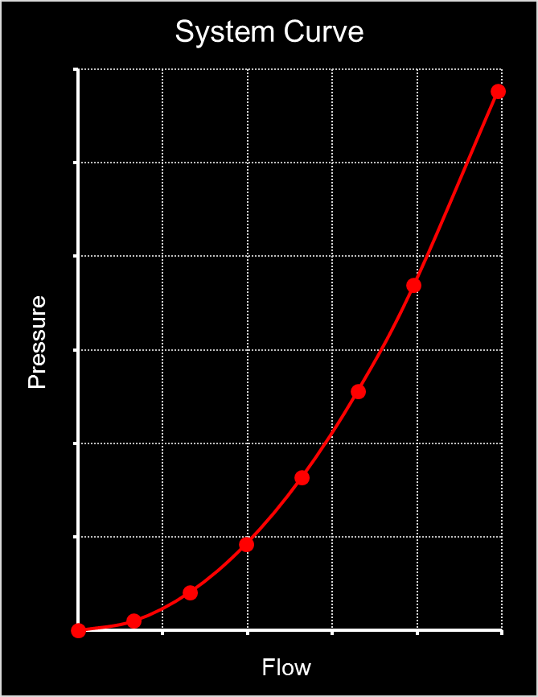
The Square Law:
Common to both Air and Water Systems
Applies to a fixed system
    If a damper moves in an air system, you generate a new system curve
    If a valve moves in a water system you generate a new system curve
  There are places in our systems where the flow is not fully developed turbulent flow
    ASHRAE research suggests the nominal exponent is 1.85 – 1.89
    Using 2 is close enough for field work most of the time

Slide 29
Why This Matters if You are Working with Control Systems
Fan power is a function of flow and static pressure

Slide 30
Why This Matters if You are Working with Control Systems
The Square Law says that if we reduce the flow rate in a given system, the static required to deliver the flow will be reduced exponentially
  Cut the flow by 50%, then you cut the static required to 25% of what it was (.5 x .5 or .5²)

Slide 31
Why This Matters if You are Working with Control Systems
As a result, for a fixed system, fan power varies as the cube of the flow rate
  Control systems can optimize both the flow and the static required by a system, thus control systems can optimize the fan power required by a system
  Control systems can also mess this up if we are not careful and as a result waste energy and resources

Slide 32
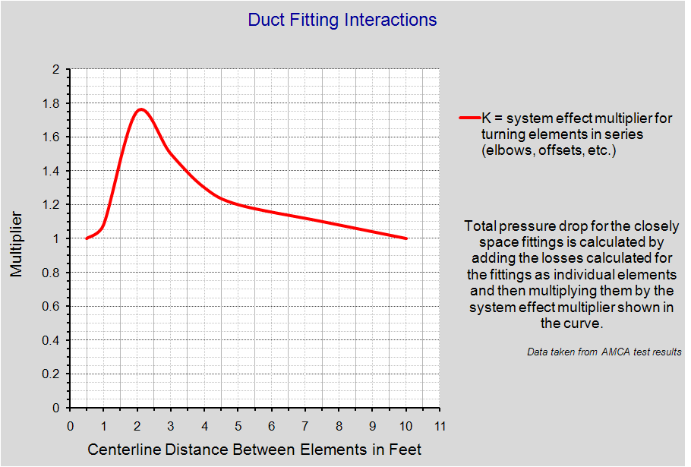
System Effect and Duct Fittings
(Fittings Interact!)

Slide 33
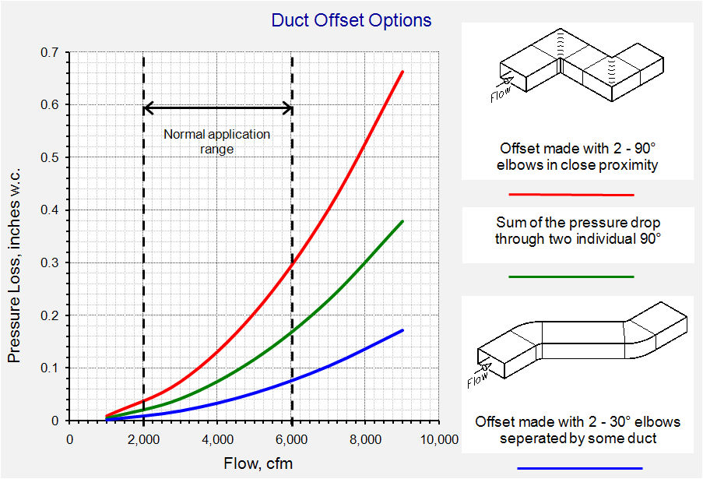
Notes:
Changing the dimension of a duct in the elbow can have significant pressure losses associated with it as compared to making the turn at a constant size and then transitioning. This is illustrated in the graph in the slide, which was based on ASHRAE and verified by (bitter) experience.
This configuration is quite common in the field because the elbow is often used to solve a geometry problem with out considering the pressure drop implications.
Story – Outdoor Air Intake Elbow Expansion – In which a young engineer inadvertently does a science experiment that verifies the ASHRAE data for an expanding elbow.

Slide 34
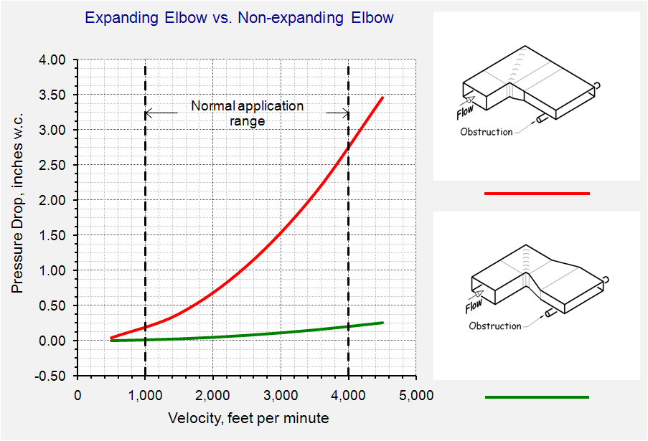
Subtle Geometry Difference =
Big Pressure Drop Difference

Slide 35
Loss coefficients rely on a uniform velocity profile for accurate measurements

Slide 36
Turns and other obstructions distort the flow profile
Interactions between the air and the duct wall will eventually restore the uniform flow profile
Generally takes 5-10 equivalent duct diameters of distance

Slide 37
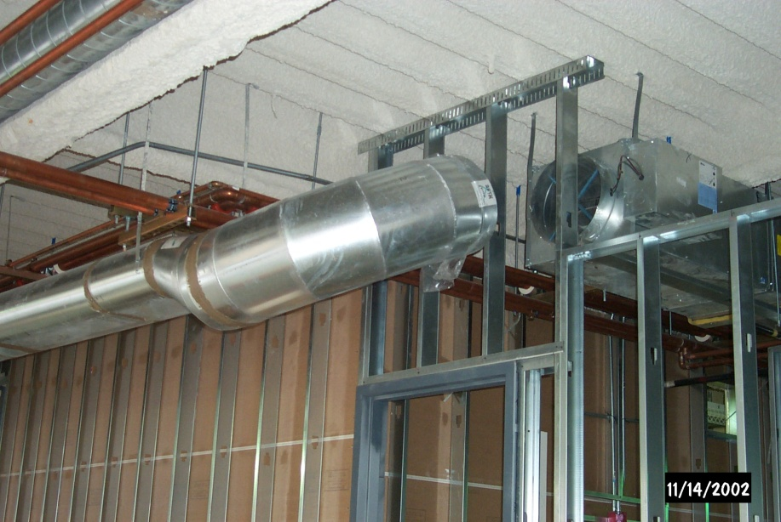
Typical Terminal Unit Inlet Duct

Slide 38
Using Loss Coefficients

Slide 39
Velocity Pressure is VERY significant

Slide 40
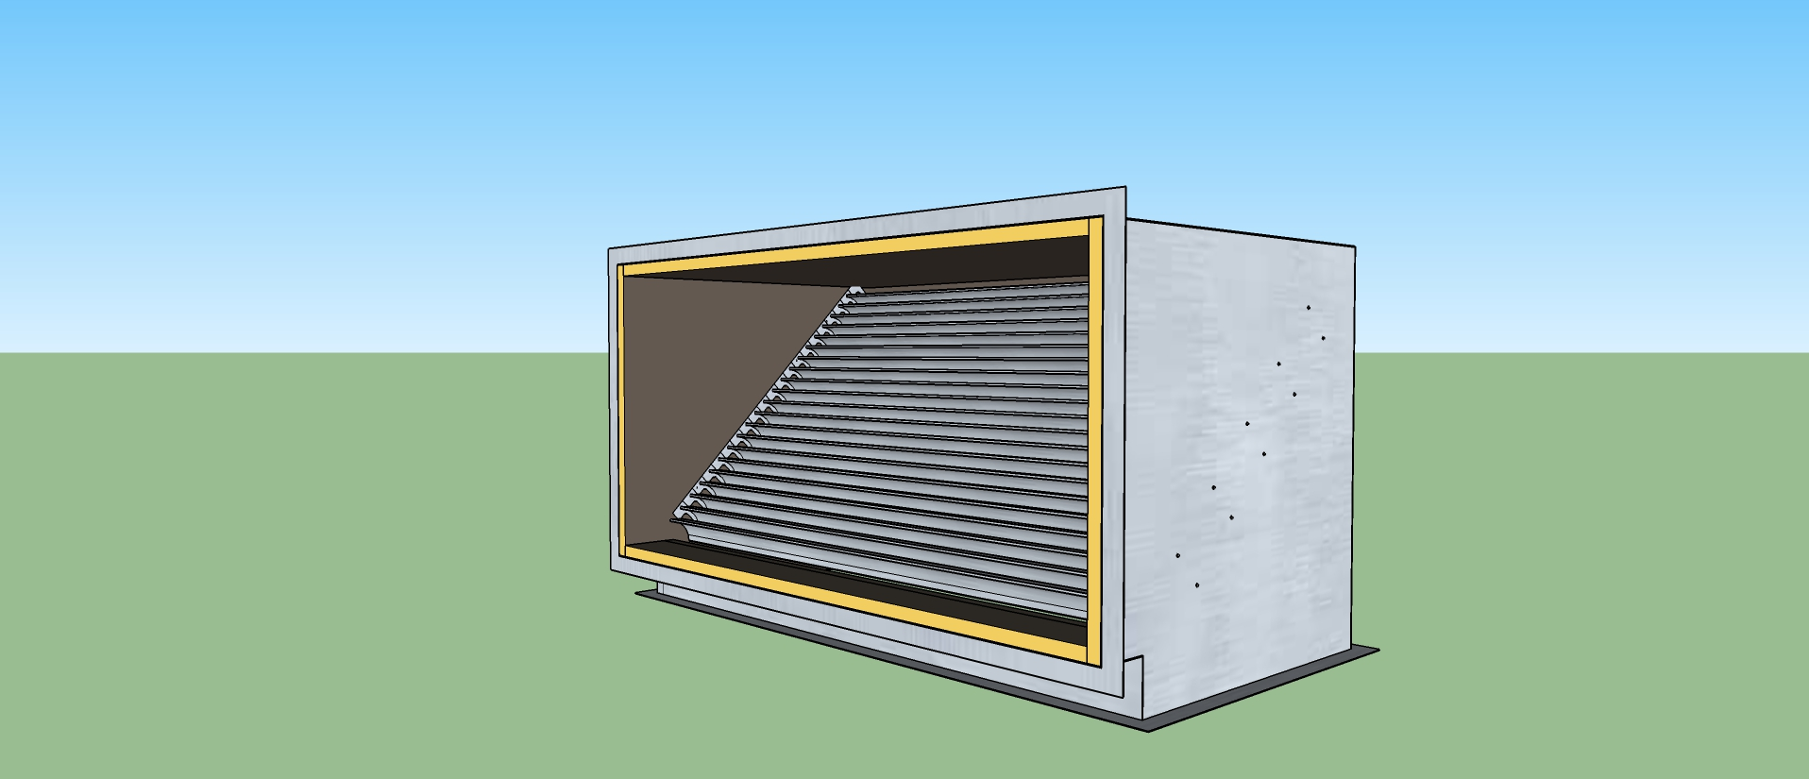
A Closer Look at a Mitered Elbow

Slide 41
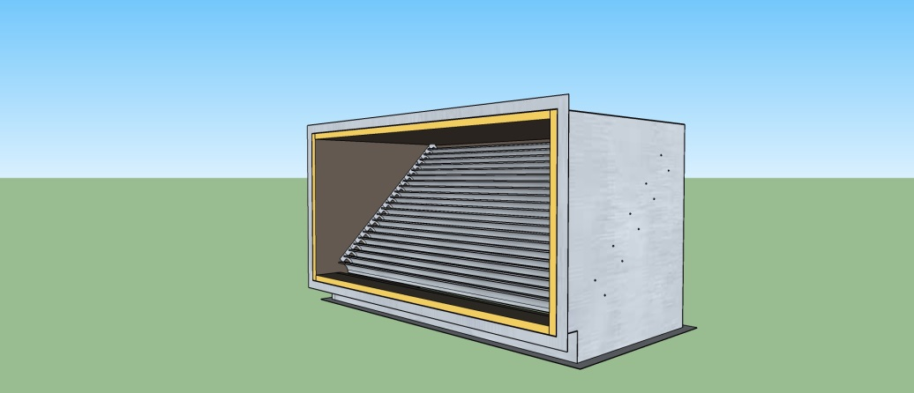
An Exercise
What is the loss for the fitting?

Slide 42
An Exercise
What is the loss for the fitting?

Slide 43
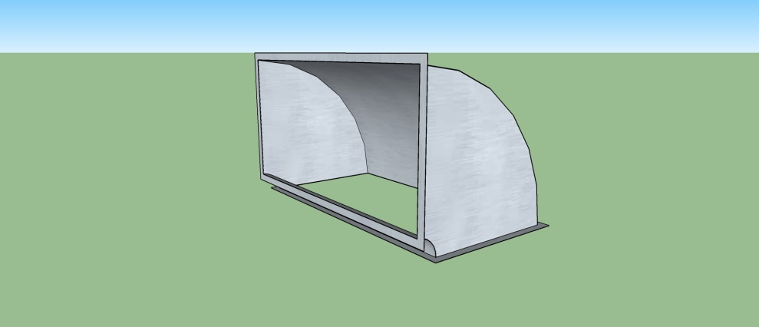
Different Geometry = Different Loss
Base Case
  Square duct
  Low velocity
  12” centerline radius
  No vanes

Slide 44
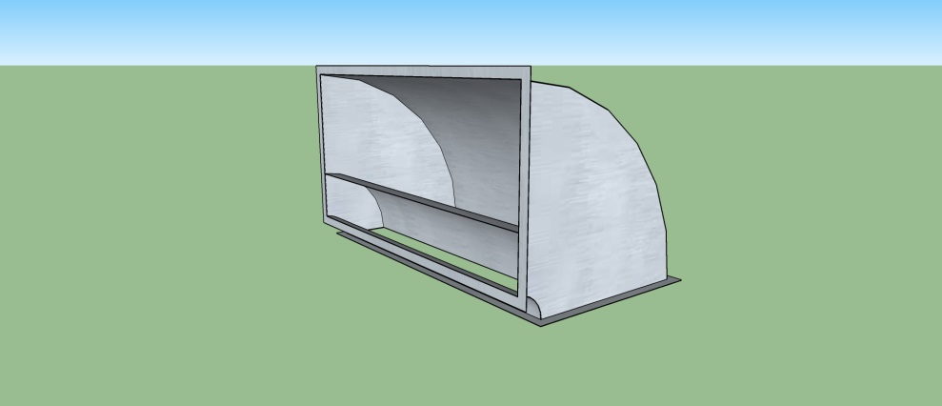
Different Geometry = Different Loss
Base Case with One Vane

Slide 45
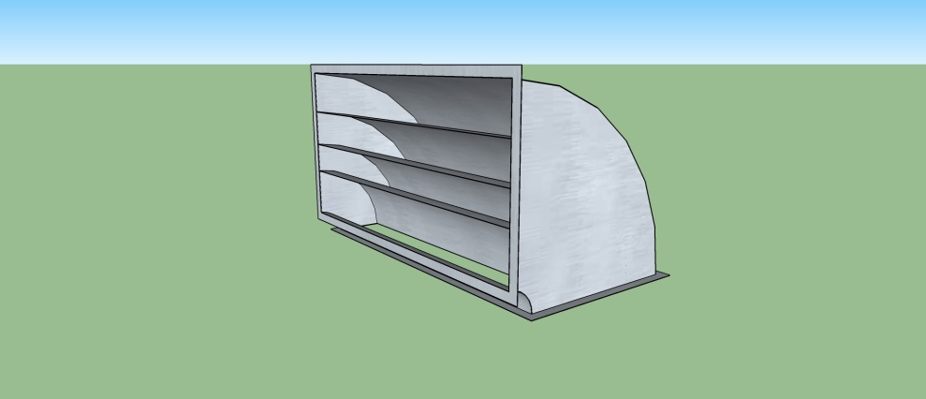
Different Geometry = Different Loss
Base Case with Three Vanes

Slide 46
Different Geometry = Different Loss
Base Case with Twice as Much Air Flow (Twice the Velocity)

Slide 47
Different Geometry = Different Loss
Base Case with Three Vanes and Twice as Much Air Flow (Twice the Velocity)

Slide 48
Different Geometry = Different Loss
Base Case with Three Vanes and a Smaller Centerline Radius and Twice as Much Air Flow (Twice the Velocity)

Slide 49
Different Geometry = Different Loss
Base Case with Three Vanes, and a High Aspect Ratio (Thin and Wide) and Twice as Much Air Flow (Twice the Velocity)

Slide 50
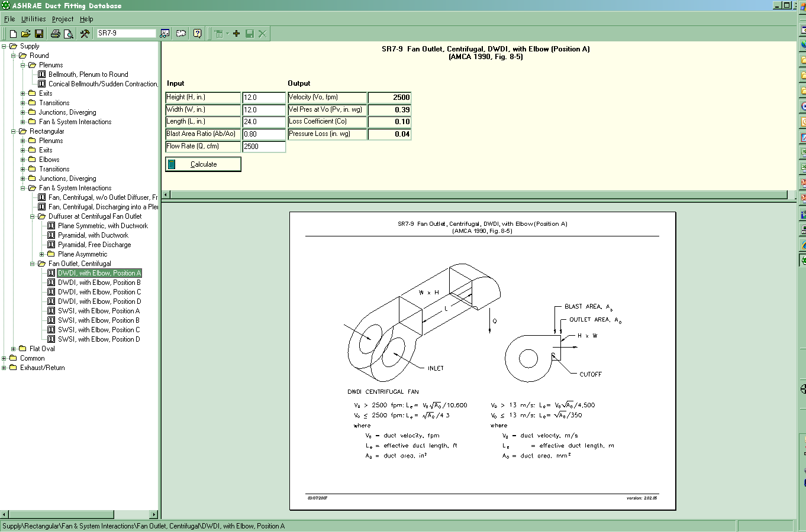
A Tool that Makes the Analysis Easy
Notes:
2.77 4.15
.75 2.17

Slide 51
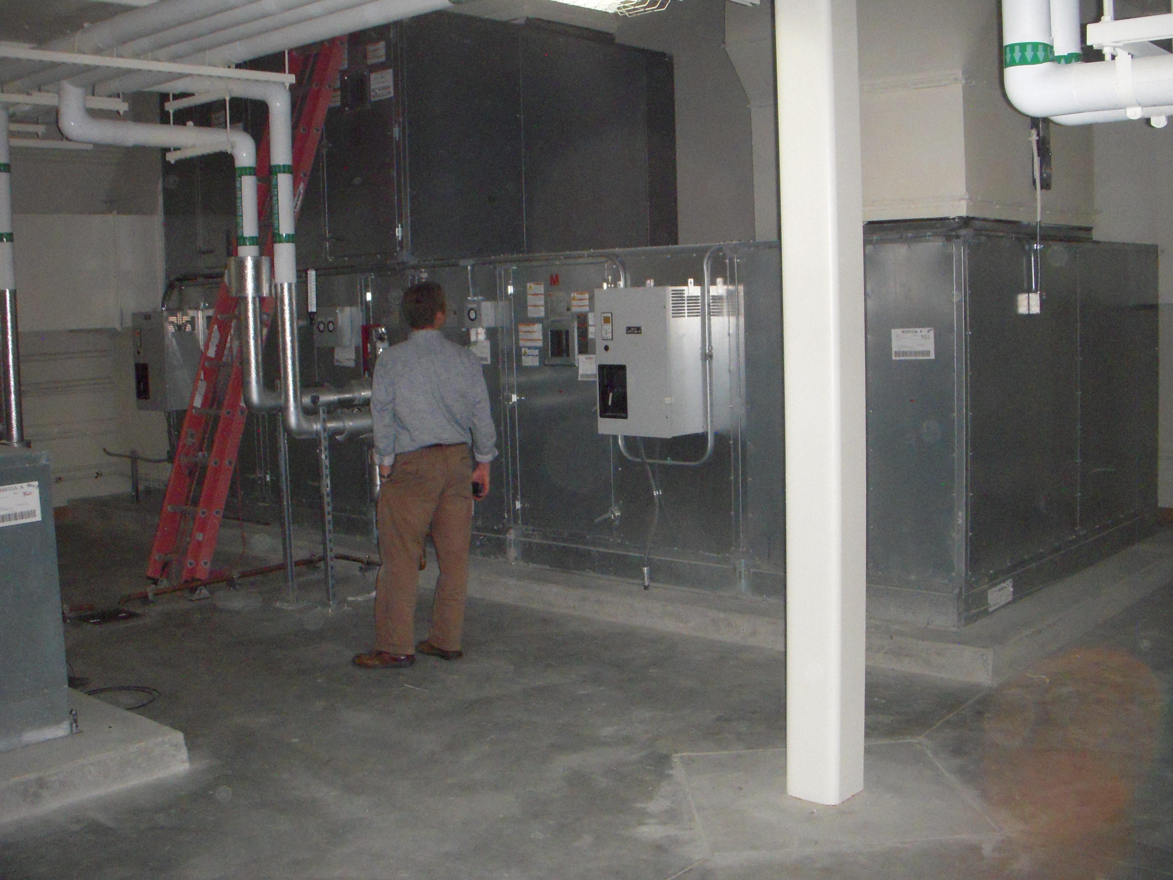
A Recent Field Example

Slide 52
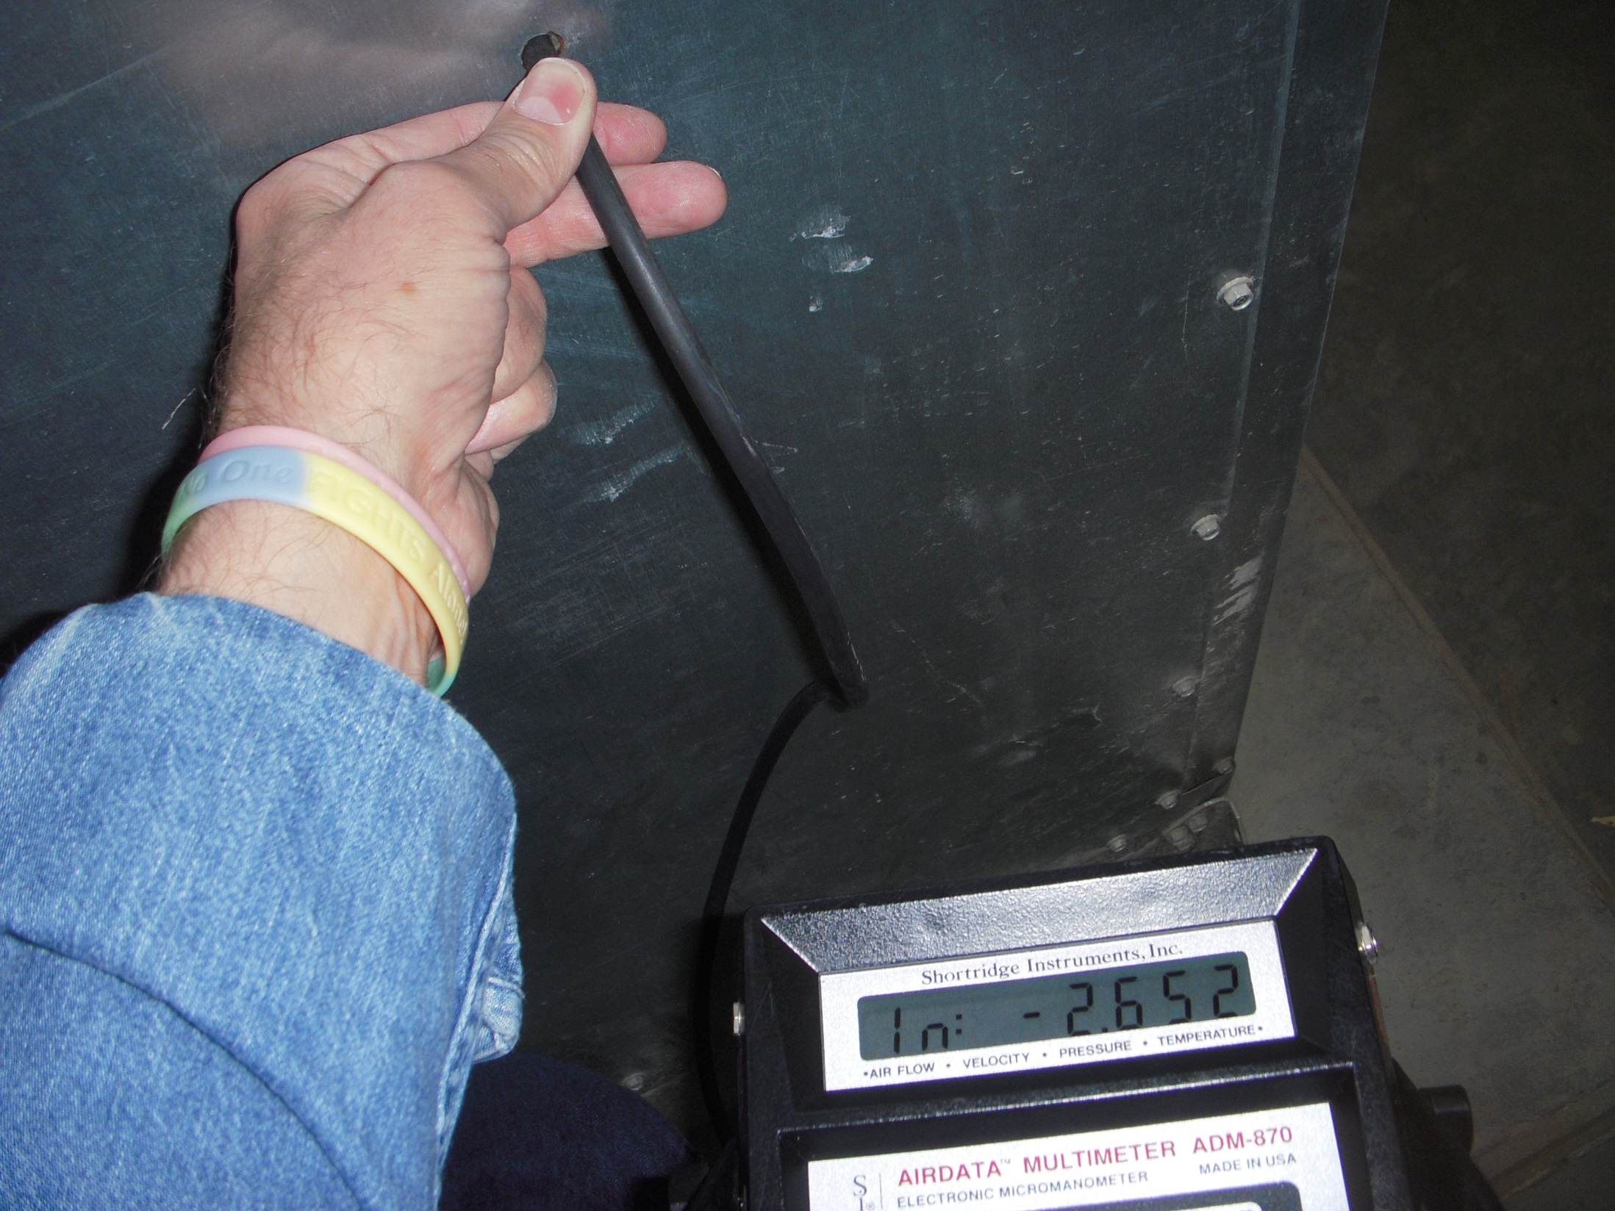

Slide 53
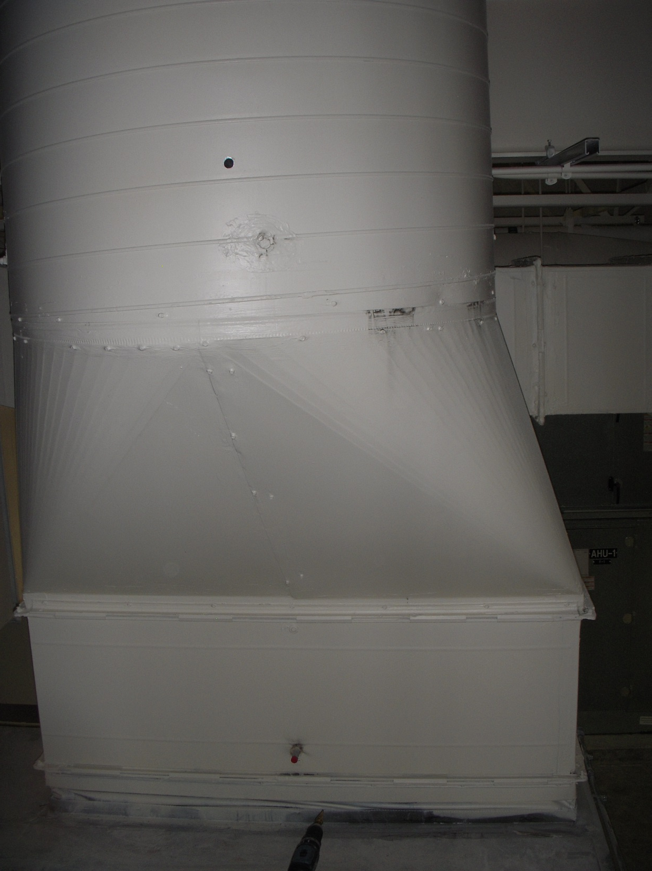

Slide 54
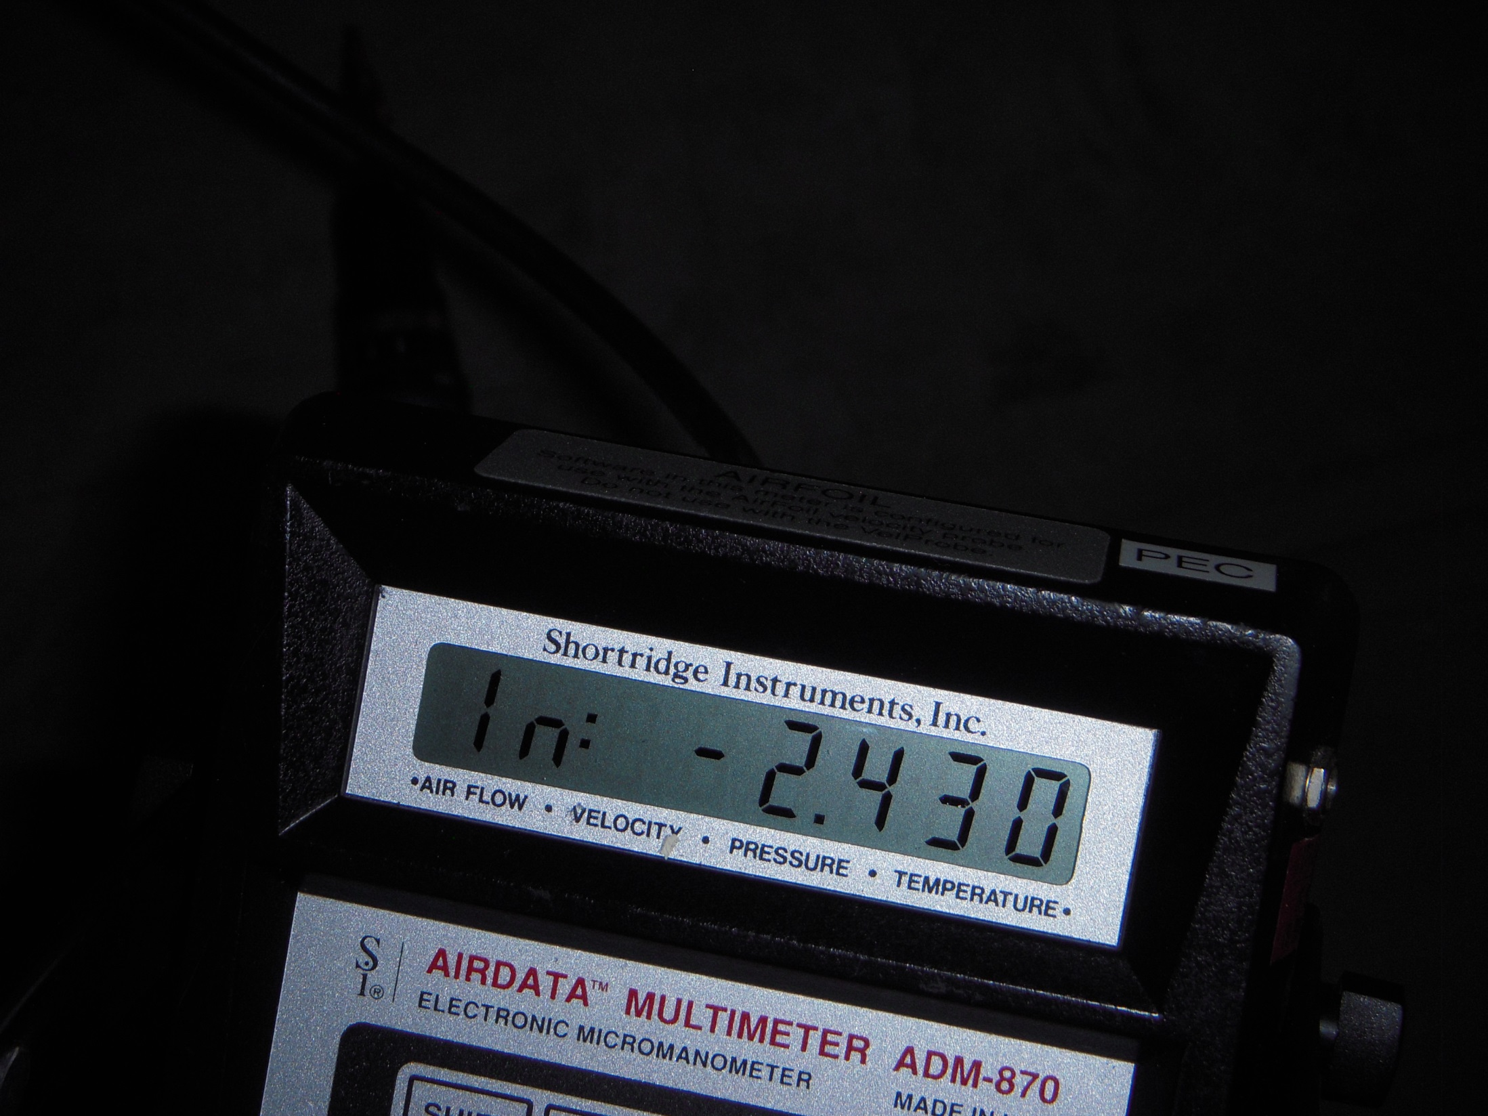

Slide 55
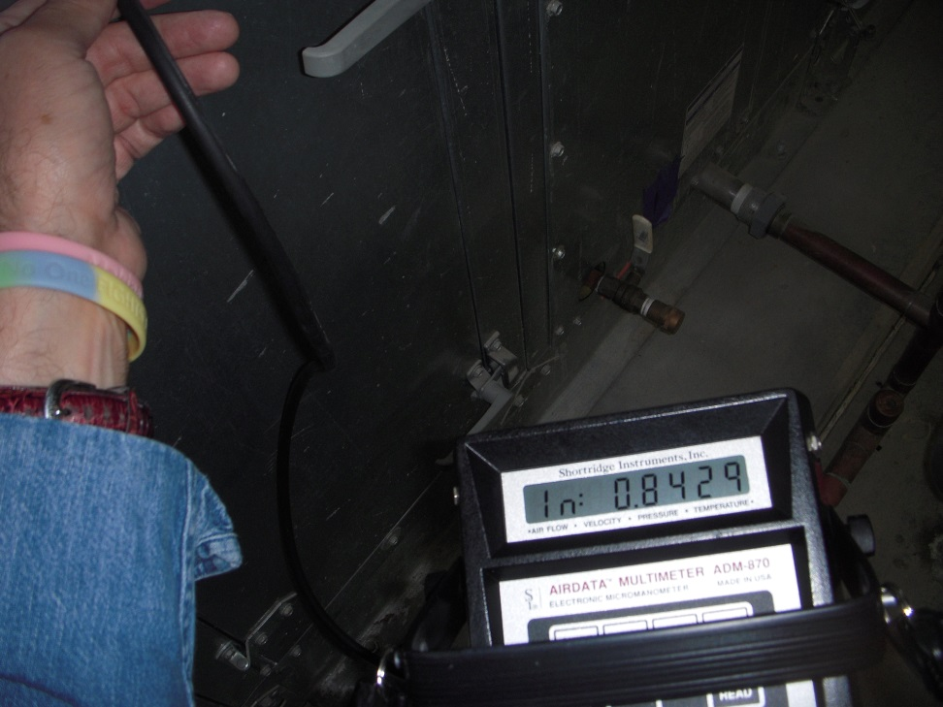
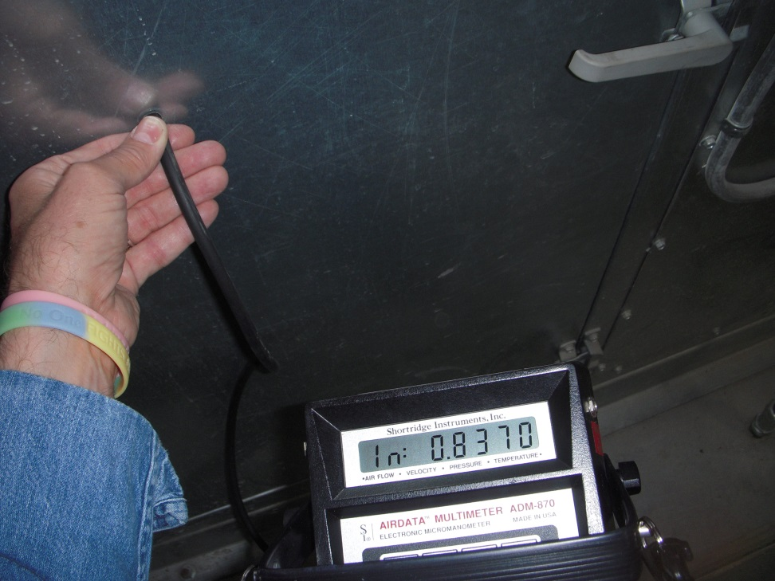

Assessing the Operating Point

Slide 56
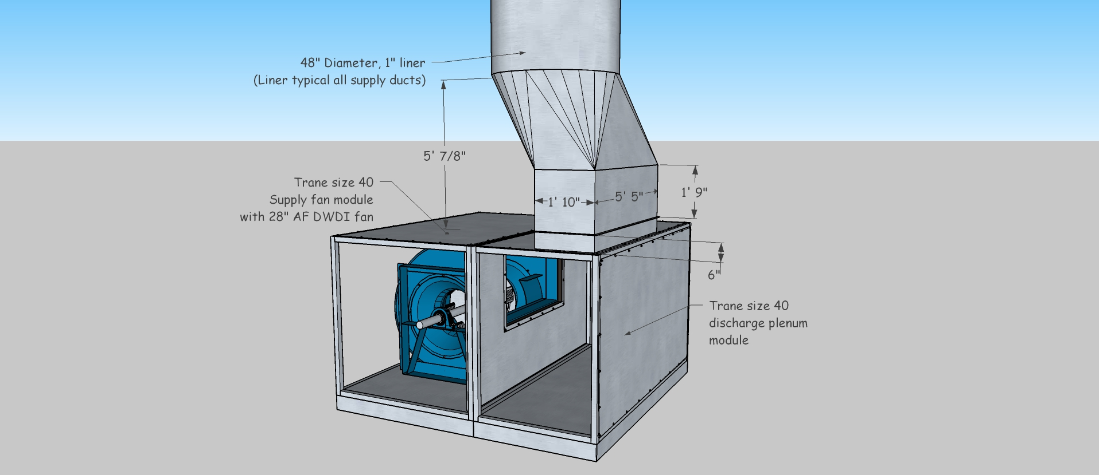

Slide 57
Interesting Relationships
57 - 7/31/2019
Notes:
As a general rule, round or low aspect ratio ducts will provided most cost effective solution for moving a given volume of air at a given friction rate.
Note:
They contain the largest volume per unit of wetted perimeter length.
They tend to have the lowest weight per contained volume. This is somewhat a function of the specific construction technique used.
They will tend to be structurally more rigid, especially round ducts.
Due to the structural rigidity, they will produce less noise, especially drumming.
Also note how the velocities in the round and lower aspect ratio ducts are higher for the same volume and friction rate as compared to ducts with higher aspect ratios. This means that you may need to be more attentive to fitting design and other details where the losses are a function of the velocity pressure.

Slide 58
Interesting Relationships
Higher velocities for ducts with less sheet metal implies higher operating cost all things being equal and more susceptibility problems due to poor fitting design
Less sheet metal for a round or low aspect ratio duct implies a more sustainable solution (fewer resources used) assuming building height is not affected
58 - 7/31/2019
Notes:
As a general rule, round or low aspect ratio ducts will provided most cost effective solution for moving a given volume of air at a given friction rate.
Note:
They contain the largest volume per unit of wetted perimeter length.
They tend to have the lowest weight per contained volume. This is somewhat a function of the specific construction technique used.
They will tend to be structurally more rigid, especially round ducts.
Due to the structural rigidity, they will produce less noise, especially drumming.
Also note how the velocities in the round and lower aspect ratio ducts are higher for the same volume and friction rate as compared to ducts with higher aspect ratios. This means that you may need to be more attentive to fitting design and other details where the losses are a function of the velocity pressure.

Slide 59

Interesting Relationships
Notes:
The difference in velocity associated with the same friction rate in a large duct as compared to a small duct can be very significant. The ratio of cross sectional area enclosed to perimeter length is much larger for big ducts. This means that for a large duct, the impact of resistance to flow due to friction with the duct wall is much less significant because a much lower percentage of the enclose air is in contact with the wall. As a result, the air in a large duct is moving at a much higher velocity that it would in a smaller duct selected at the same friction rate. If the velocities are higher, then the velocity pressures in the larger ducts will also be higher as compared to a smaller duct applied at the same friction rate.
Since fitting pressure drop is related to duct velocity and duct velocity pressure, the impact of a poor fitting solution or design in a large duct can be much more significant that it would be in a smaller duct, even though the friction rate for both ducts is identical. Thus, it is important to pay particular attention to the details of fitting design in large ducts.

Slide 60
Interesting Relationships
Small ducts don’t handle much air relative to large ducts at the same friction rate because a relatively small volume of air is contained by a relatively large sheet metal perimeter.
Thus, small duct velocities and velocity pressures are low relative to large ducts and poor fittings are not as much of an issue.
Notes:
The difference in velocity associated with the same friction rate in a large duct as compared to a small duct can be very significant. The ratio of cross sectional area enclosed to perimeter length is much larger for big ducts. This means that for a large duct, the impact of resistance to flow due to friction with the duct wall is much less significant because a much lower percentage of the enclose air is in contact with the wall. As a result, the air in a large duct is moving at a much higher velocity that it would in a smaller duct selected at the same friction rate. If the velocities are higher, then the velocity pressures in the larger ducts will also be higher as compared to a smaller duct applied at the same friction rate.
Since fitting pressure drop is related to duct velocity and duct velocity pressure, the impact of a poor fitting solution or design in a large duct can be much more significant that it would be in a smaller duct, even though the friction rate for both ducts is identical. Thus, it is important to pay particular attention to the details of fitting design in large ducts.

Slide 61
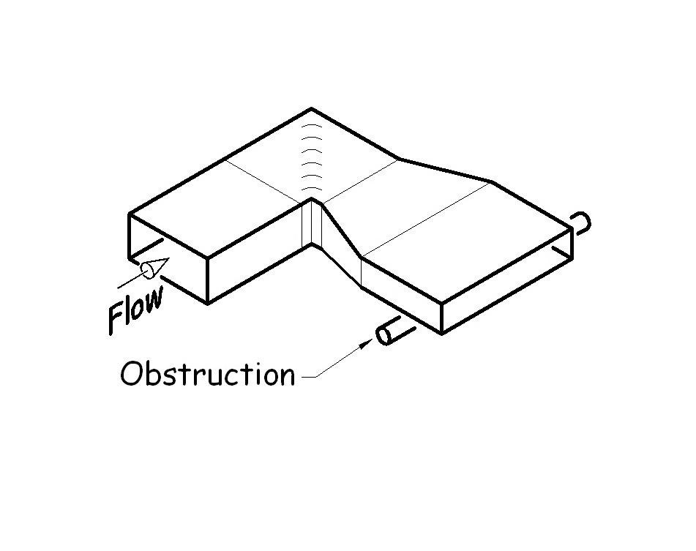
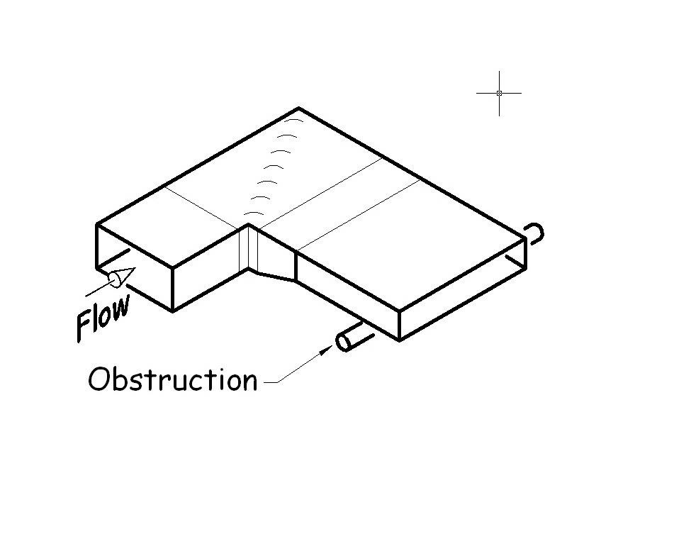
I Specify Construction to SMACNA Standards so I’ll Get Low Loss Fittings
Maybe …
… or Maybe Not
SMACNA is a design and construction standard, not an efficiency standard

Slide 62
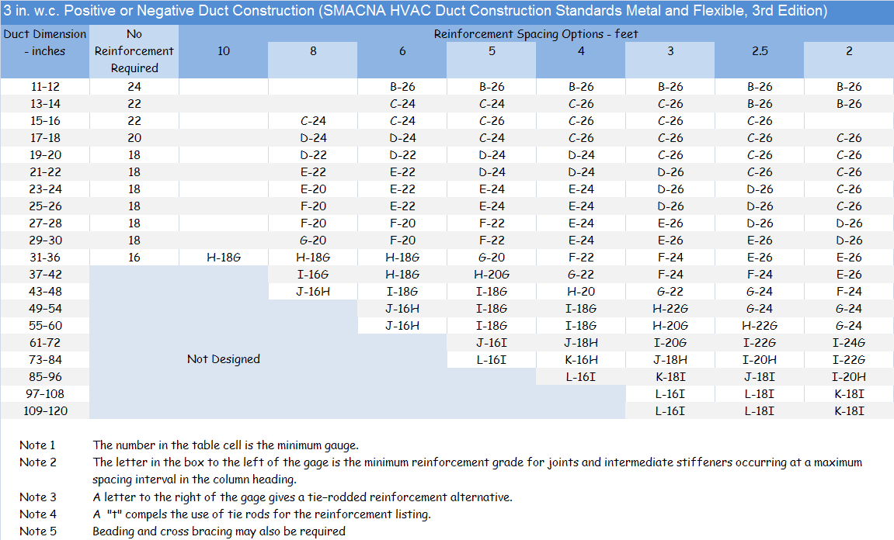
For Any Given SMACNA Duct or Fitting:
There are multiple combinations of metal thickness (gauge) and reinforcement

Slide 63
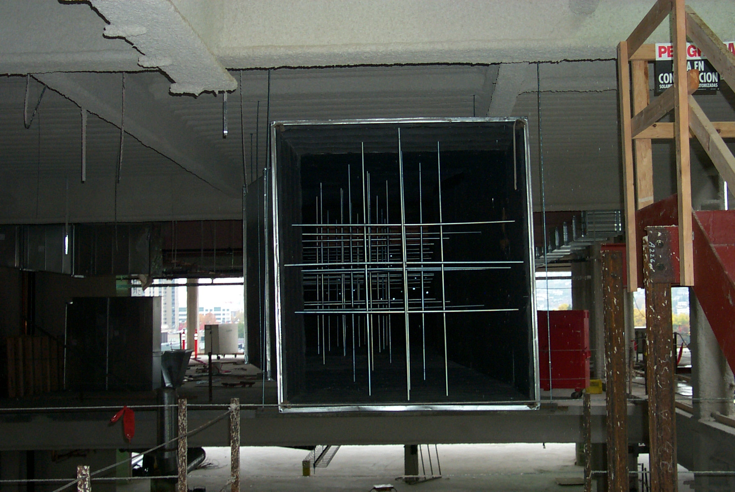
Internal Reinforcement

Slide 64
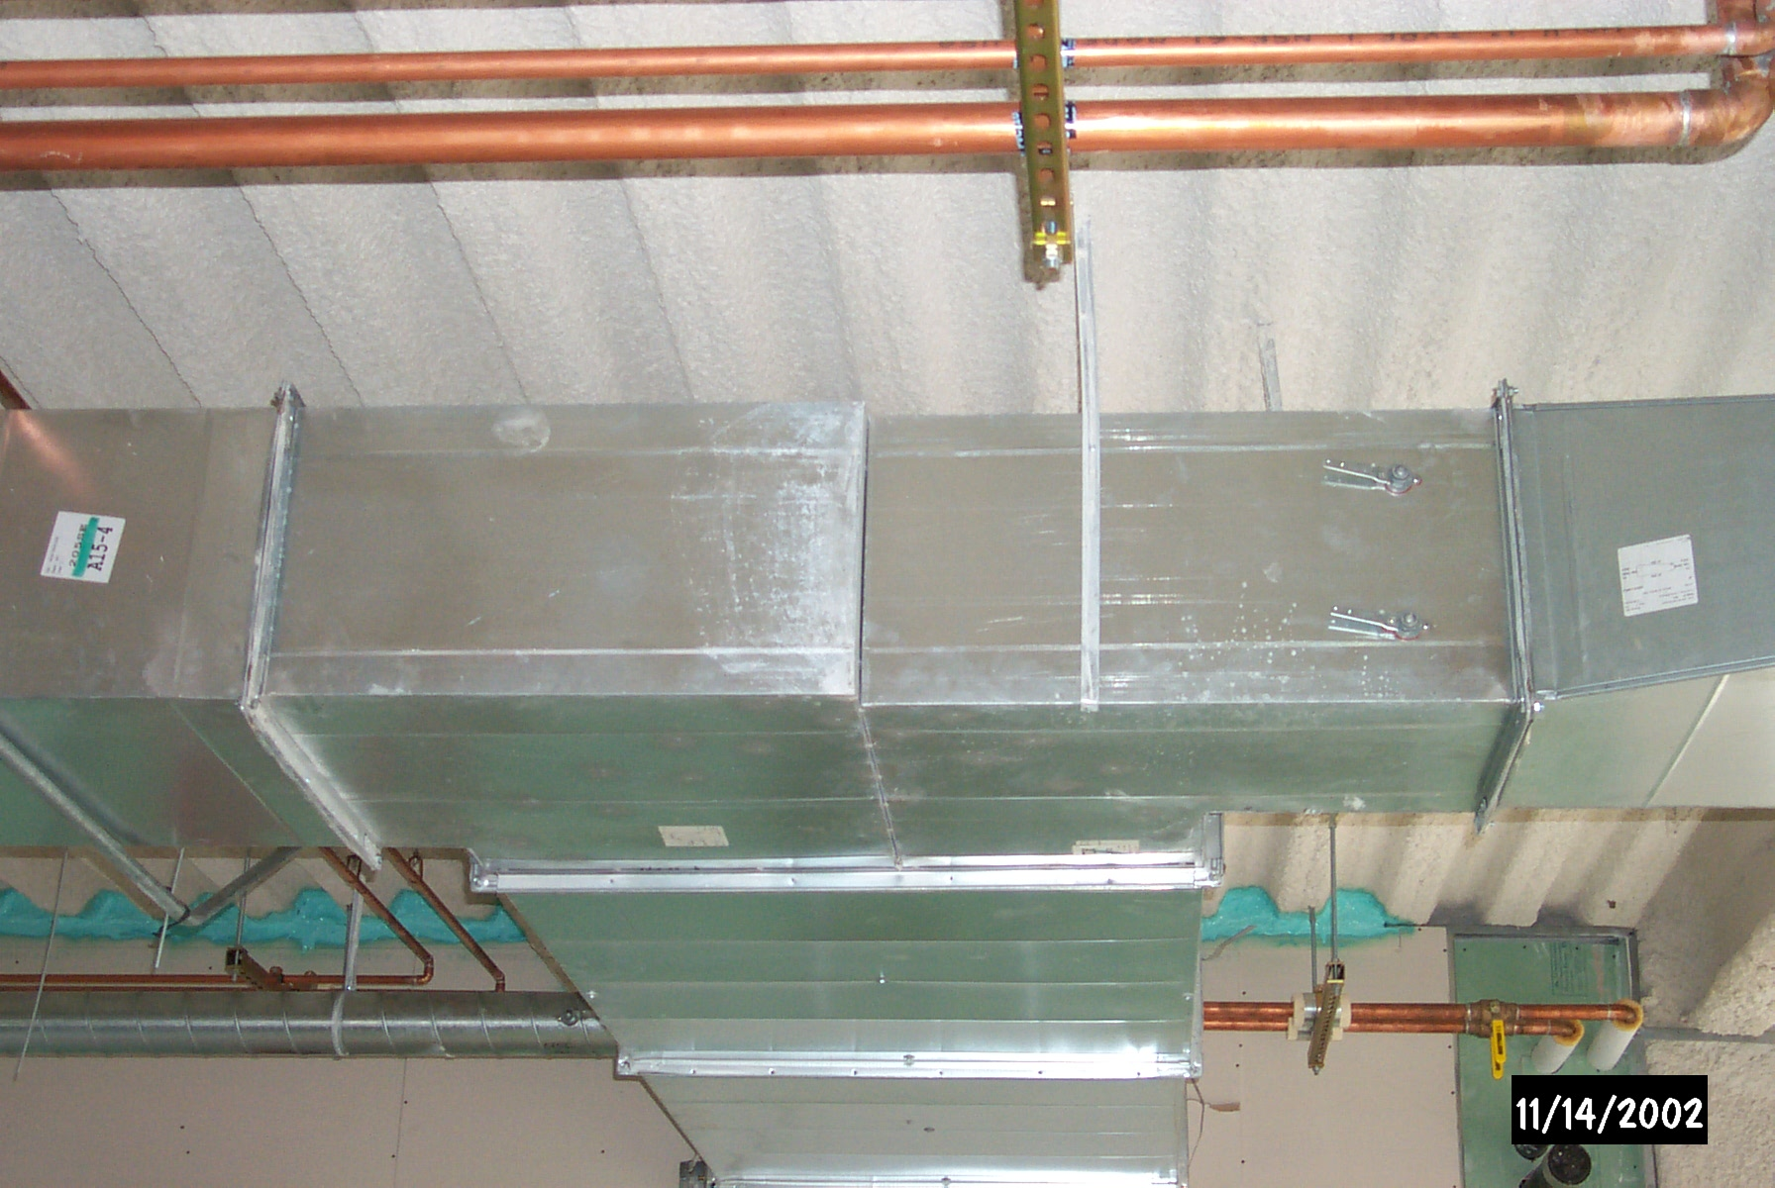
External Reinforcement and a Flow Division Fitting

Slide 65
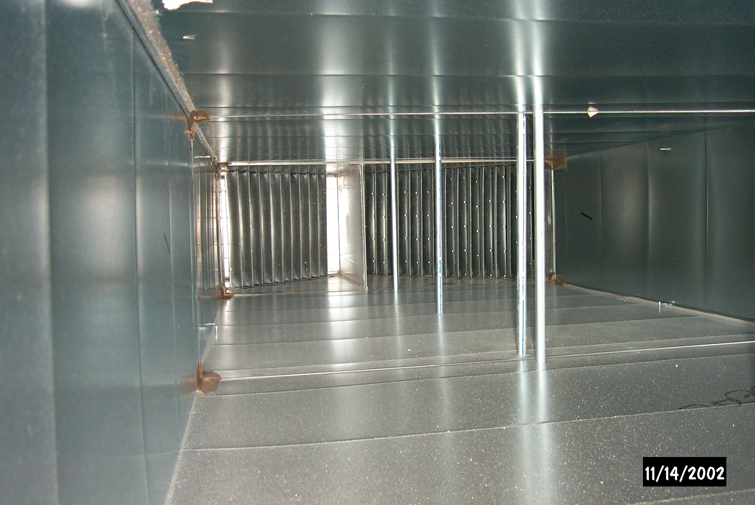
Inside the Fitting

Slide 66
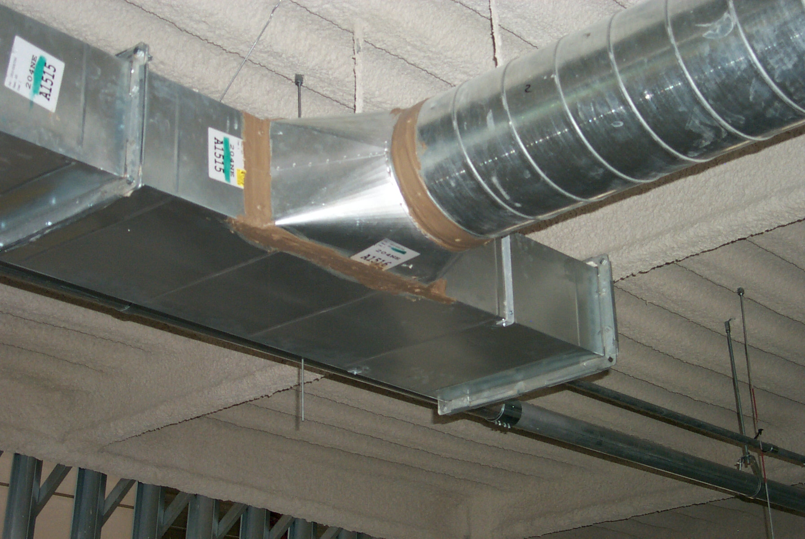
Spiral Duct and a “Boot” Type Duct Tap

Slide 67
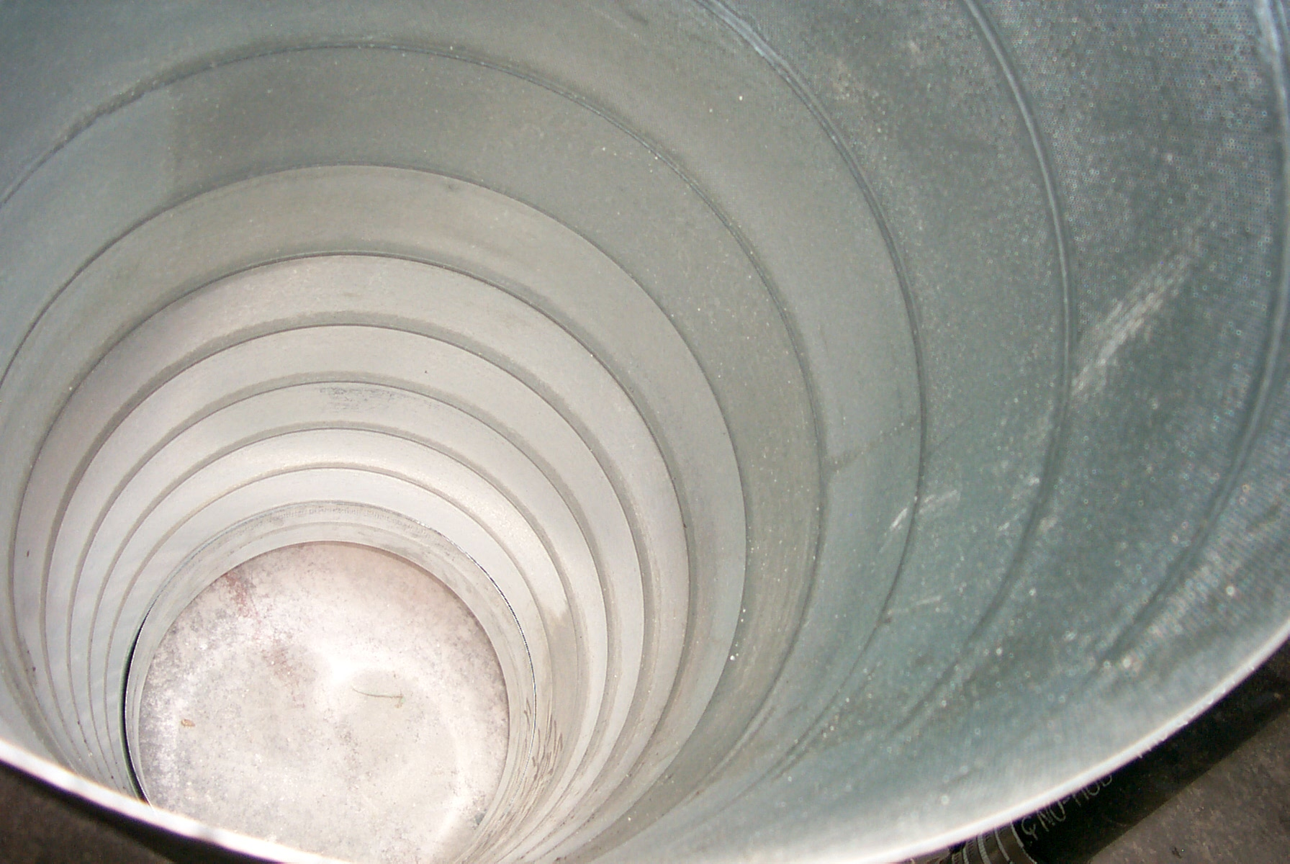
Inside Spiral Duct

Slide 68
For Any Given SMACNA Duct or Fitting:
There are multiple combinations of metal thickness (gauge) and reinforcement
There are multiple joint and seam specifications
Drive slip
Standing drive slip
Hemmed S slip
Flange with gasket; bolted or riveted
SMACNA shows about 27 transverse joint options and about 7 longitudinal joint options
Notes:
20 Transverse

Slide 69
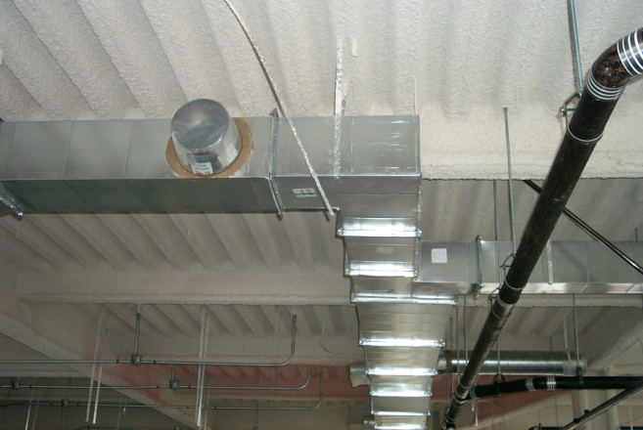
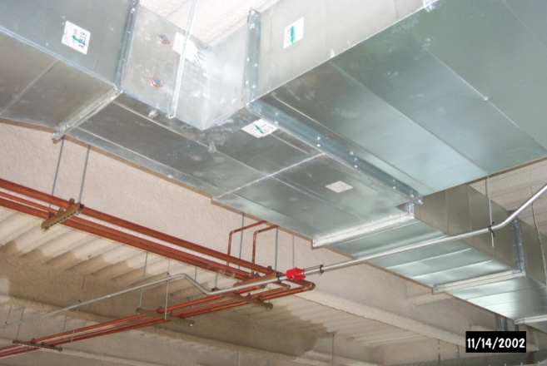
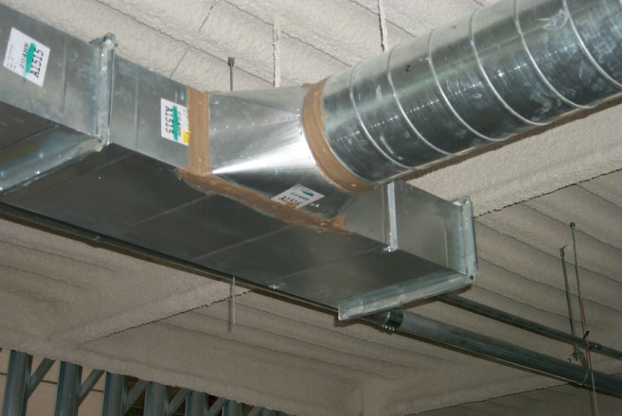
For Any Given SMACNA Duct or Fitting:
There are multiple combinations of metal thickness (gauge) and reinforcement
There are multiple joint and seam specifications
There are multiple geometries; SMACNA details:
  15 different elbow designs
  21 different branch connections
  9 different ways to offset around an obstruction
ASHRAE documents 11 different turning vane designs
Three different ways to split of flow; three different pressure drops; three different costs to fabricate

Slide 70
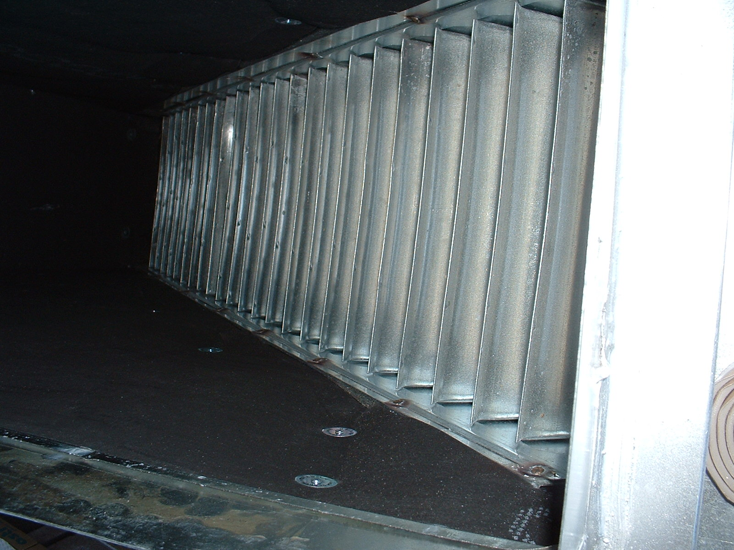
Typical Turning Vanes
Double Thickness Turning Vanes Slip Over Tabs on the Mounting Rail
Mounting Rail Screwed to Duct wall

Slide 71
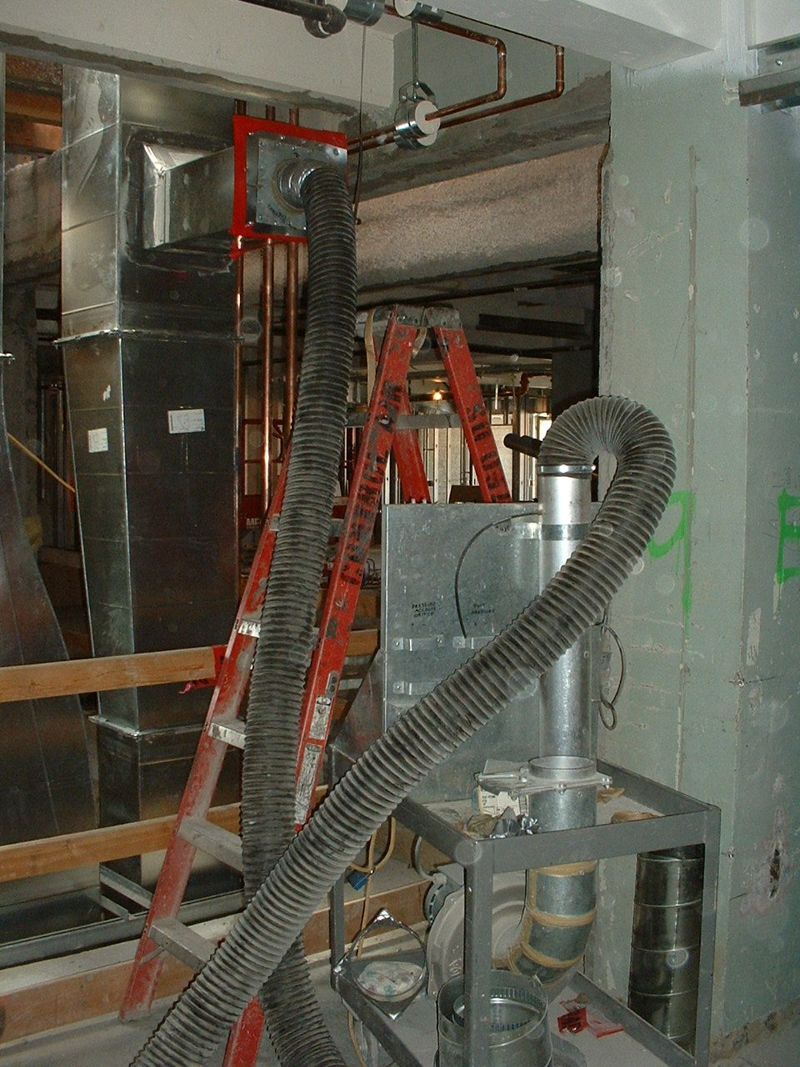
Leakage;
Another SMACNA Standard
Multiple leakage classes in terms of cfm per hundred square feet of duct area for a given test pressure
General procedure:
  Calculate anticipated leakage
  Select test section based on test machine capacity
  Temporarily seal open ends of duct
  Gradually pressurize duct
  Read leakage from flow meter

Slide 72
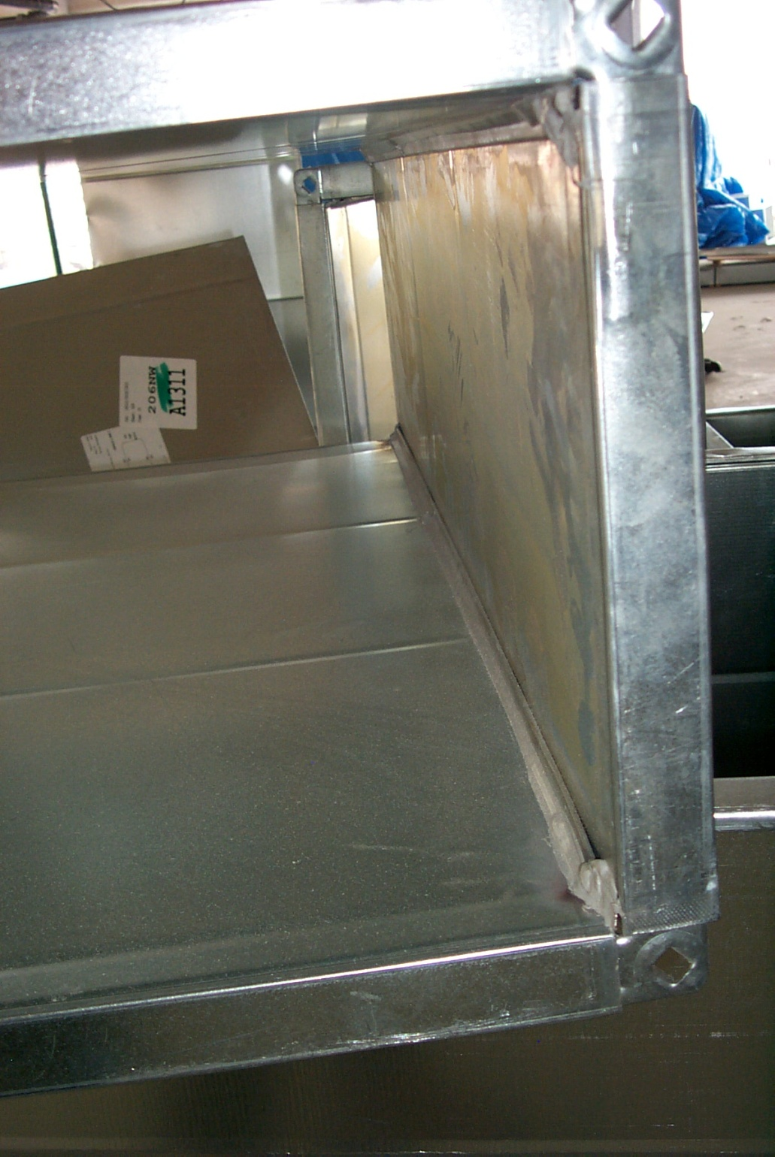
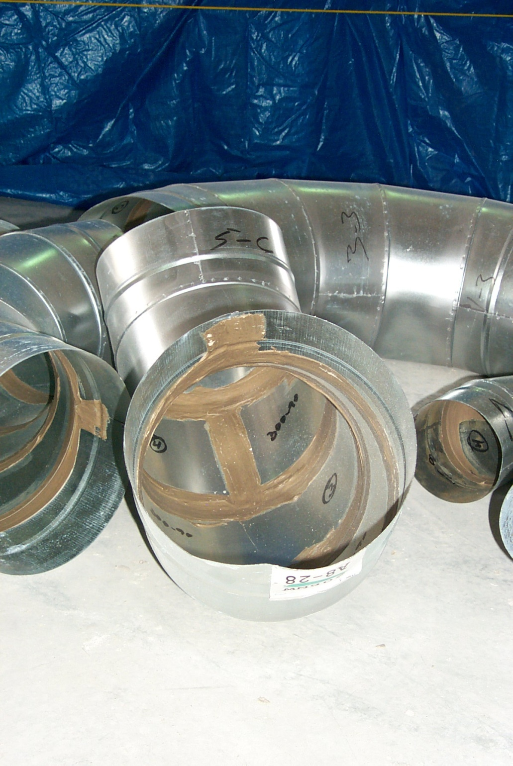
Duct Sealant

Slide 73
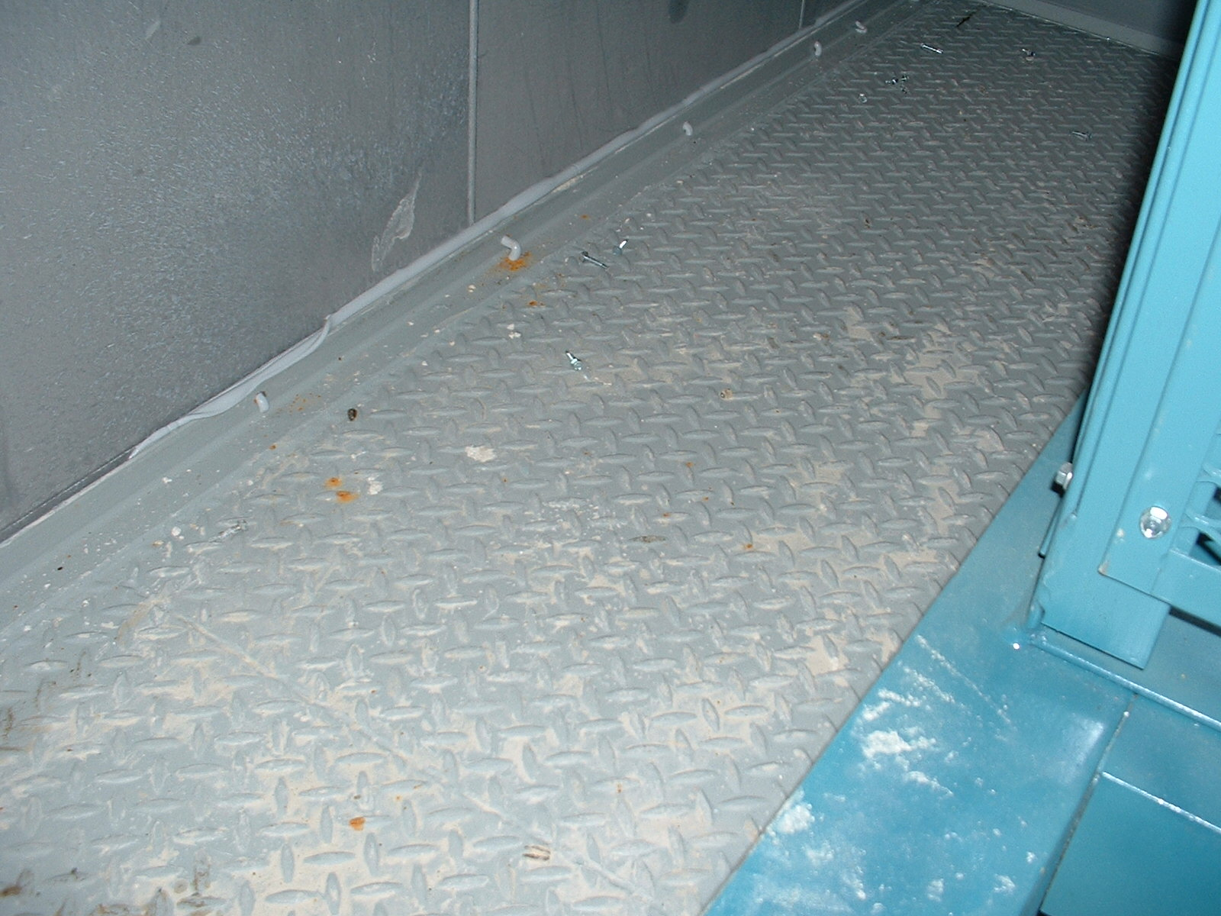
Duct Sealant as a Clue to a Different Problem

Slide 74
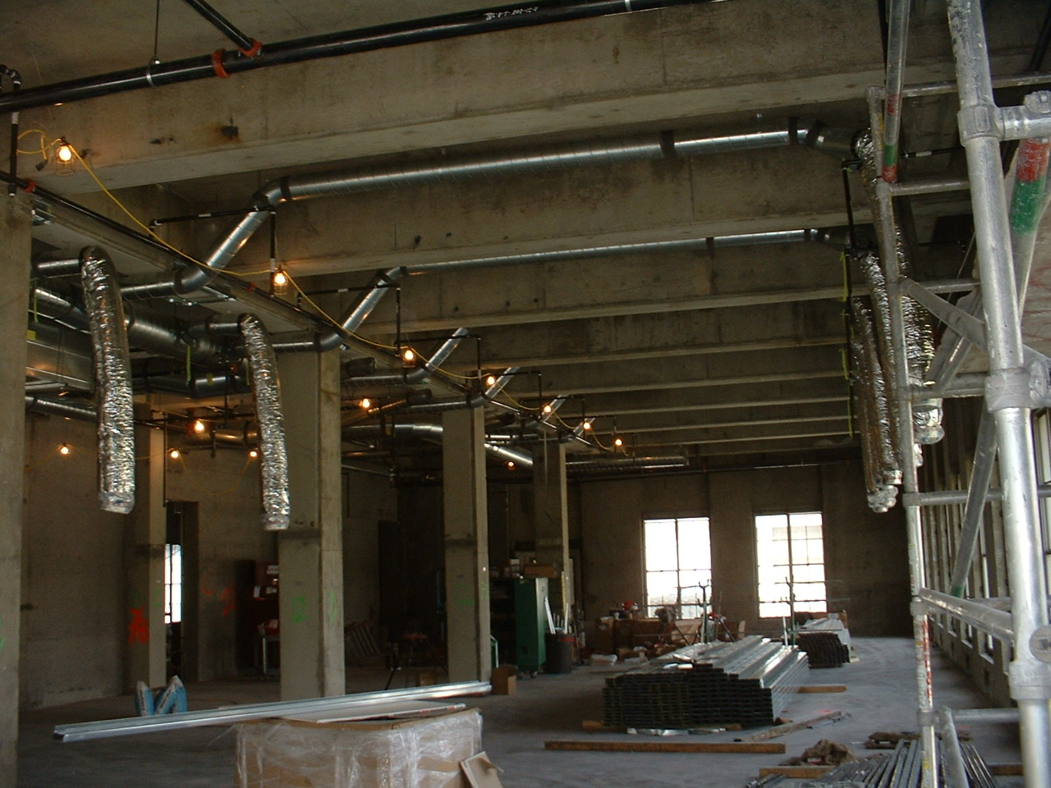
Flex Duct
Accommodates field tolerances for final alignment of exposed devices
Provides some vibration isolation
Proper installation is critical
  Use minimum lengths
  Support is critical
    Frequency
    Methodology
  Bend radius is critical

Slide 75
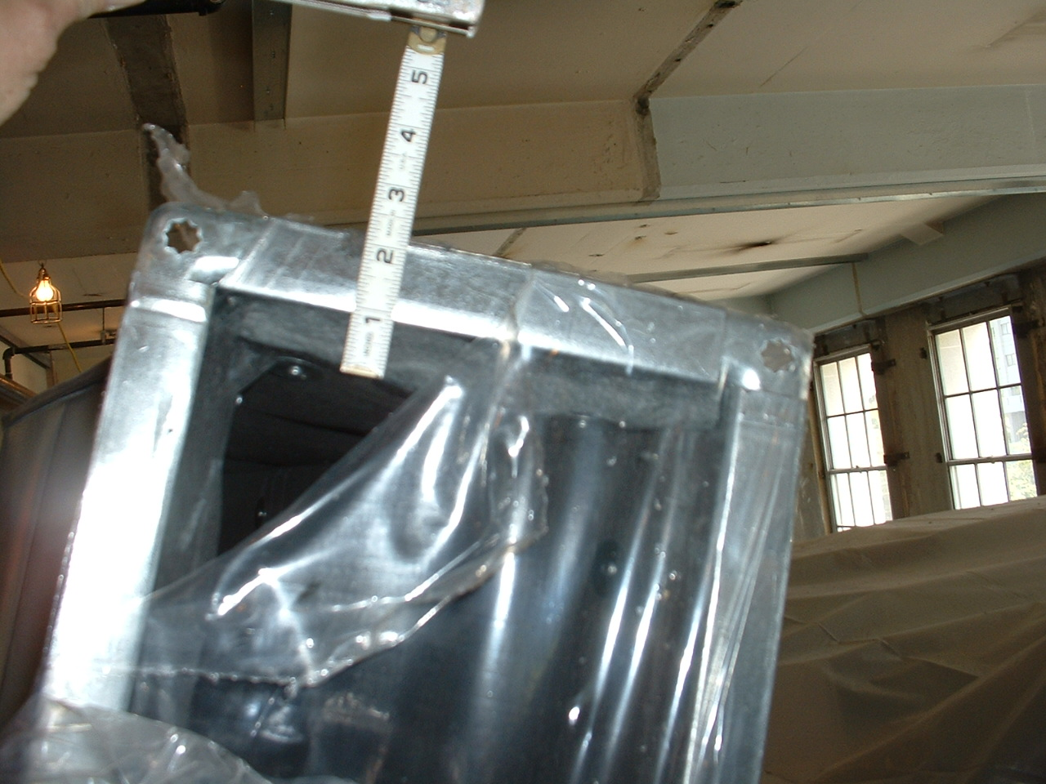
Insulation and Duct Liner
Thickness typically set by energy and efficiency codes and standards …

Slide 76
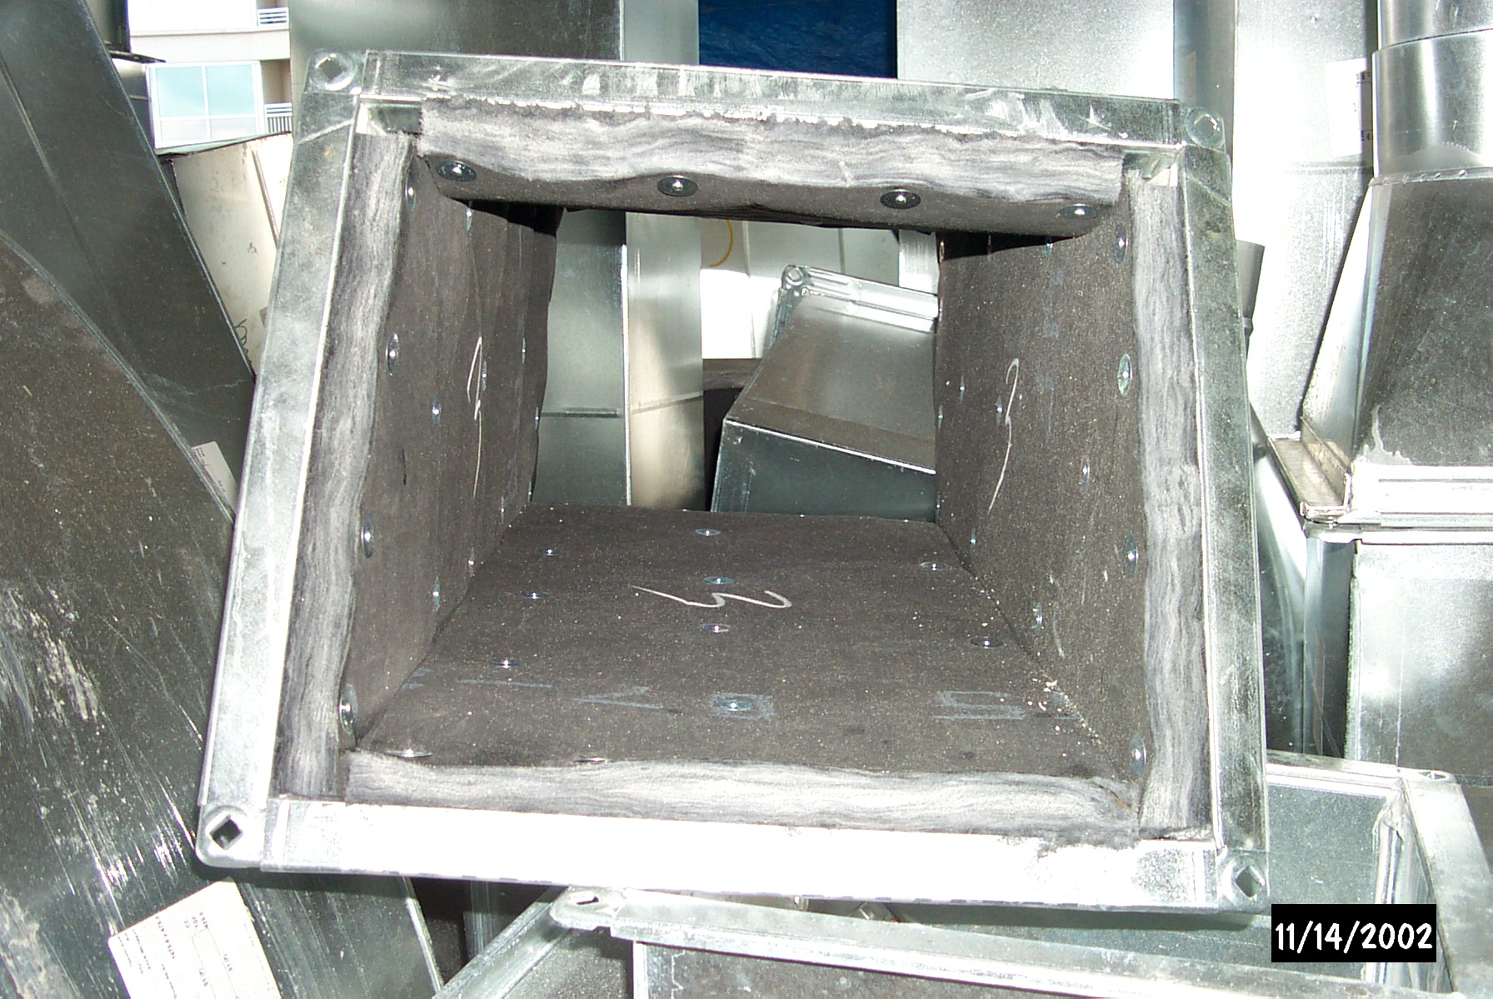
Installation requirements typically set by industry association standards like SMACNA …

Slide 77
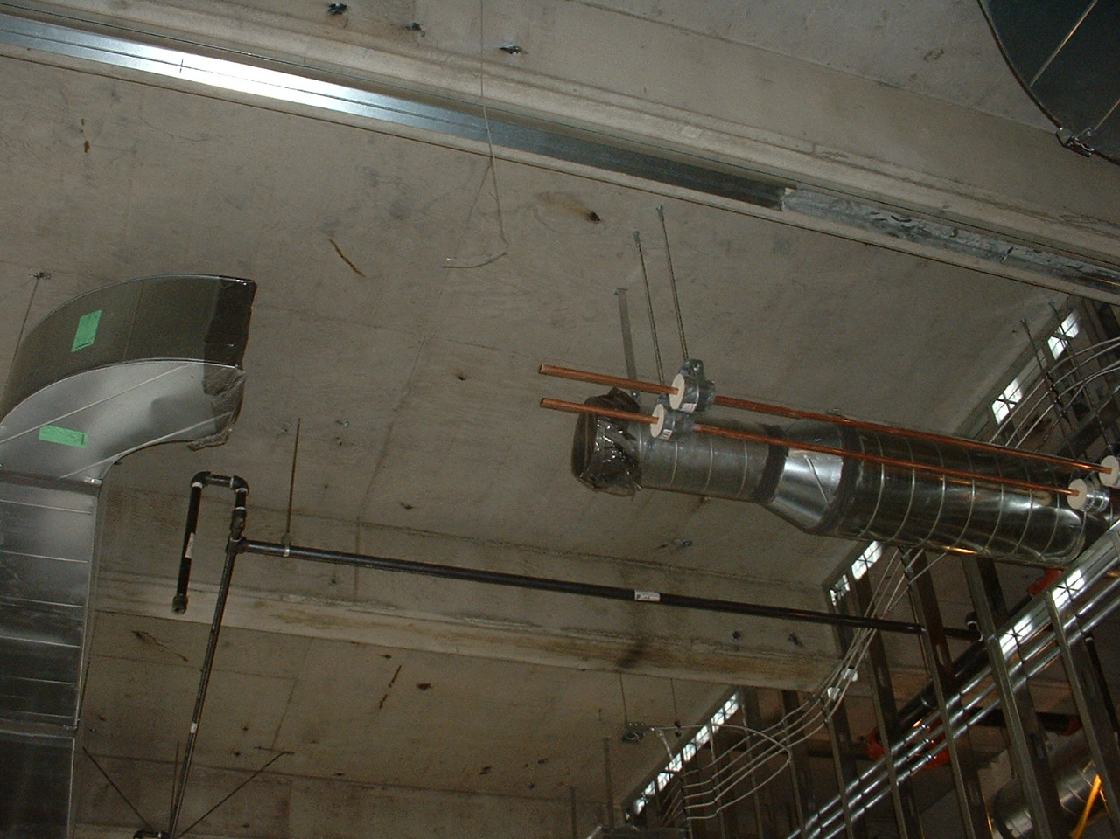
Protection during construction
usually covered by LEED® or other
project contractual requirements … or not

Slide 78
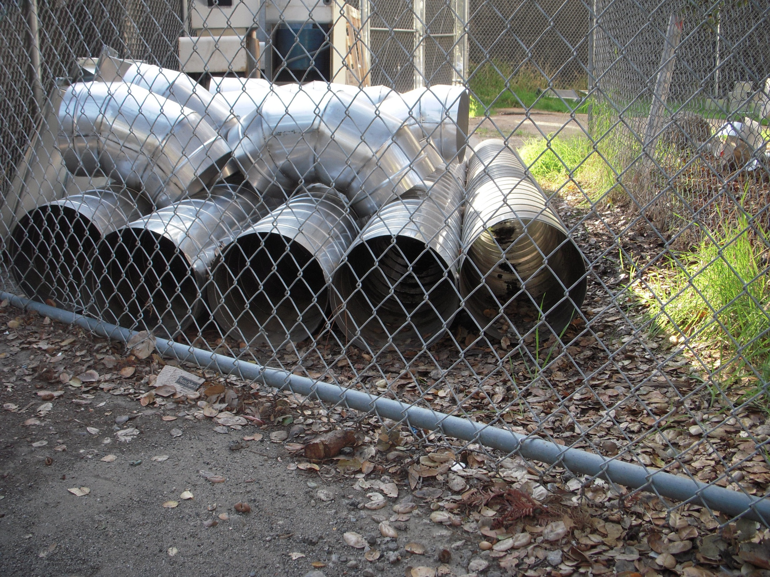
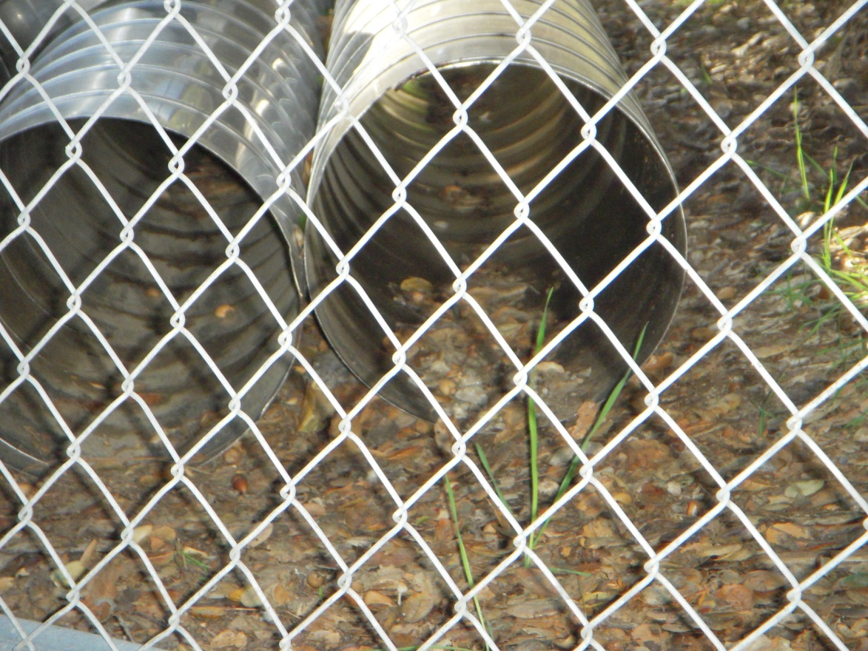
Protection during construction
usually covered by LEED® or other
project contractual requirements … or not

Slide 79
Flex Duct Resources
JPLFlex website (www.jplflex.com)
  Installation guide lines
  Friction loss calculator
Predicting the Performance of Flexible Duct Systems
  William Allen
  December 2010 Heating, Piping and Air Conditioning Magazine, page 28
  www.HPAC.com

Slide 80
Fans, Ductwork, & Air Handling Components:
Design, Performance, & Commissioning Issues
Supplement - Loss Coefficient Exercise
David Sellers
Senior Engineer
Facility Dynamics Engineering
November 10, 2015

Slide 81
Loss Coefficient Exercise
Given
The ASHRAE loss coefficient table that follows
A 12” x 12” duct dimension
A 12” centerline radius
A flow rate of 1,500 cfm
Determine
  The loss through an elbow with no vanes
  The loss through the elbow with 1 vane
  The loss through the elbow with no vanes if the flow rate is 3,000 cfm

Slide 82
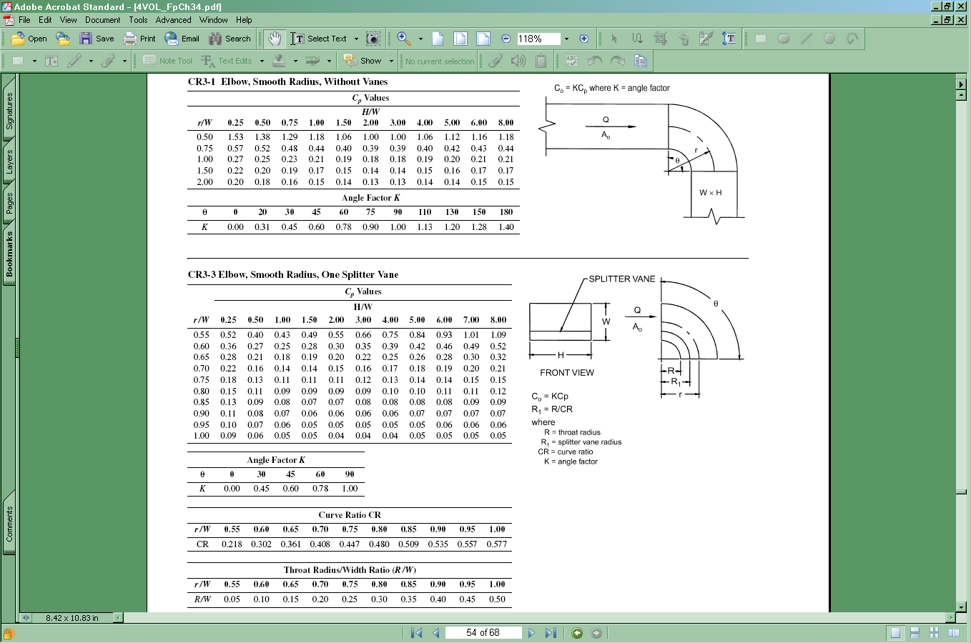

Slide 83
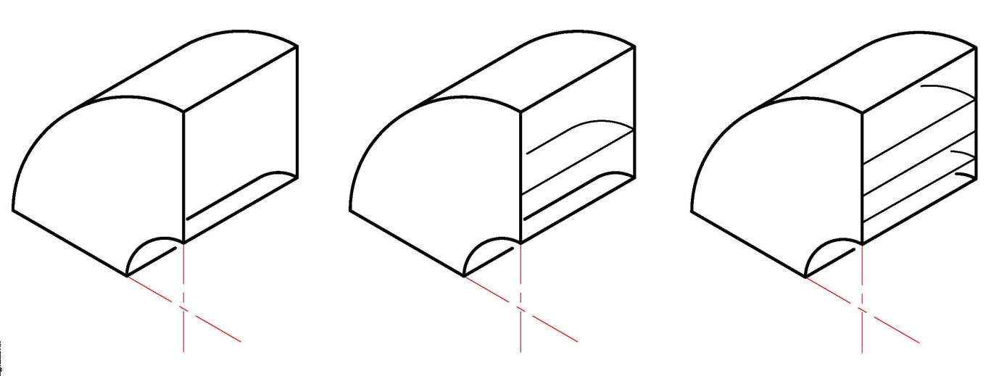
Calculating Velocity Pressure

Slide 84
Calculating Velocity Pressure

Slide 85
Calculating Velocity Pressure

Slide 86
Selecting and Applying the Loss Coefficient

Slide 87
Selecting and Applying the Loss Coefficient

Slide 88
Selecting and Applying the Loss Coefficient

Slide 89
Selecting and Applying the Loss Coefficient

Slide 90
Selecting and Applying the Loss Coefficient

Slide 91
Selecting and Applying the Loss Coefficient

Slide 92
Selecting and Applying the Loss Coefficient

Slide 93
Selecting and Applying the Loss Coefficient

Slide 94
Selecting and Applying the Loss Coefficient

Slide 95
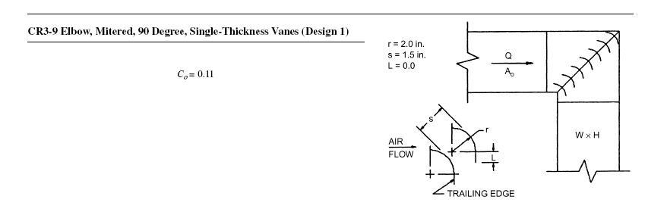
A Contrast
Cp = Co for a 90° elbow

Slide 96
A Contrast
The loss coefficient for a mitered 90° elbow is about twice that of a radiused 90° elbow with one vane

