Slide 1
Existing Building Commissioning Workshop
Series 16, Session 2
Introduction to System Diagrams

Slide 2

Resources for Details Behind this Content
www.Av8rdas.Wordpress.com
Search for “System Diagrams: …”
You can also filter for them with the drop-down menu
Developing a System Diagram: Getting Started and the next few posts walk you through the process using the PEC ice storage system as an example

Slide 3
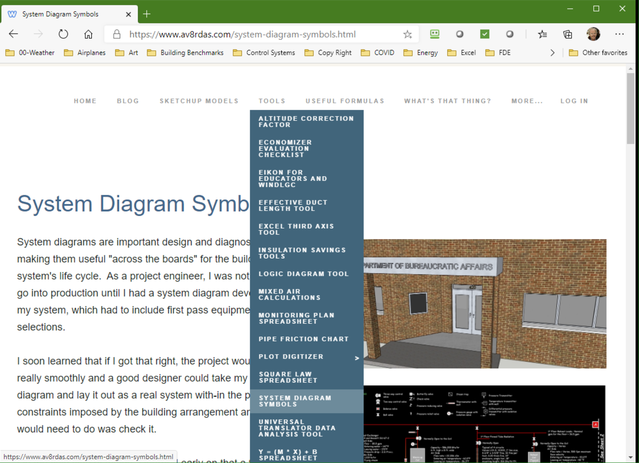
Resources for Details Behind this Content
https://www.av8rdas.com/system-diagram-symbols.html
PowerPoint based tool and symbol library
AutoCAD symbol library
Examples in AutoCAD and PowerPoint

Slide 4
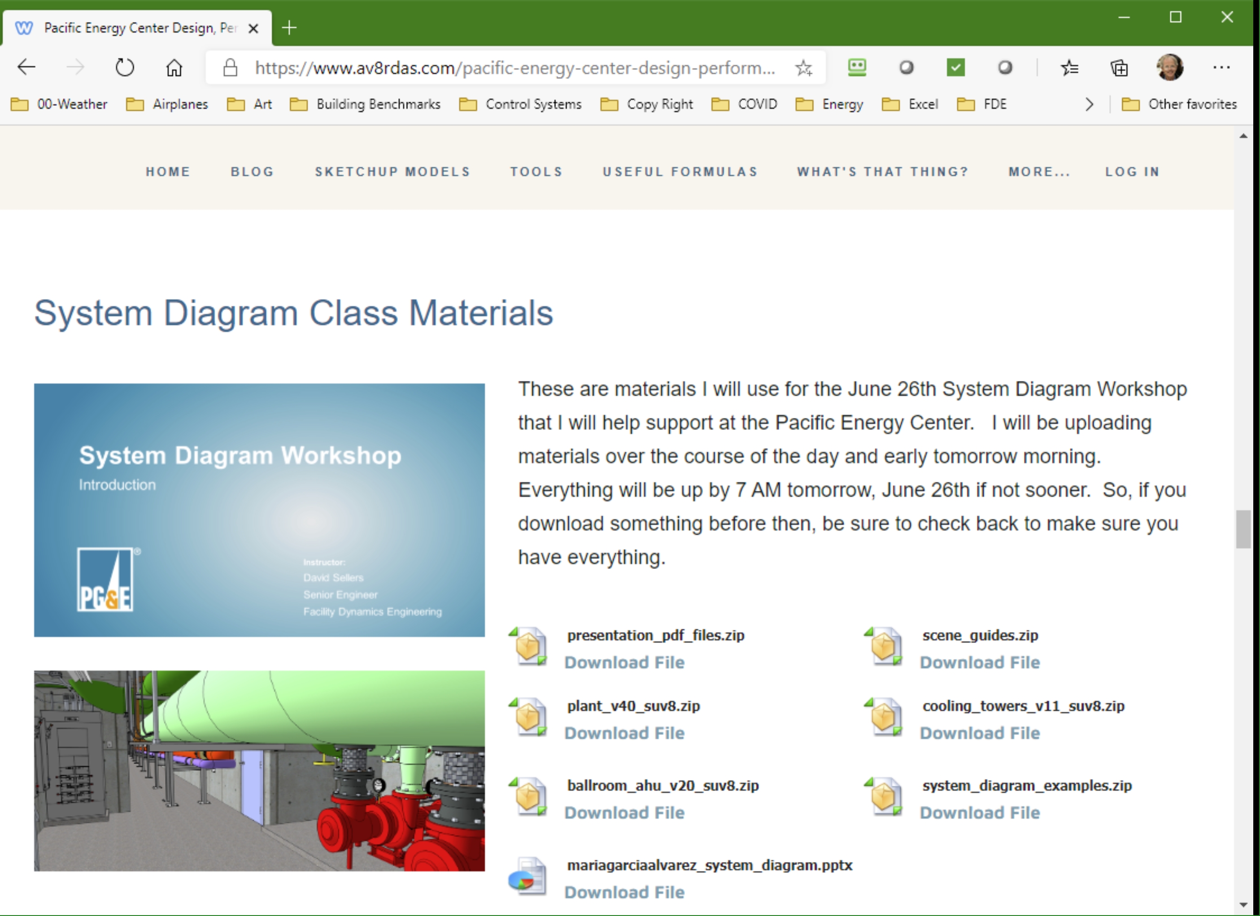
Resources for Details Behind this Content
https://www.av8rdas.com/pacific-energy-center-design-performance-and-commissioning-issues-classes.html#System
Full day workshop content
Multiple examples in multiple formats

Slide 5
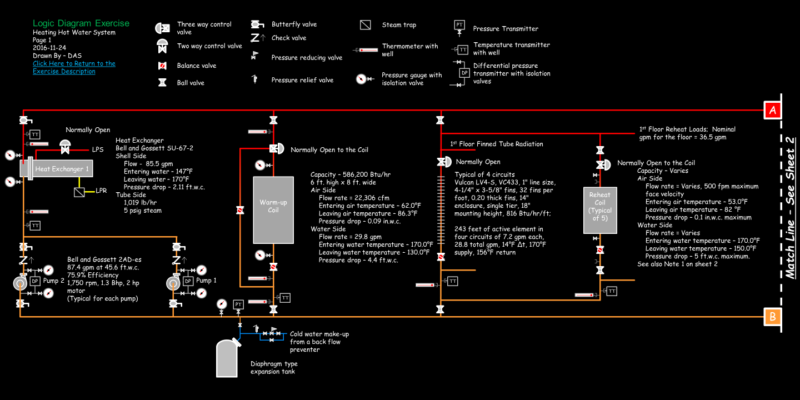
Its Not Just a Heat Exchanger … …It’s a Hot Water System

Slide 6
Its Not Just a Heat Exchanger … …It’s a Hot Water System

Slide 7
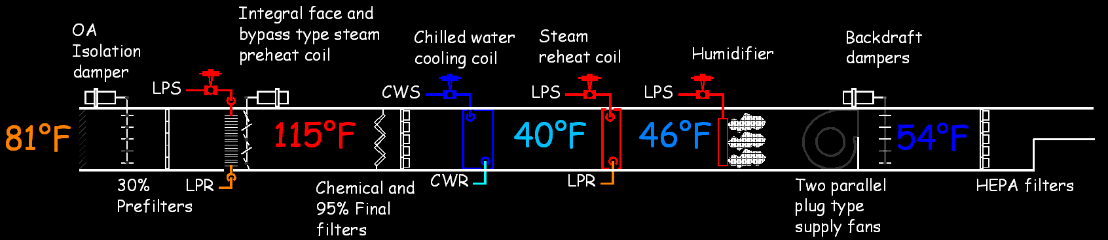
Its Not Just an Air Handling Unit … …It’s an Air Handling System

Slide 8
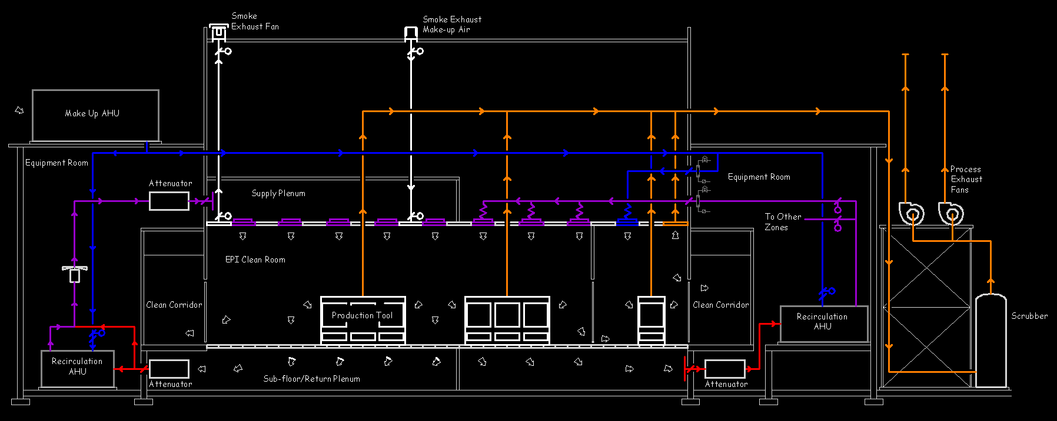
Its Not Just an Air Handling Unit … …It’s an Air Handling System

Slide 9
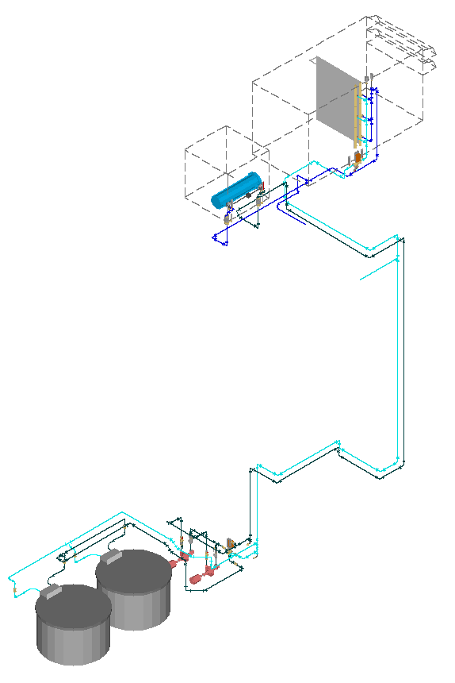
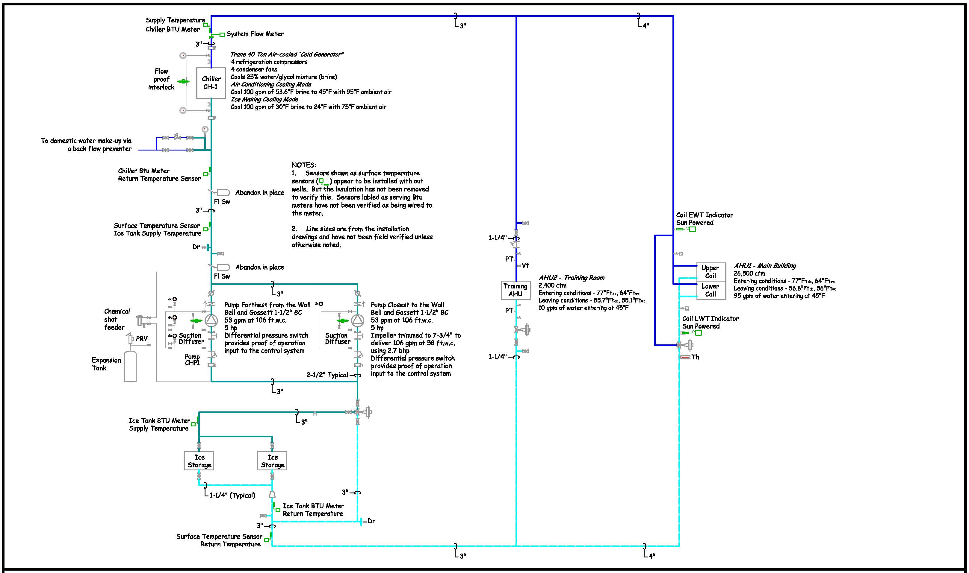
Physically Complex, Schematically Simple

Slide 10
“Like a Ladder on its Side”
Chuck McClure

Slide 11
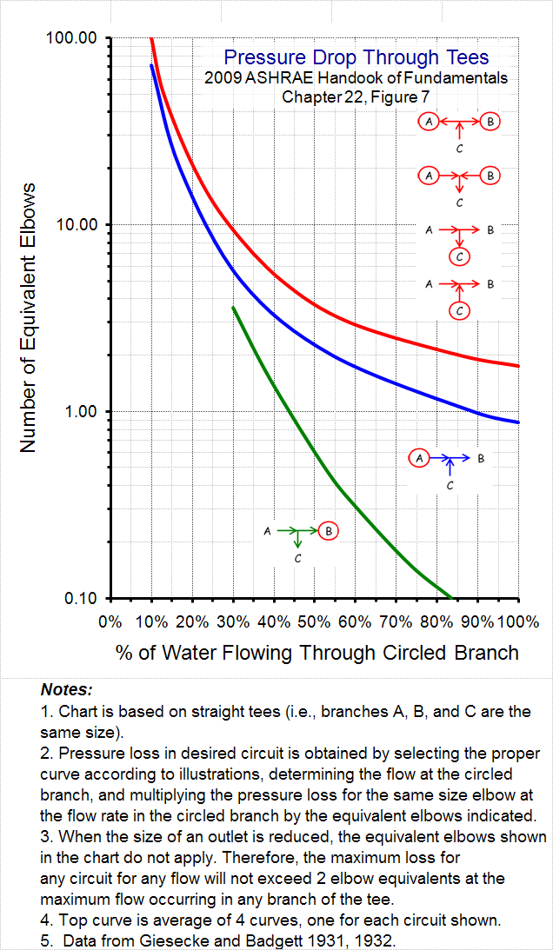
Tee’s are Important
For both the physical system and the system diagram:
  Divergence or convergence of flow
  An opportunity to introduce a problem if the order of connection is not correct
For the physical system, they represent a pressure drop
  Significant
  Highly variable with configuration

Slide 12
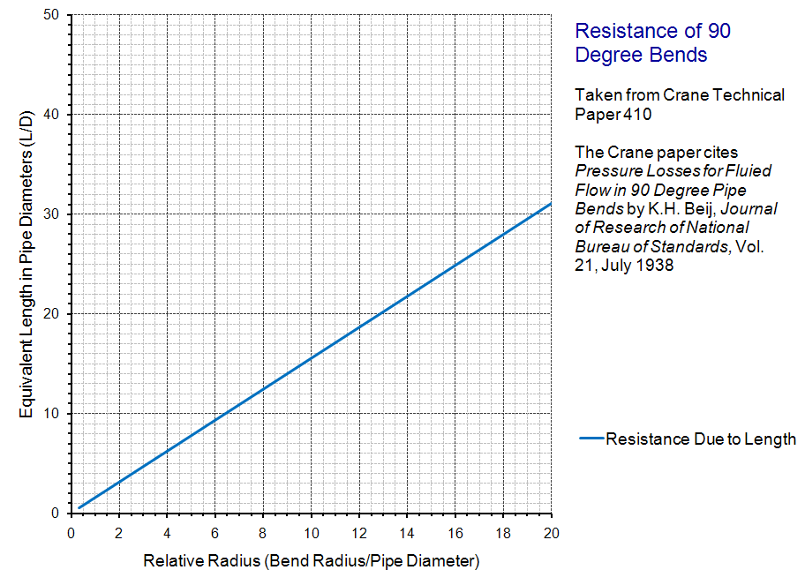
Elbows; Not So Much Maybe
From the perspective of the system diagram:
  Just a bent piece of straight pipe
  Water in = Water out
One way to think of elbow resistance is to consider it as composed of:
    Resistance due to interaction with the pipe wall

Slide 13
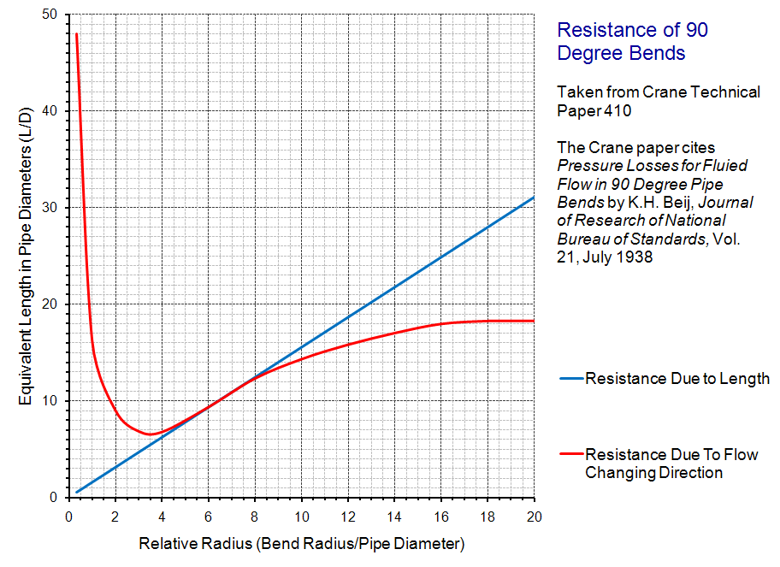
Elbows; Not So Much Maybe
From the perspective of the system diagram:
  Just a bent piece of straight pipe
  Water in = Water out
One way to think of elbow resistance is to consider it as composed of:
    Resistance due to interaction with the pipe wall
    + Resistance due to a change in direction

Slide 14
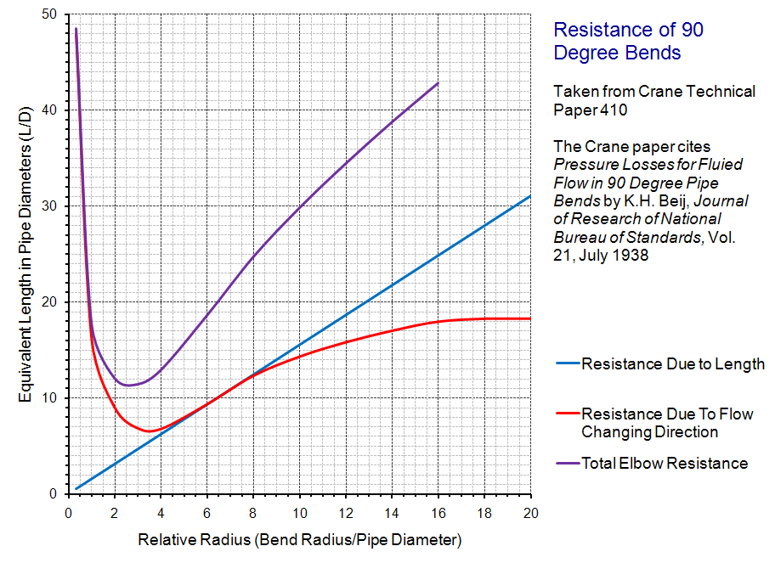
Elbows; Not So Much Maybe
From the perspective of the system diagram:
  Just a bent piece of straight pipe
  Water in = Water out
One way to think of elbow resistance is to consider it as composed of:
    Resistance due to interaction with the pipe wall
    + Resistance due to a change in direction
    _______________________________________________________________
    Total Resistance for the Elbow

Slide 15
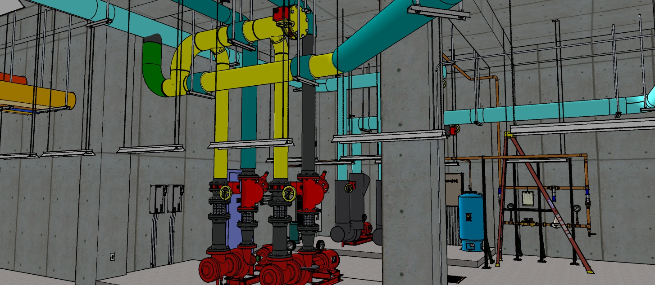
Order of Connection Matters

Slide 16
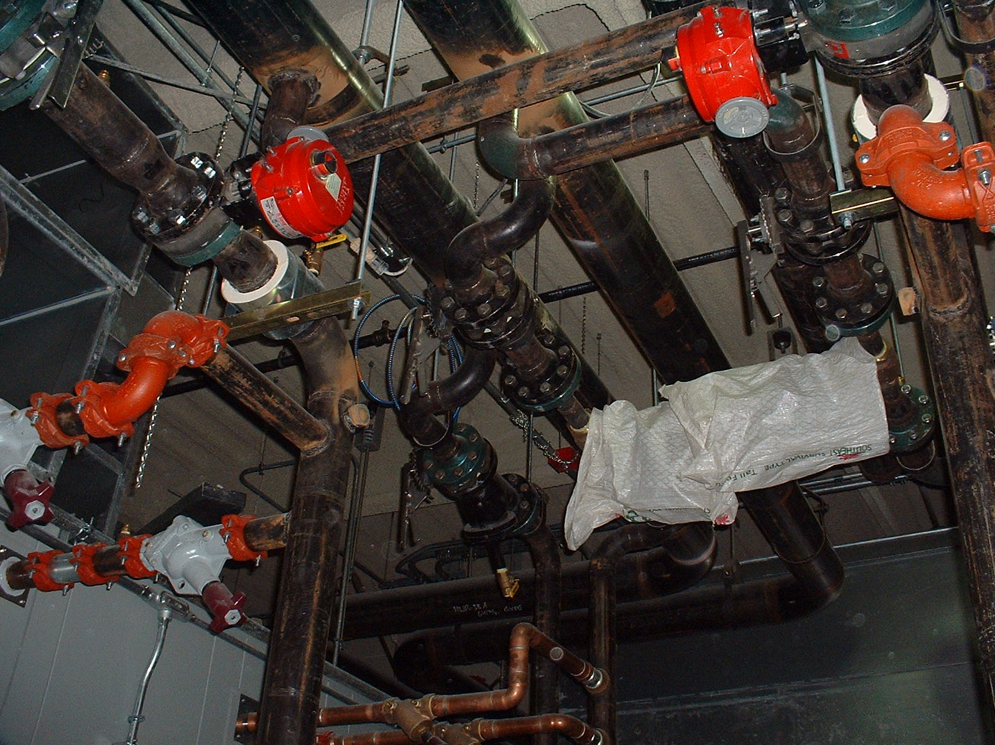
System Diagram Rules for Elbows and Tees
Show all tees
  Verify order of connection
  Order of connection “trumps” drawing organization
  Drawing organization “trumps” matching branch and main configuration in the field
Don’t show elbows
  Turns on the system diagram should be made for drawing organization purposes, not to reflect real elbows

Slide 17
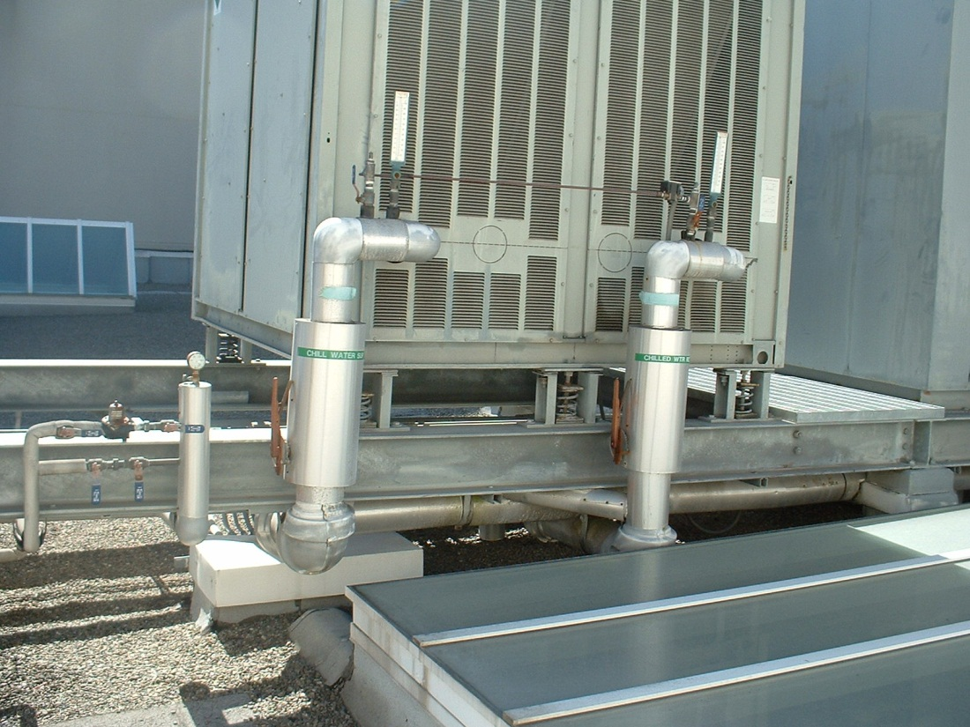
Getting Started
Find something you can identify
  Nameplate data
  Labels
  Past experience

Slide 18
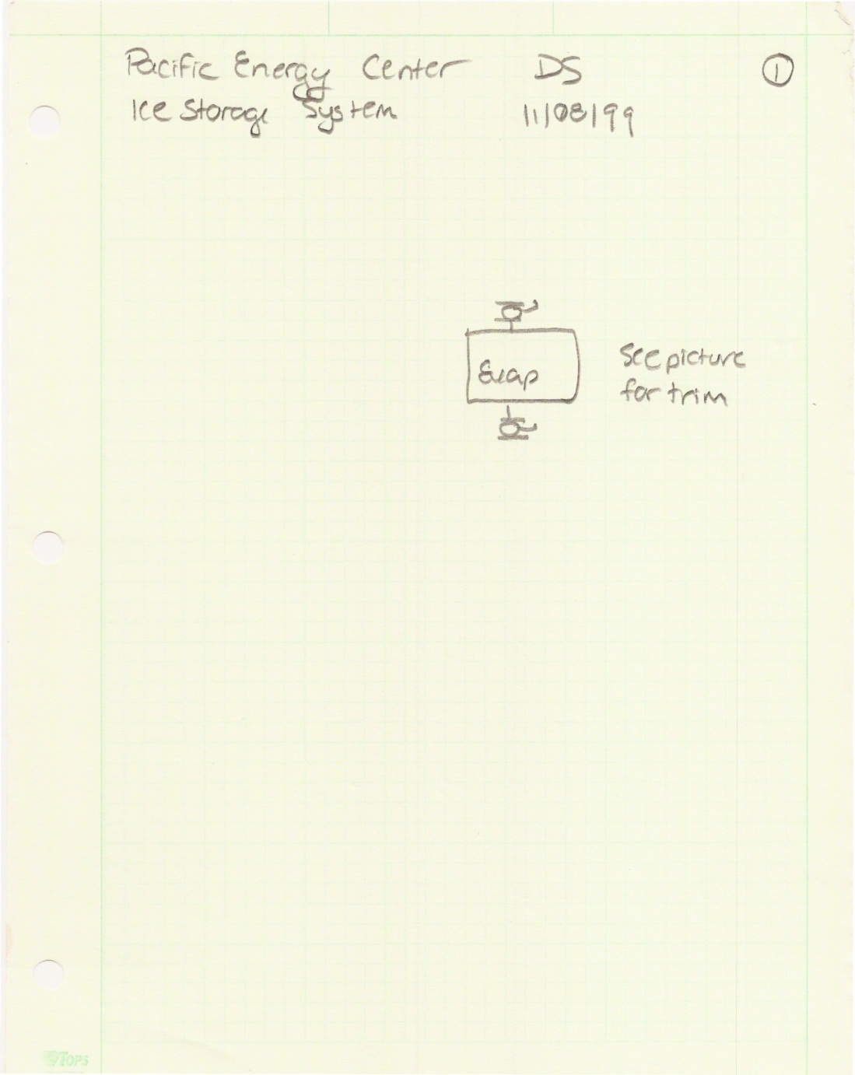
Getting Started
Find something you can identify
  Nameplate data
  Labels
  Past experience
Start following the system of interest
  Your first effort will likely not be your last effort

Slide 19
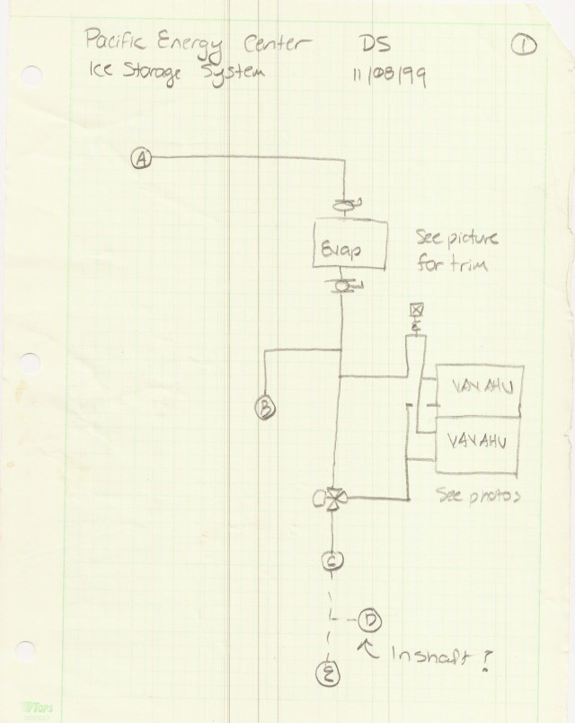
Getting Started
Find something you can identify
  Nameplate data
  Labels
  Past experience
Start following the system of interest
  Your first effort will likely not be your last effort
  “Follow your nose”
  Make decisions at tees

Slide 20
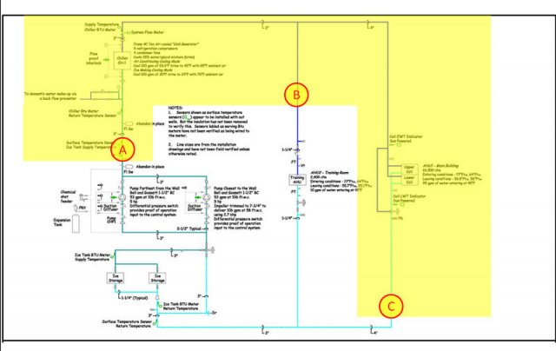
Getting Started
Find something you can identify
  Nameplate data
  Labels
  Past experience
Start following the system of interest
  Your first effort will likely not be your last effort
  “Follow your nose”
  Make decisions at tees

Slide 21
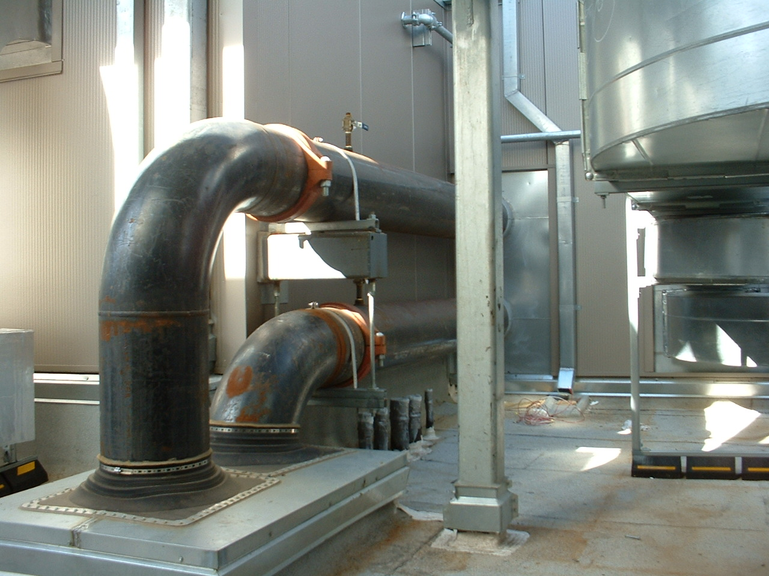
Sometimes Rules are Made to be Broken
Elbows that form traps or inverted traps in open systems
Pipes that run above basin level in open systems
Pipe runs with an relatively excessive number of elbows
Tees where the pressure drop created by the installed configuration could cause an operational issue

Slide 22
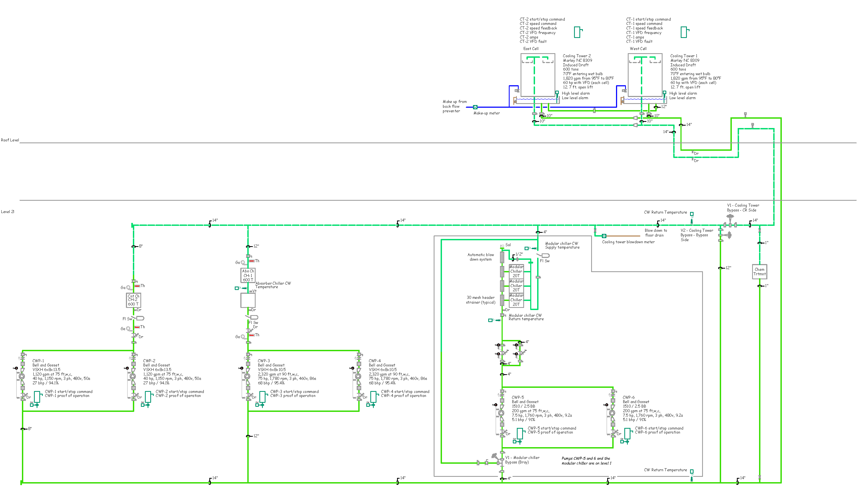

Slide 23
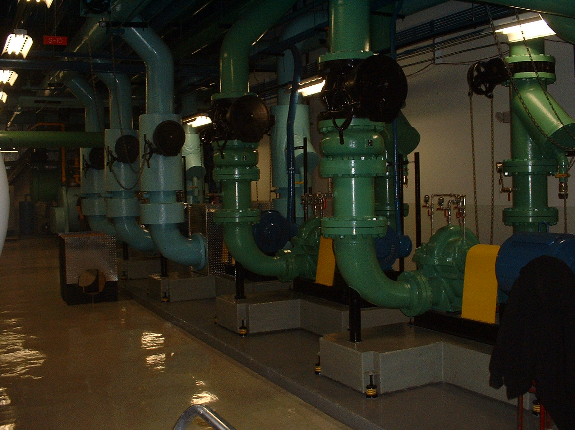
So Far, Our Focus Has Been Hydronic Systems; What About Air Systems?

Slide 24

Can You Identify the HVAC/Air Handling System Elements in this Picture?

Slide 25
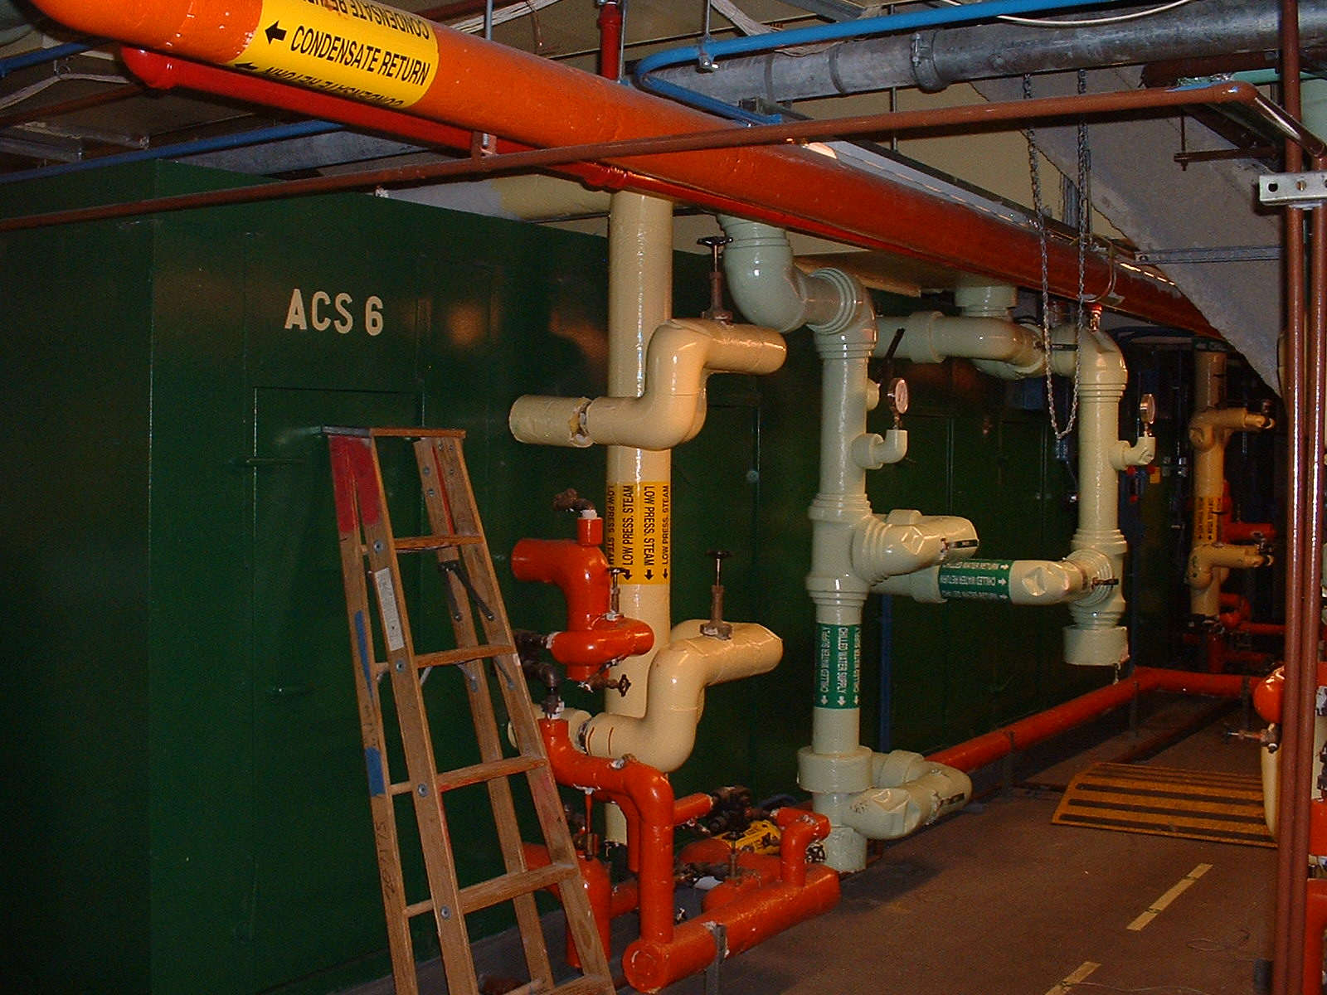
Air Handling Systems and System Diagrams
The same general rules apply
Significant differences from piping systems
  Envelope is a part of the system
  Mass (air and water vapor) are actively moved across the system boundary by the operation of the system
  The water vapor can change state in the system
  People move around inside the systems
  Building processes occur inside the system

Slide 26
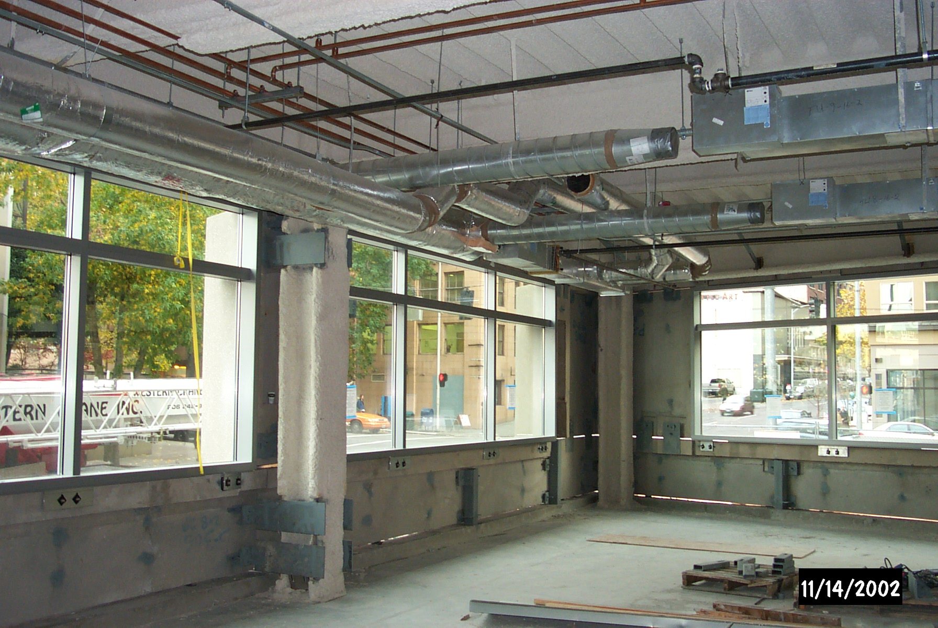
Envelope Integrity = HVAC Duct Integrity

Slide 27
The Envelope is Significant(ly Complex)
Atriums interconnect floors

Slide 28
The Envelope is Significantly Complex
Atriums interconnect floors
Stair and elevator shafts act like chimneys

Slide 29
The Envelope is Significantly Complex
Atriums interconnect floors
Stair and elevator shafts act like chimneys
Smoke shafts act like chimneys and interconnect floors

Slide 30
The Envelope is Significantly Complex
Atriums interconnect floors
Stair and elevator shafts act like chimneys
Smoke shafts act like chimneys and interconnect floors
Return and relief plenums interconnect floors and shafts

Slide 31
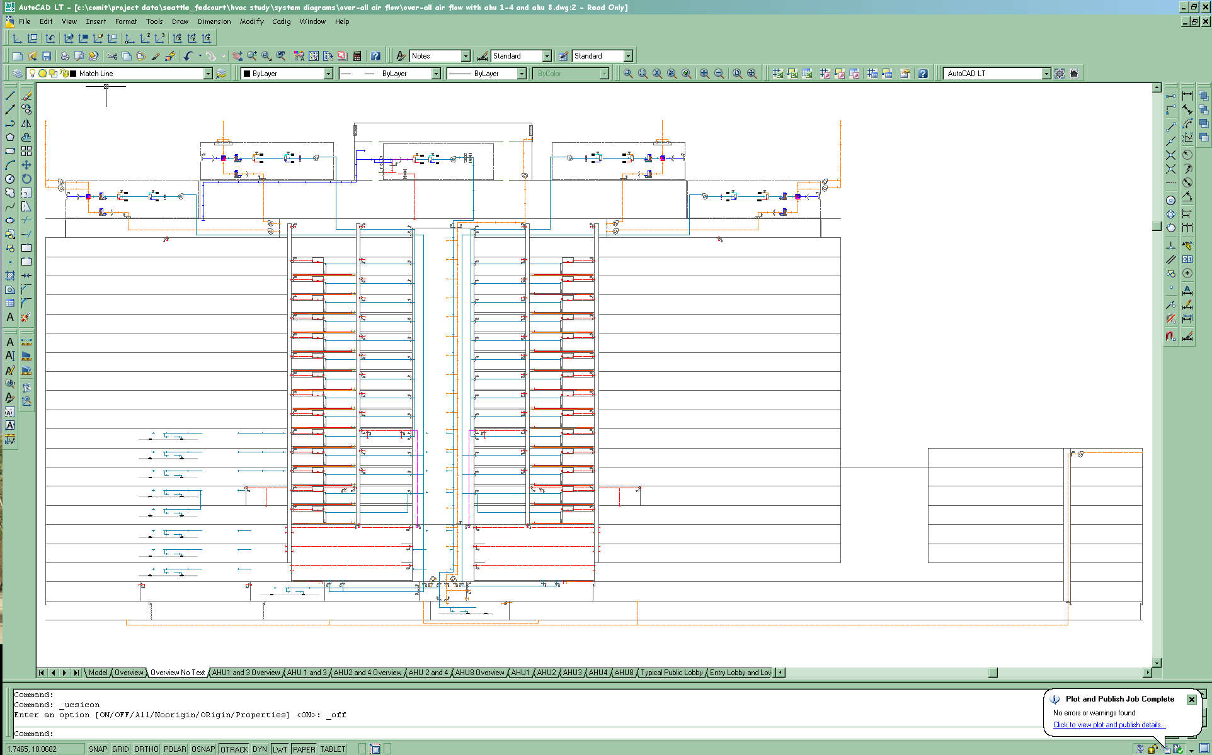
The Envelope as the Framework for the Air Handling System Diagnostics
Flow Arrow Color Codes
  AHU1
  AHU2
  AHU3
  AHU4
  AHU8 (Note AHU7 is not shown but serves a similar area and function for the other half of the building)
  Return air (all systems)
  Transferred air
  Outdoor air infiltration
  Garage exhaust
AHU3
AHU 8
AHU4
AHU1
AHU2

Slide 32
The Envelope as the Framework for the Air Handling System Diagnostics
AHU3
AHU 8
AHU4
AHU1
AHU2

Slide 33
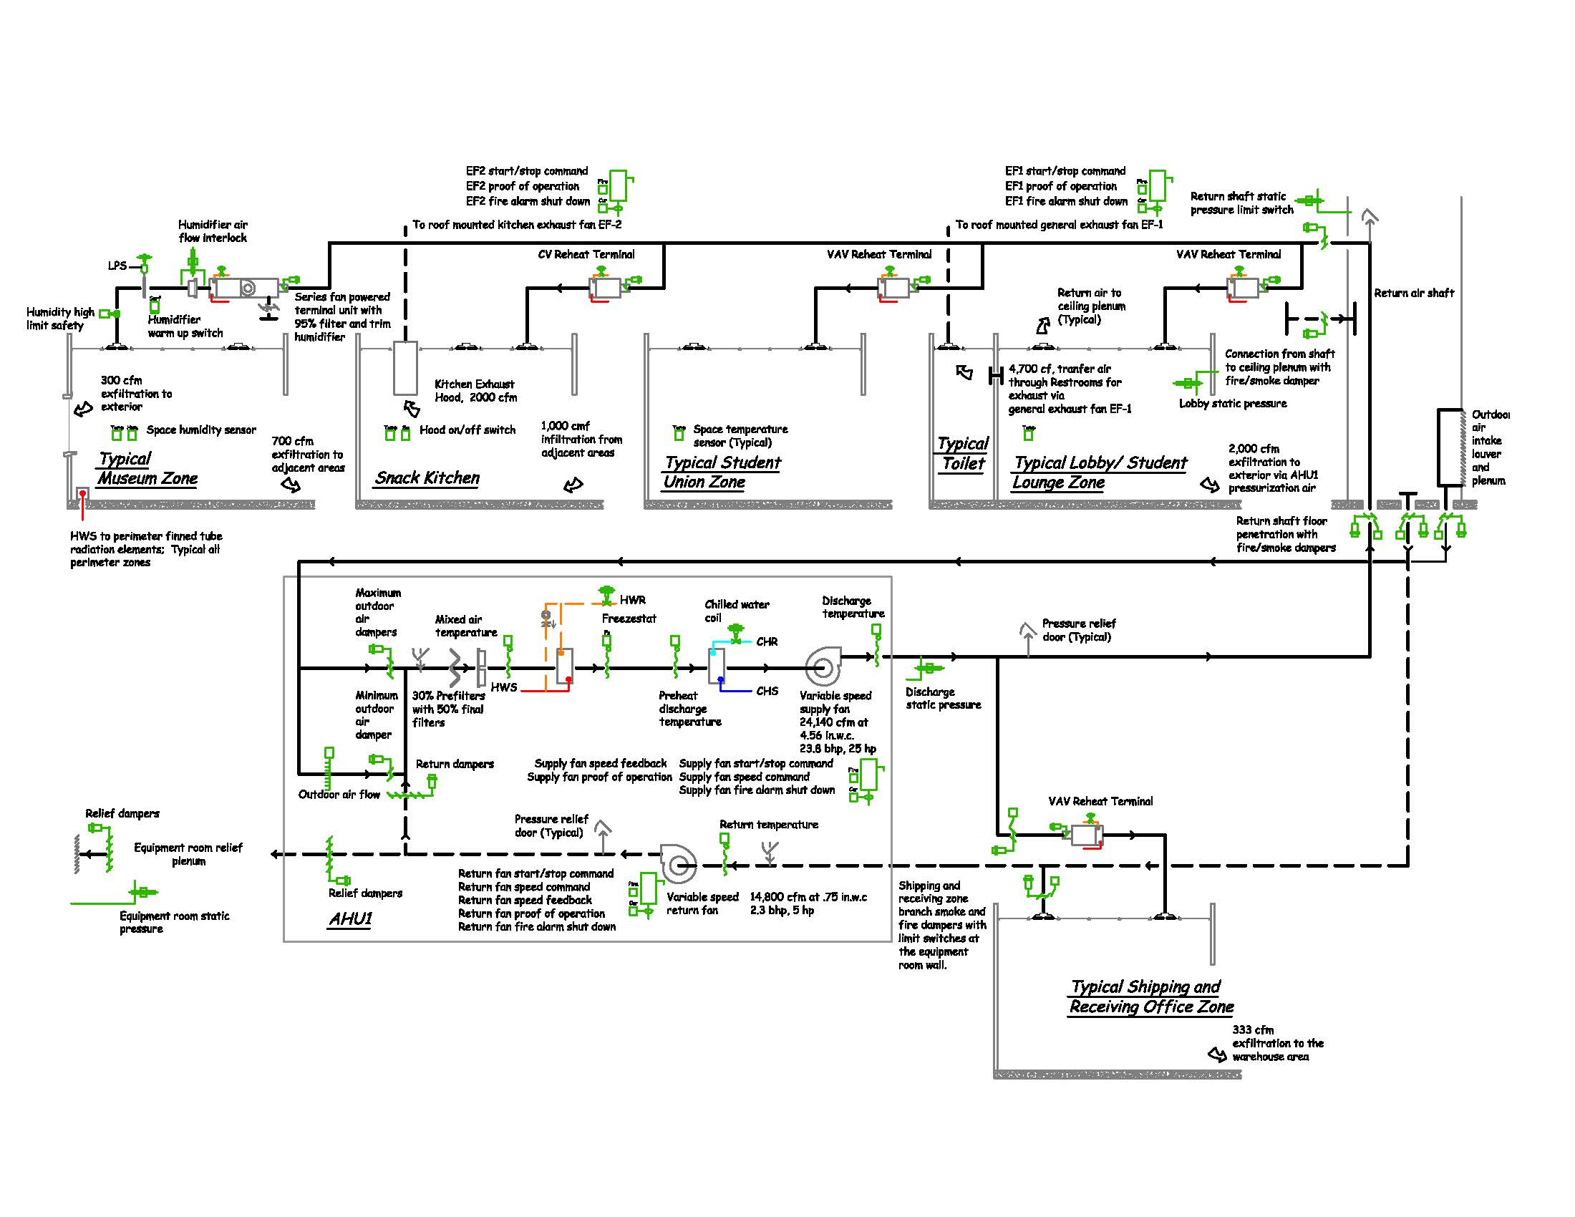
Air Handling System Diagram Characteristics

Slide 34
Reflect the Building Physical Arrangement

Slide 35
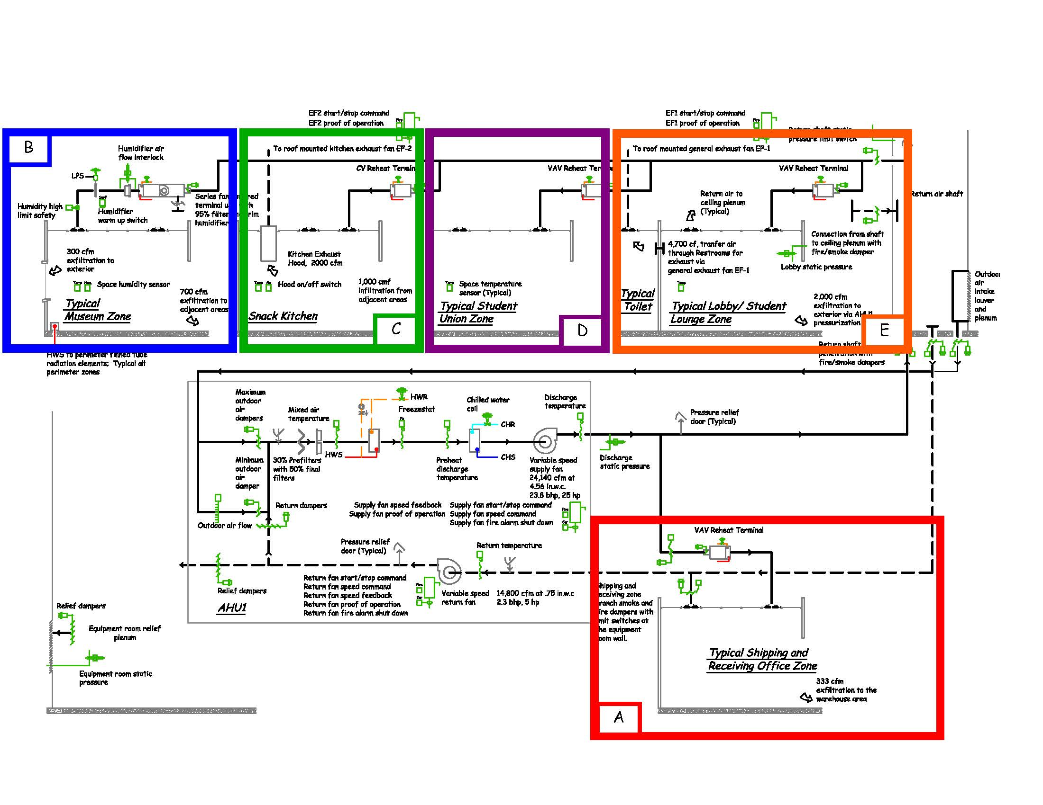
Include Examples of Each Zone Type

Slide 36
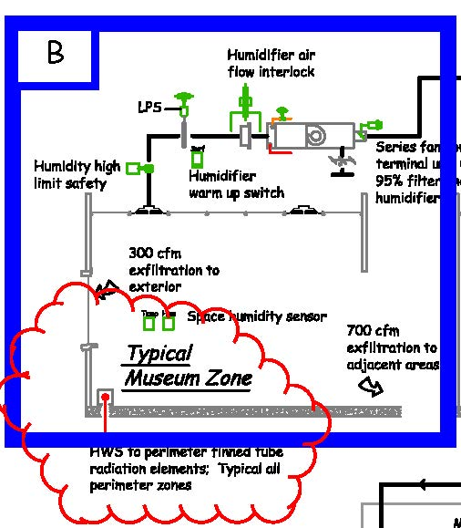
Include the Impacts of Other Systems

Slide 37
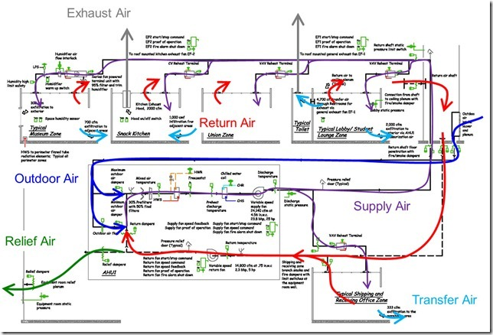
Document Conservation of Mass and Energy

Slide 38
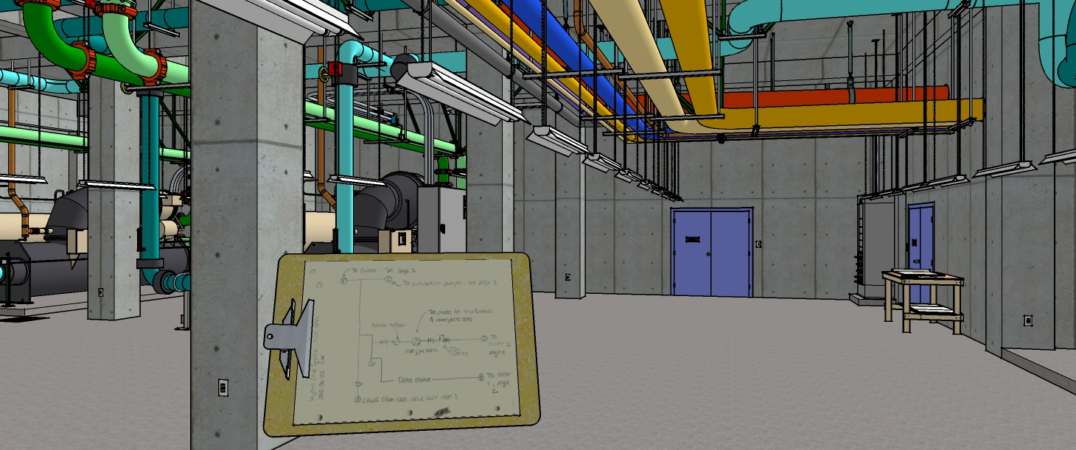
Let’s Review By Getting Started with the Hijend Hotel CHW Plant Diagram

