Slide 1


EBCx Tips and Tricks; Lessons from a Career in the Field
Introduction
Presented by:
David Sellers
Senior Engineer, Facility Dynamics Engineering

Slide 3
Learning Objectives
Attendees will become familiar with and apply assessment techniques to air side economizers that will allow resource and performance improvements to be identified during the design, construction and ongoing operations phases of a system life cycle.
Attendees will be exposed to a number of resources including the Functional Testing Guide, which they can use to support their work moving forward after the class.
Attendees will learn how to calculation power based on a machine’s rated performance characteristics. A pump calculation will be used to illustrate this but a similar approach can be applied to fans.
Attendees will learn how to expand the power calculation to reflect energy consumption and cost based on the local climate and utility rate structure.

Slide 4
Agenda
Introduction
Airside Economizer Overview
Airside Economizer Evaluation
Airside Economizer Calculation Examples
Evaporator Pump Optimization Assessment
Estimating Pump Head in the Field (Time Permitting)
Pump Optimization (Time Permitting)
Estimating CHW Plant Load in the Field (Time Permitting)

Slide 5
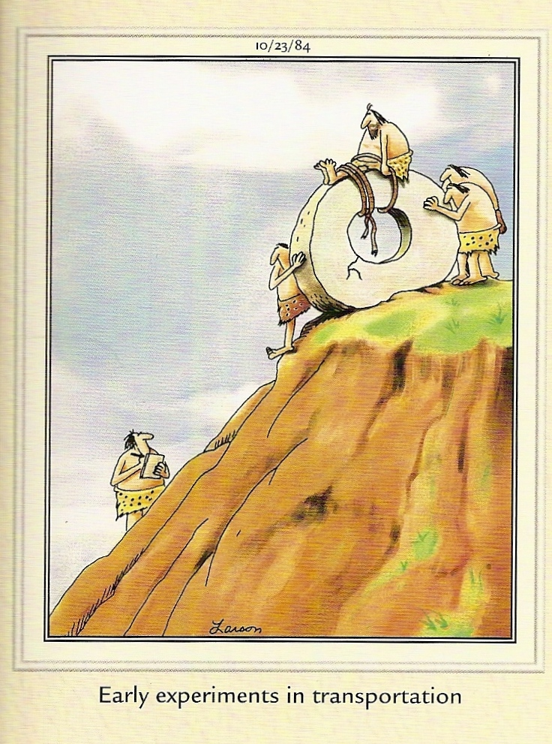
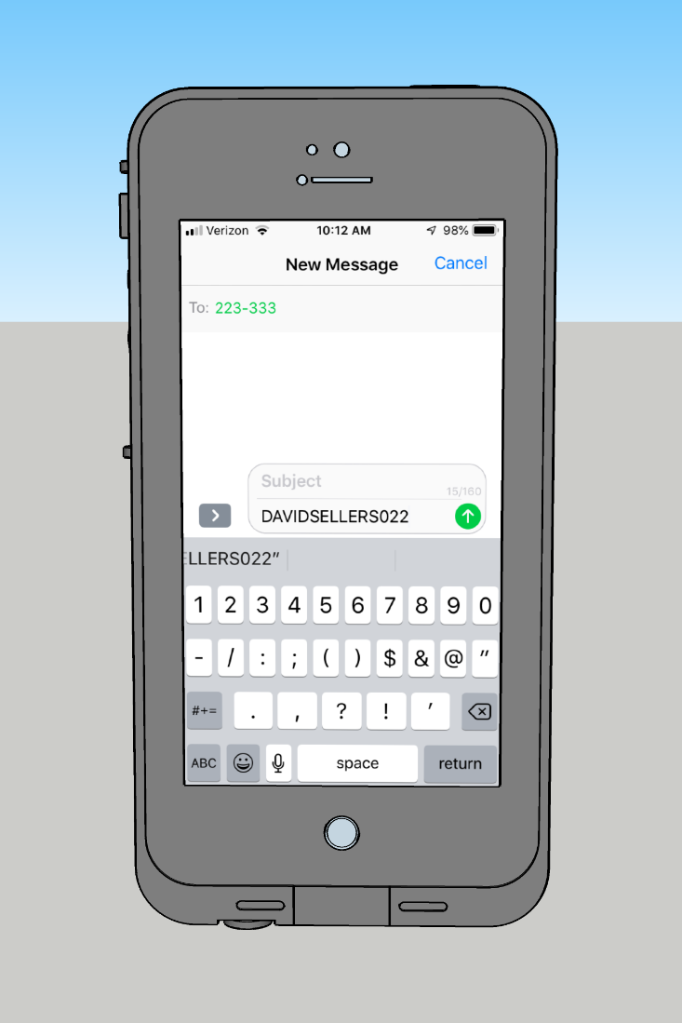
We’re trying something new
You get to have a firsthand experience as a commissioning provider
You get to functionally test using Poll Everywhere as a way to foster interactive discussion!

Slide 6
We’re trying something new
You get to have a firsthand experience as a commissioning provider
You get to functionally test using Poll Everywhere as a way to foster interactive discussion!

Slide 7
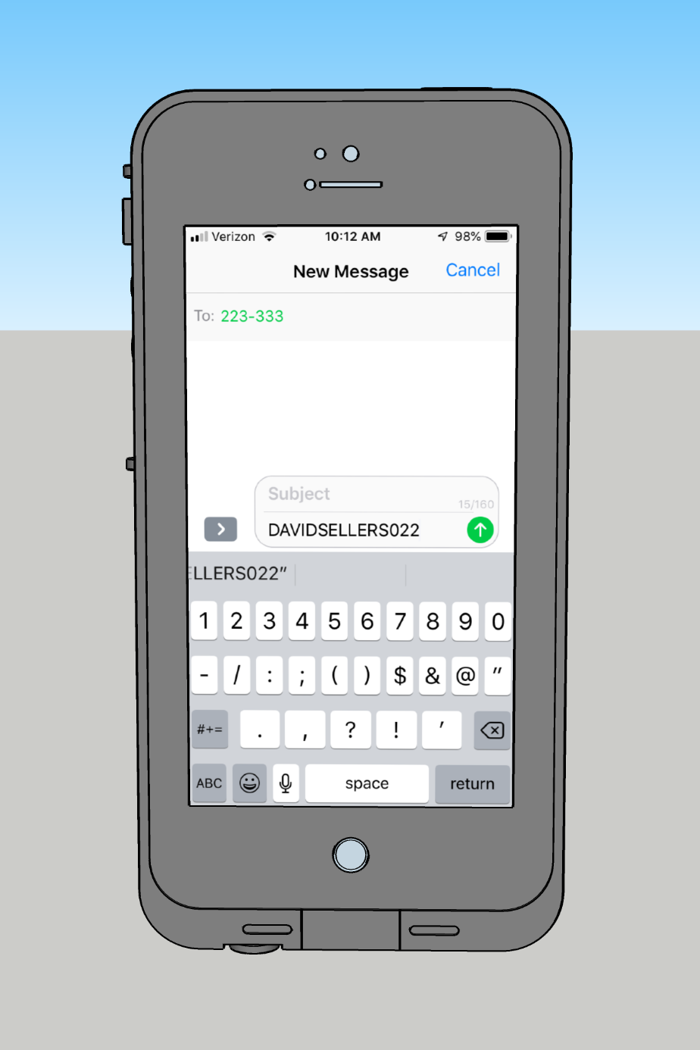
How it works
Via text messaging
Step 1
Text DAVIDSELLERS022 to 22333 (the hyphen gets inserted automatically on some phones)

Slide 8
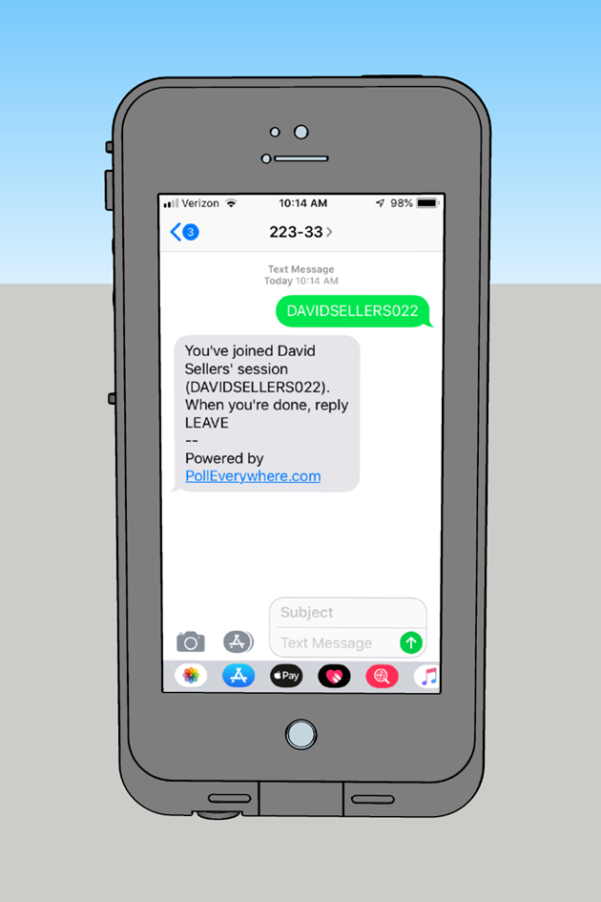
How it works
Via text messaging
Step 2
Receive confirmation that you have joined the session

Slide 9

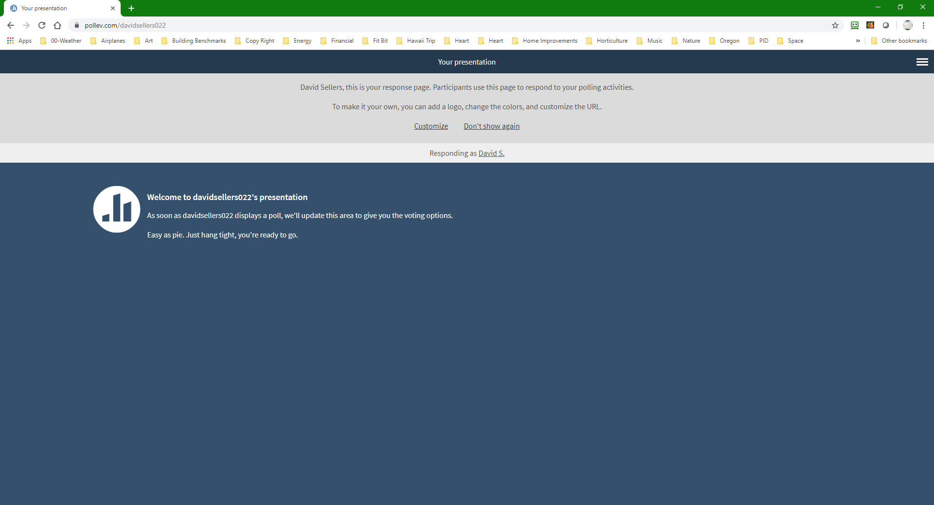
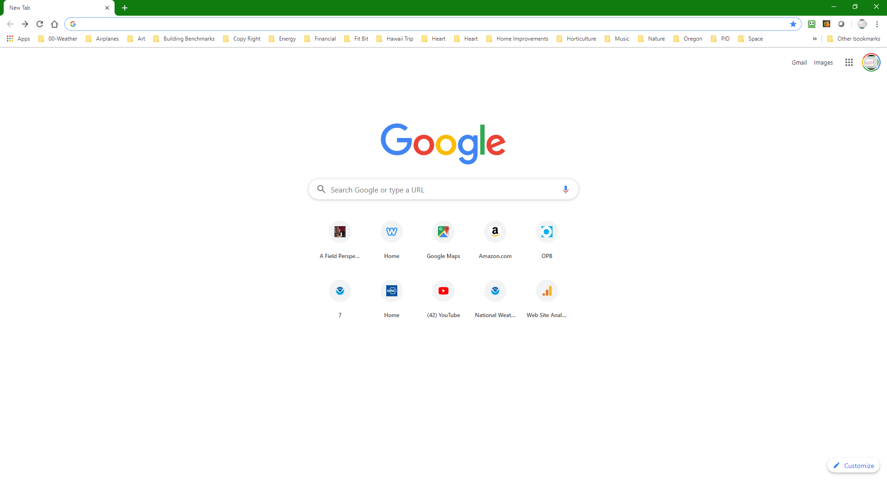
How it works
Via web browser
Step 1
Go to pollev.com/davidsellers022

Slide 10
How it works
Via web browser
Step 1
Go to pollev.com/davidsellers022

Slide 11

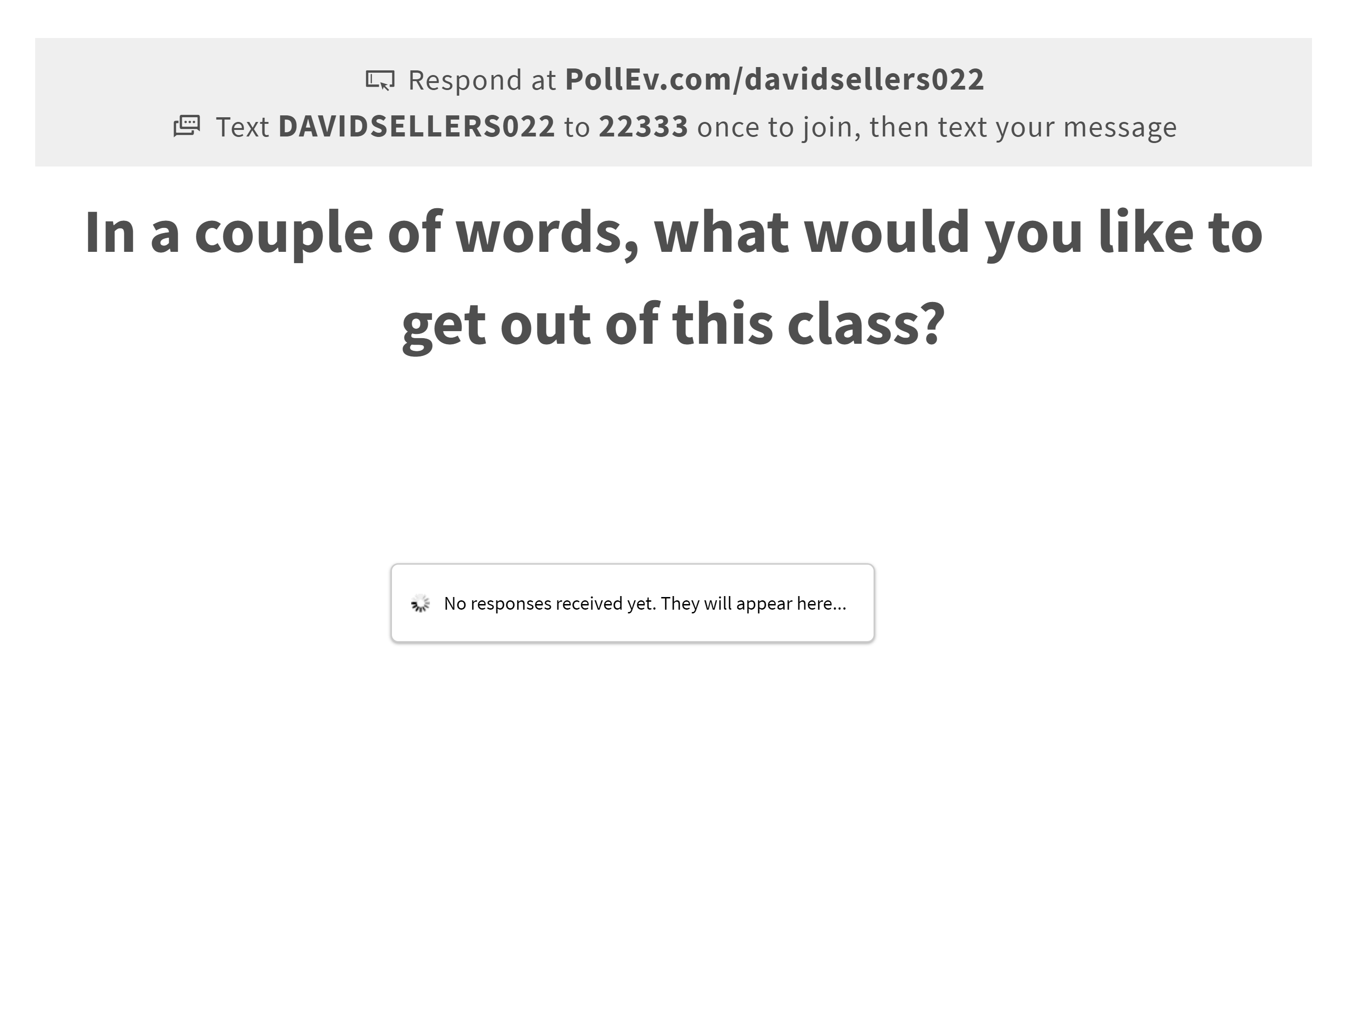
How it works
Via web browser or text messaging
Step 3
Wait for a poll question to come up

Slide 13
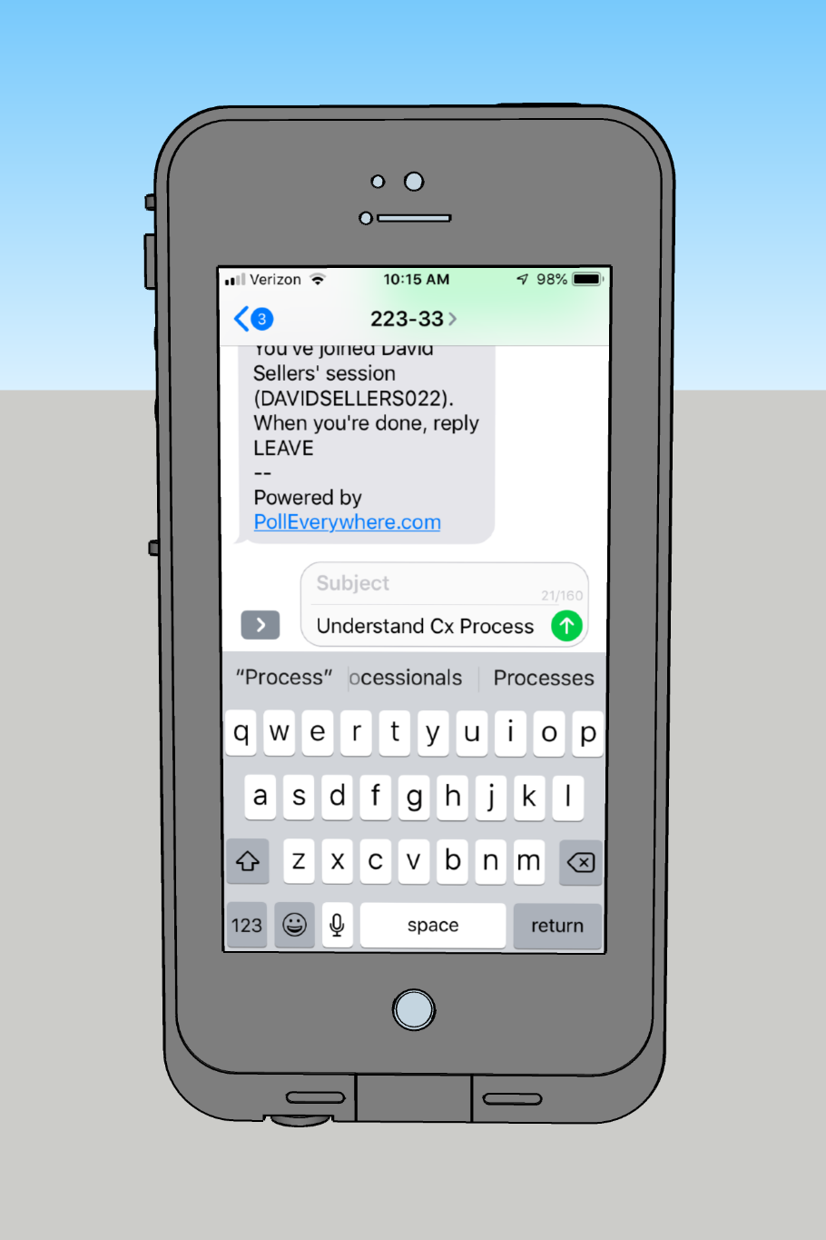
How it works
Via text messaging
Step 4
Type in your answer …

Slide 14
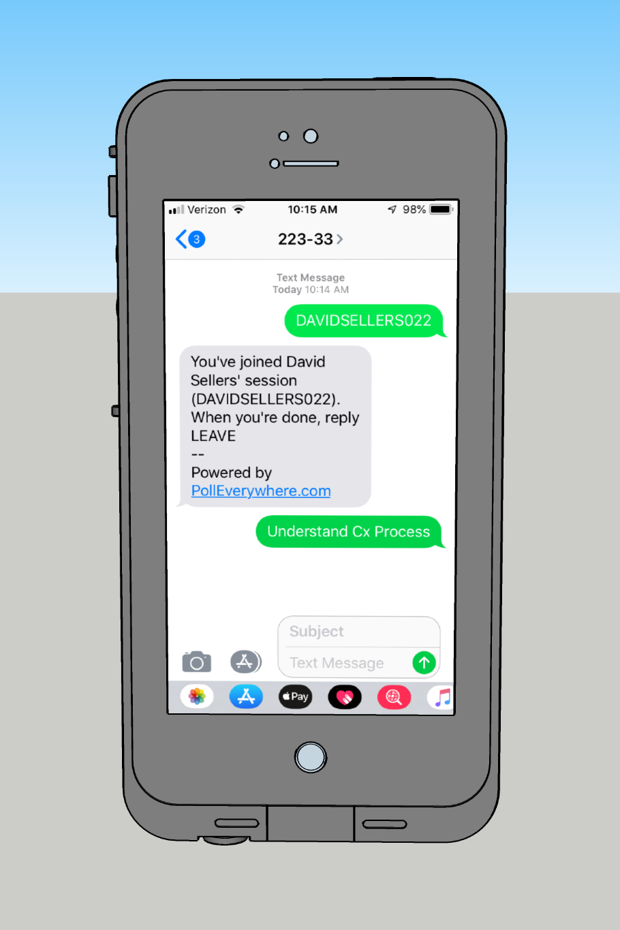
How it works
Via text messaging
Step 4
Type in your answer … and send it

Slide 15
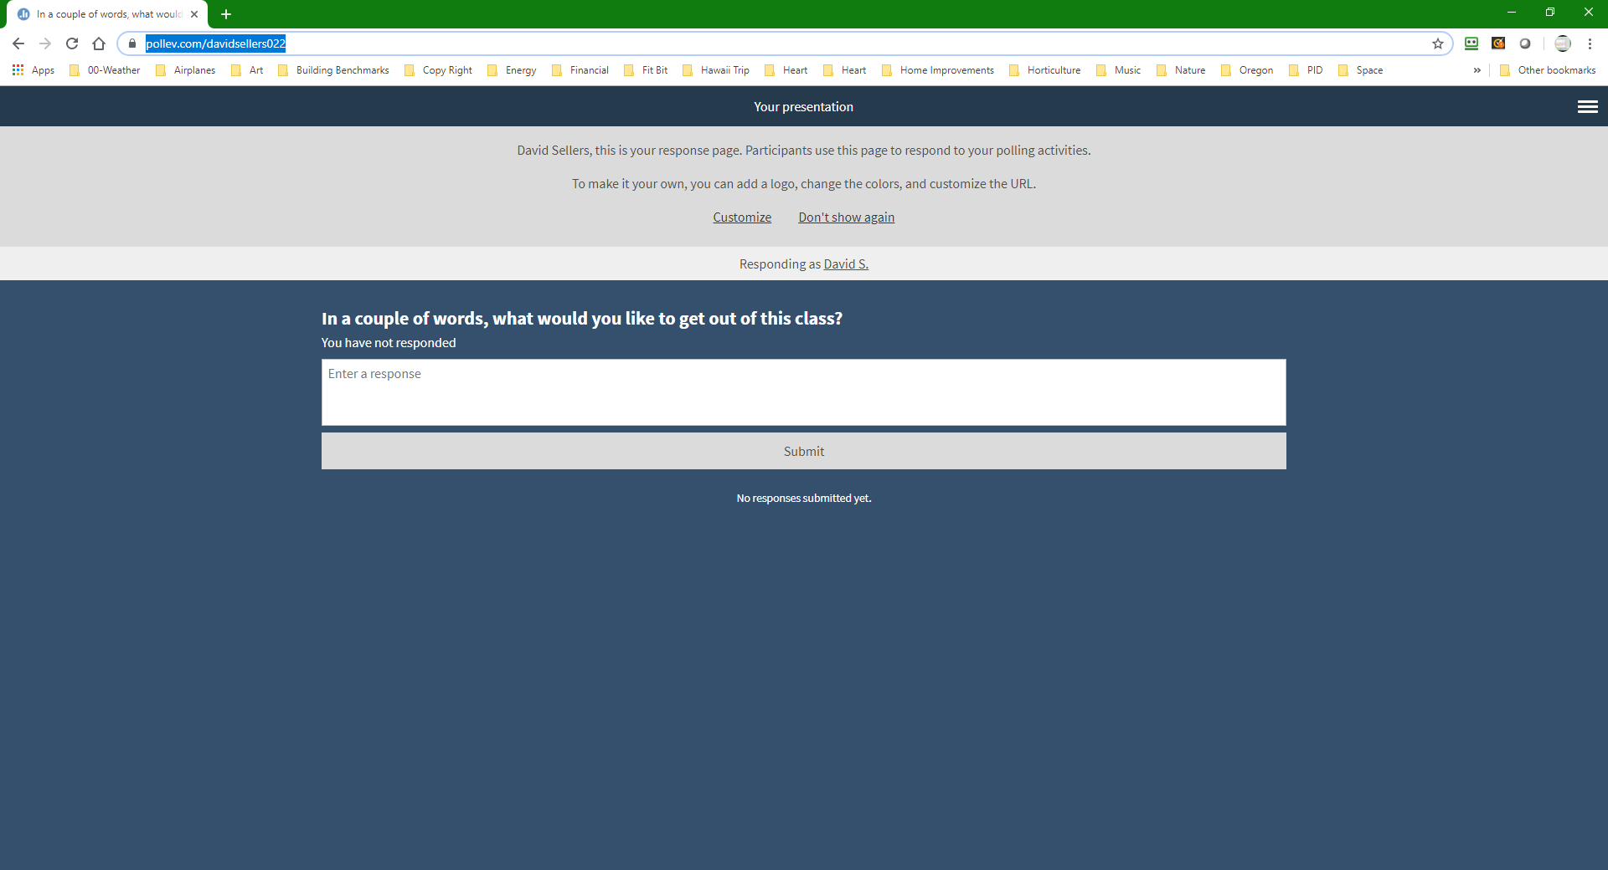
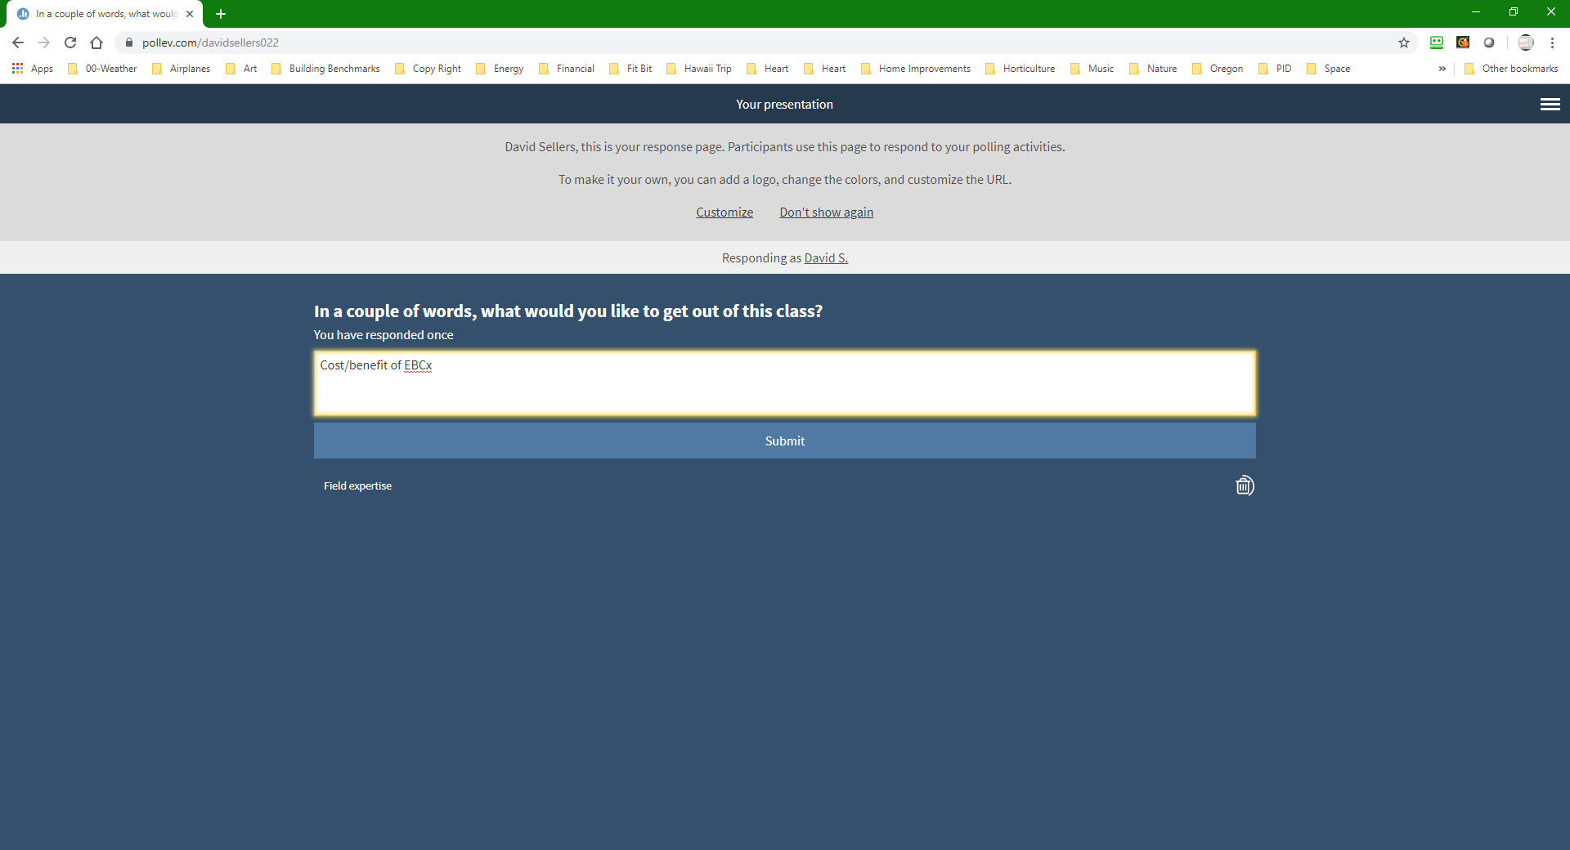
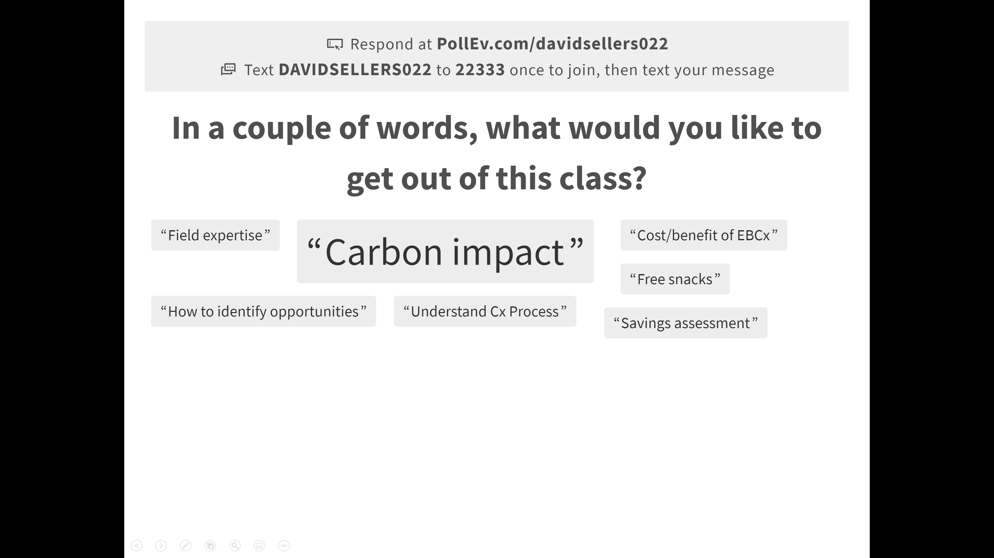
How it works
Via a browser
Step 4
Type in your answer …

Slide 16

How it works
Via a browser
Step 4
Type in your answer …and submit it

Slide 17
Via a browser
Step 4
Type in your answer

Slide 18
Let’s Try It
Via text messaging
Text DAVIDSELLERS022 to 22333 (the hyphen gets inserted automatically on some phones)
Or
Go to pollev.com/davidsellers022 in a web browser

Slide 19

Notes:
Poll Title: Where are you logged in from?
https://www.polleverywhere.com/clickable_images/GCHRK5ESQ8KsDt1aQgYSf

Slide 20

Notes:
Poll Title: What are you hoping to get from this class?
https://www.polleverywhere.com/free_text_polls/2l9sktZFjn2KafOseHyNE

Slide 21
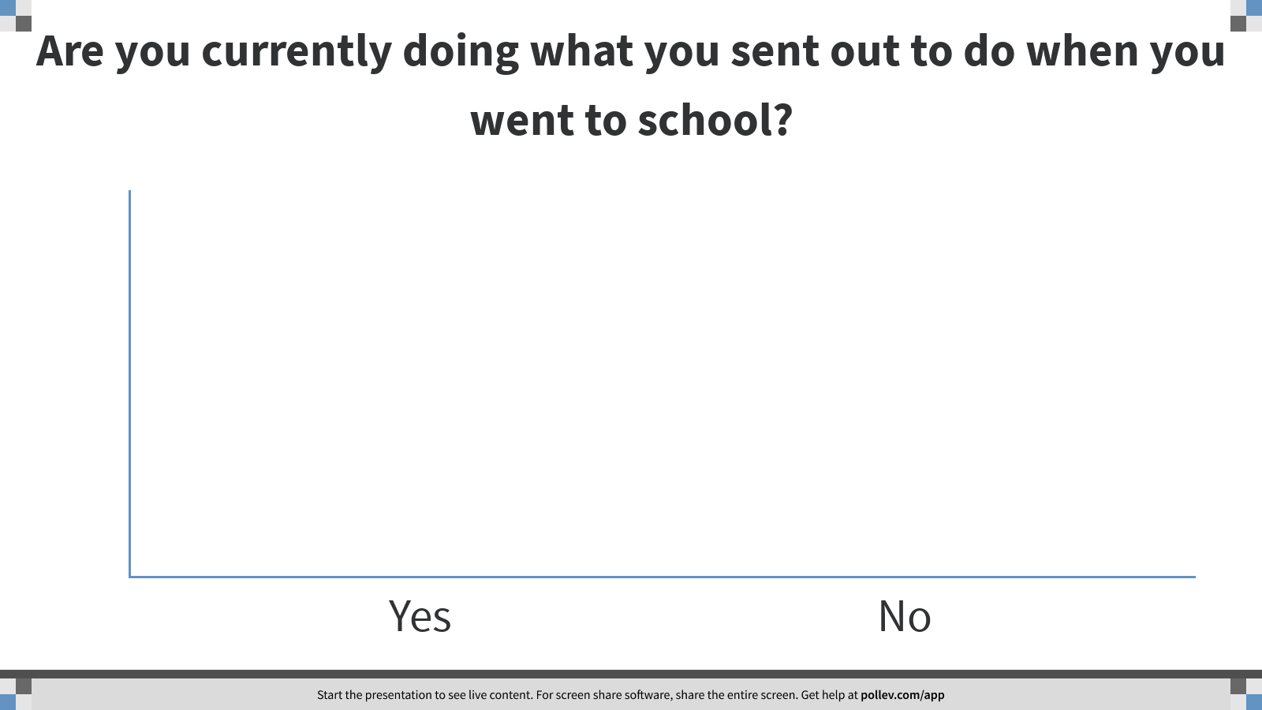
Notes:
Poll Title: Are you currently doing what you sent out to do when you went to school?
https://www.polleverywhere.com/multiple_choice_polls/YUpE2Qg1VREqfanmlDUL1?flow=Default&onscreen=persist

Slide 22
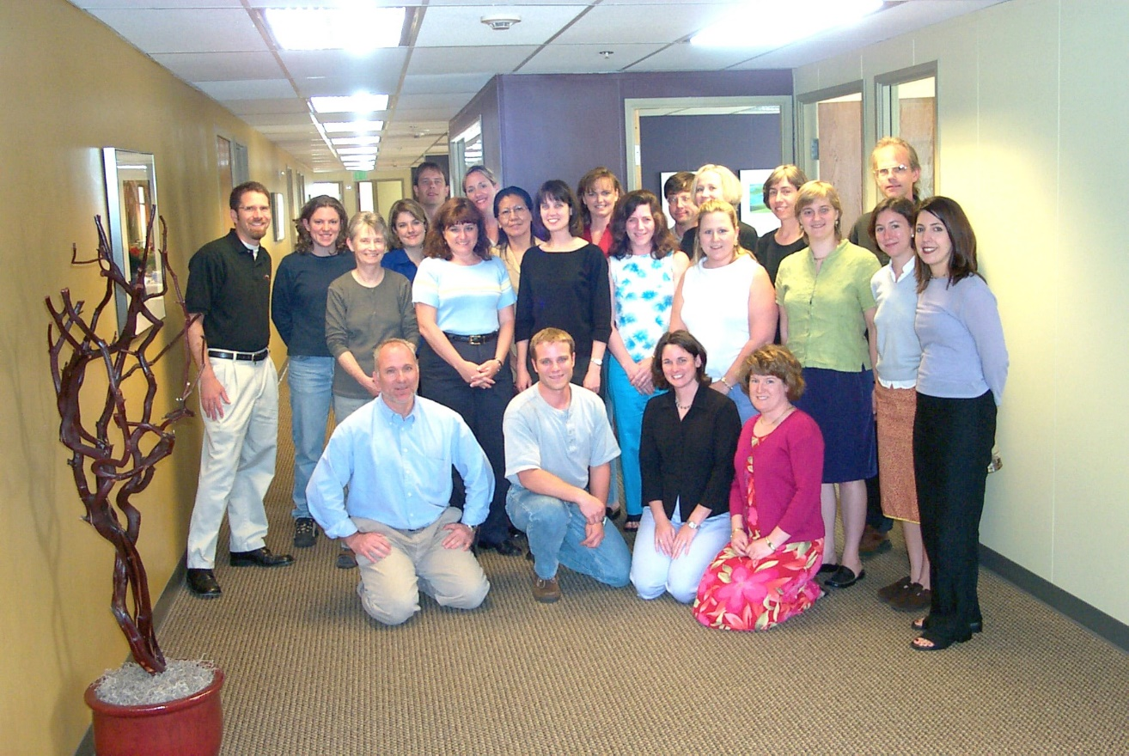
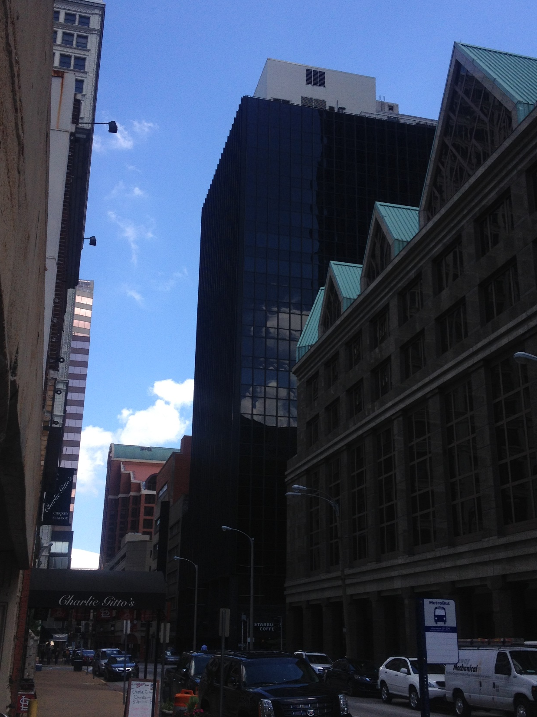
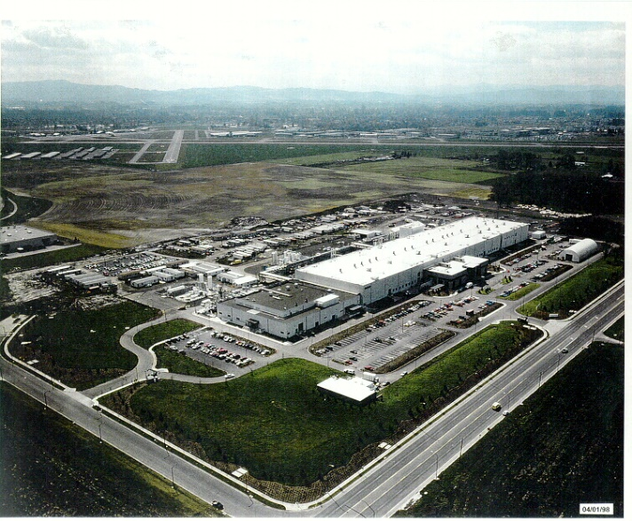
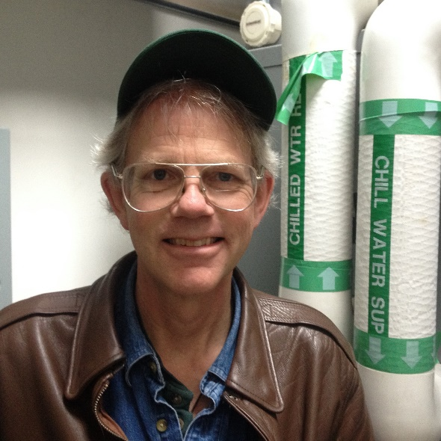
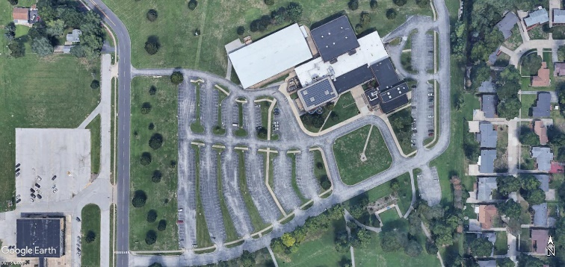
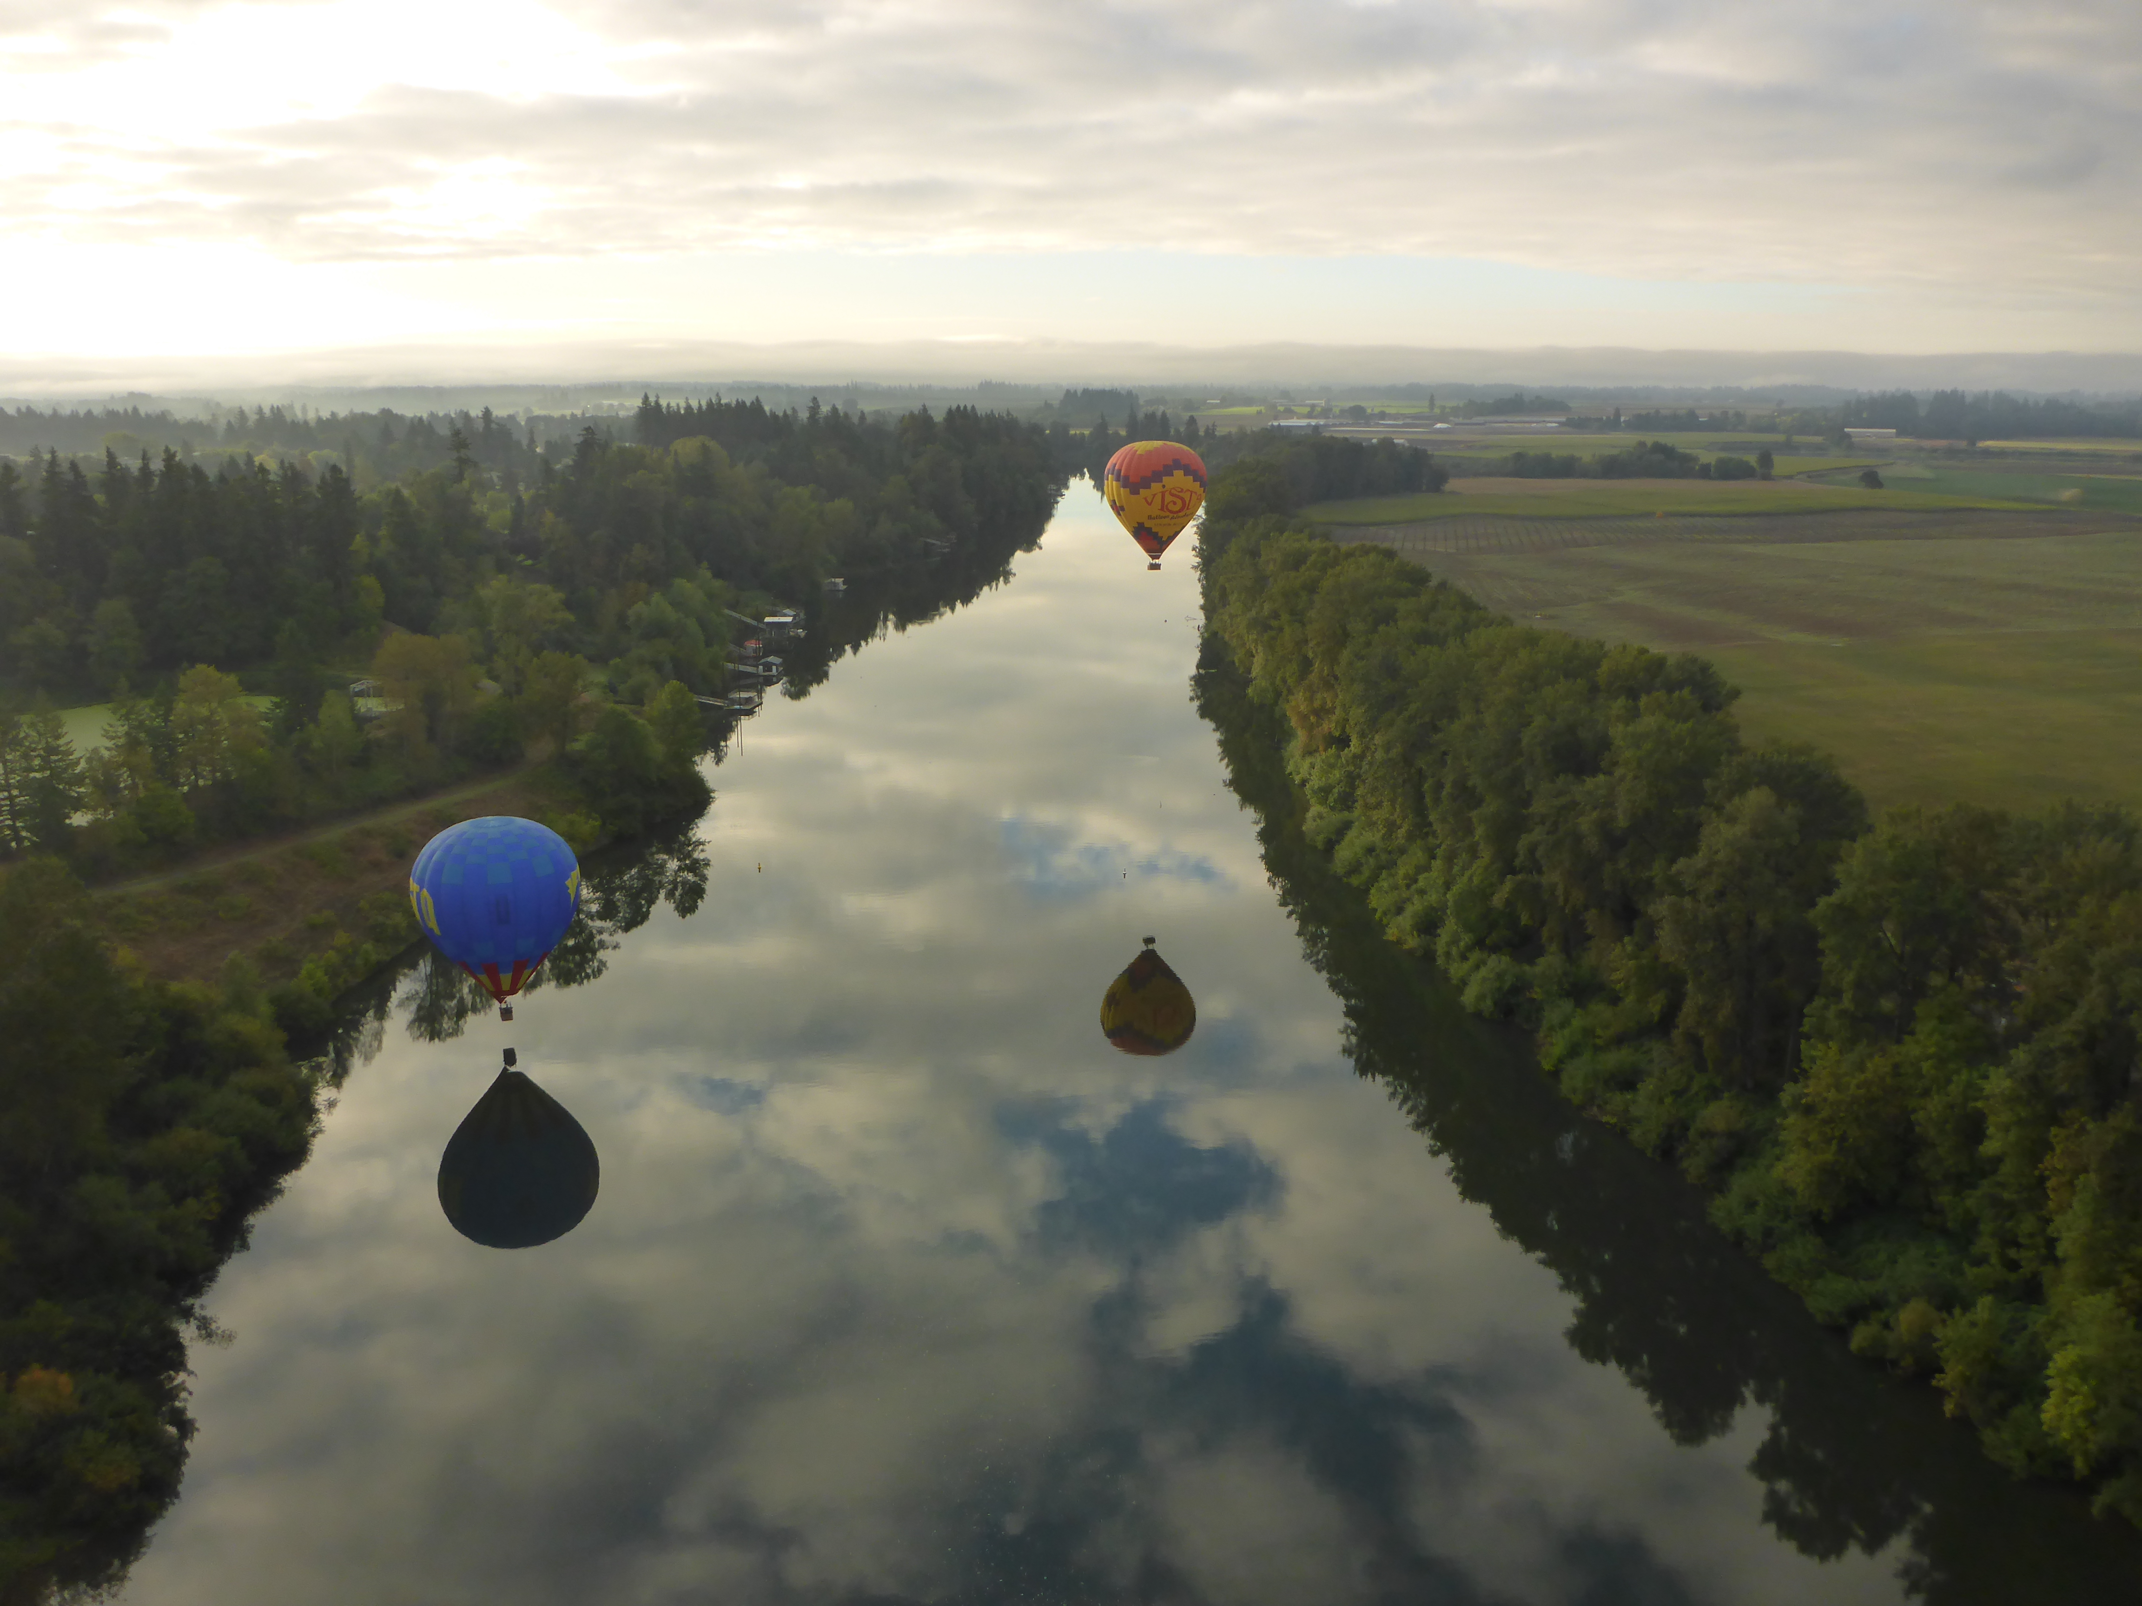

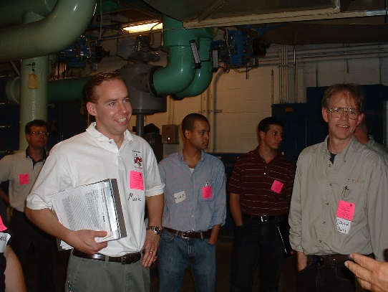
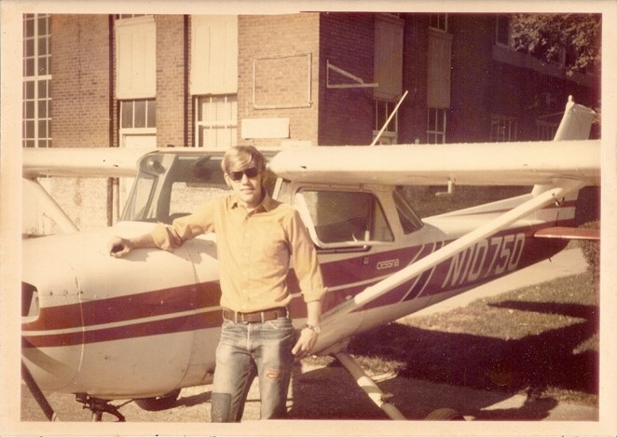

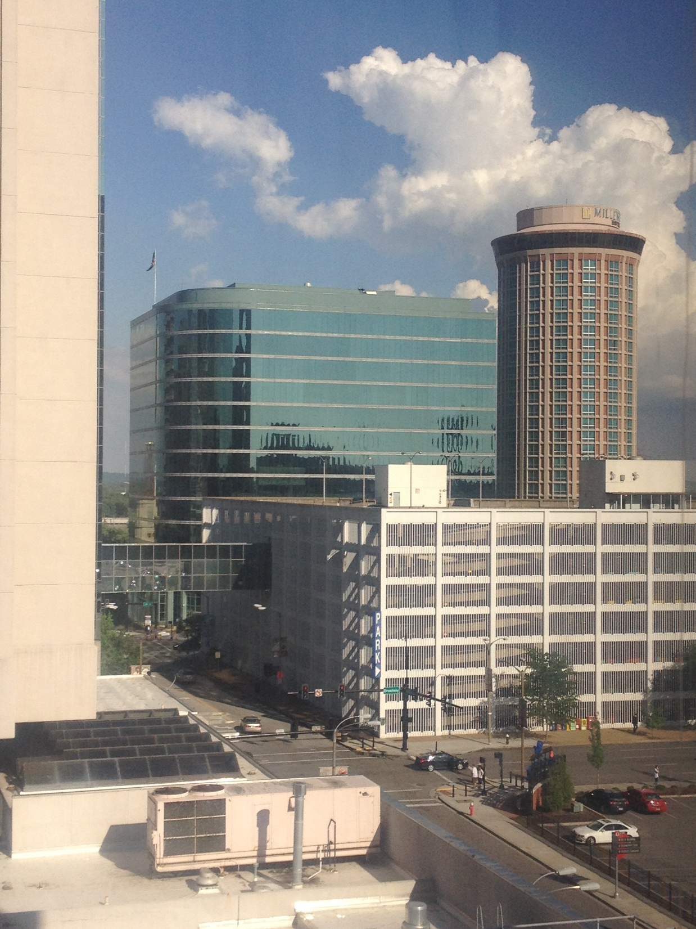
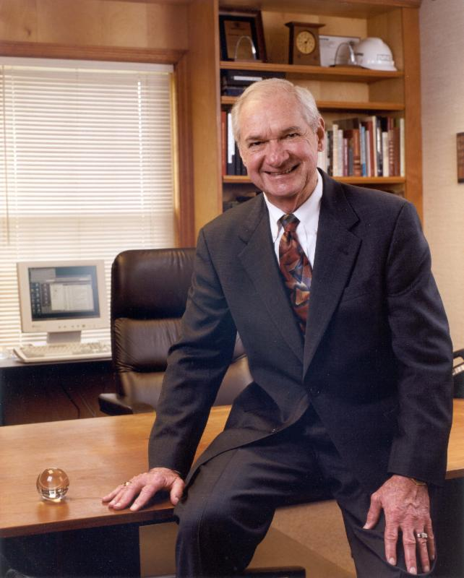
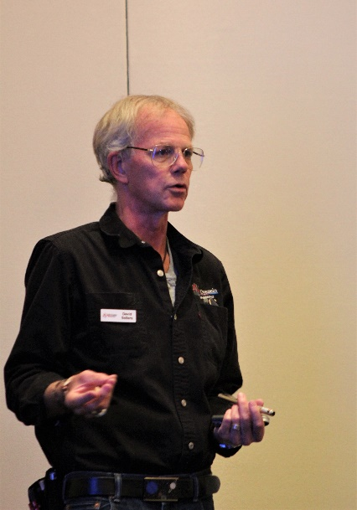
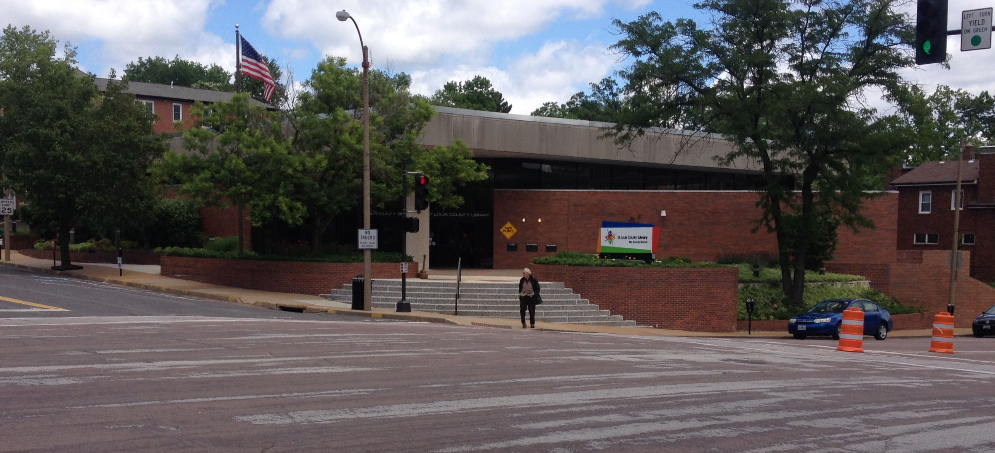
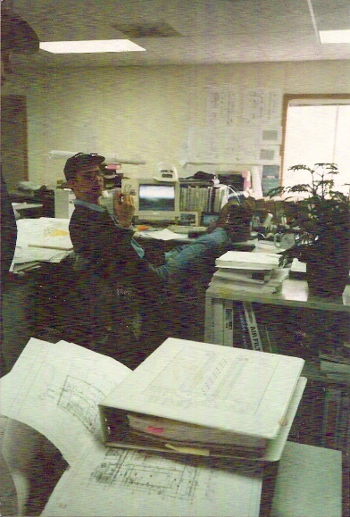
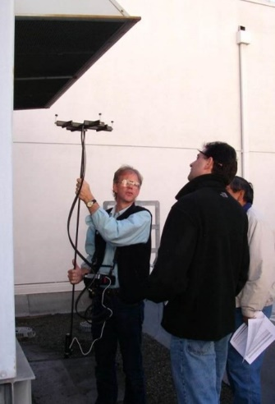
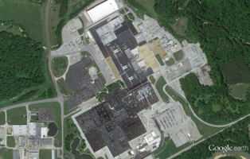
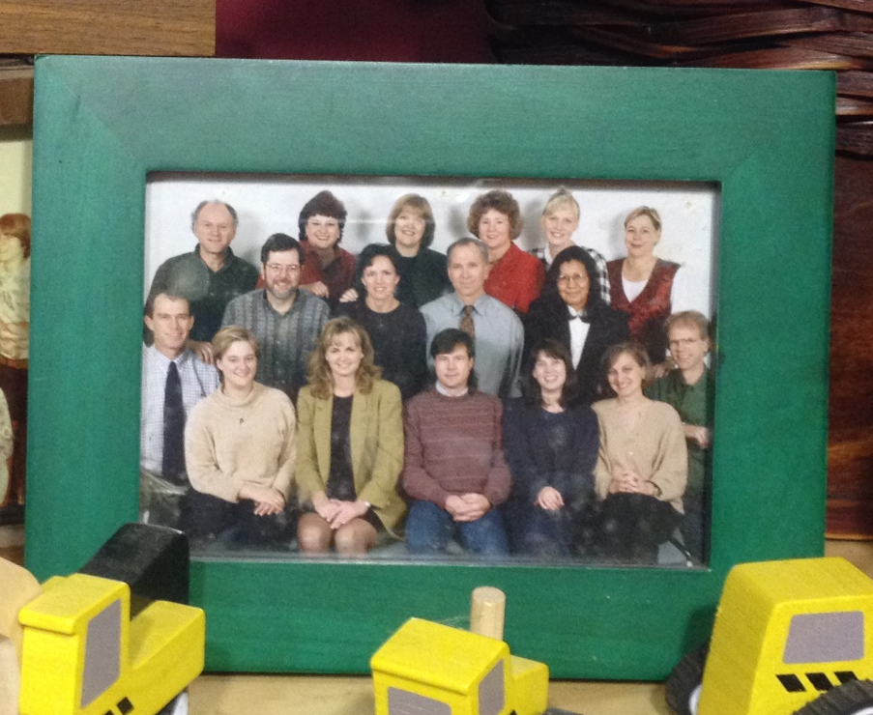
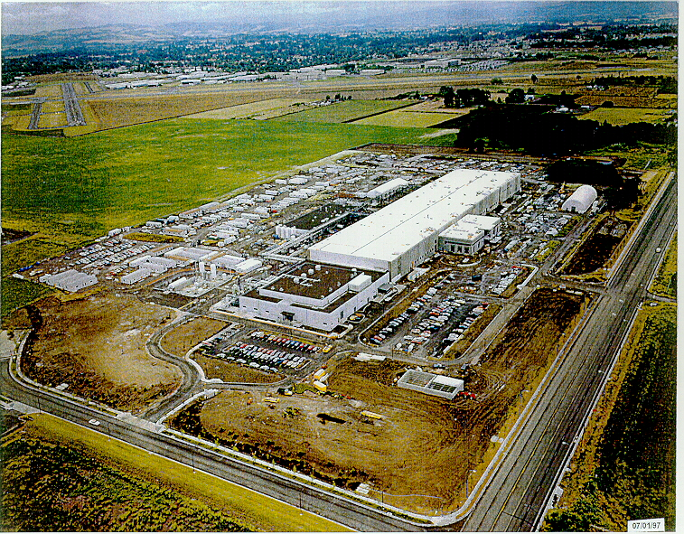
I’m Not
I intended to be an aircraft maintenance engineer ...

Slide 23
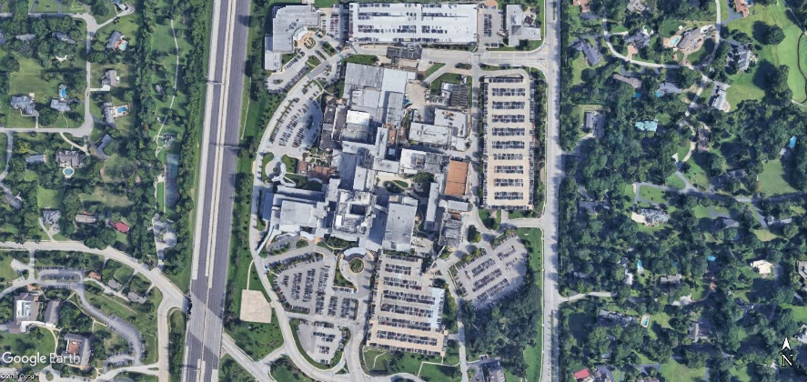

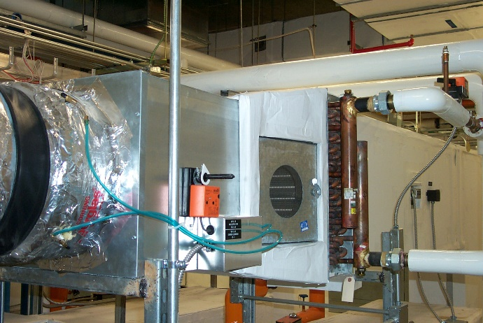
I’m Doing Something Totally Different
I intended to be an aircraft maintenance engineer
  How many of you are doing what you went to school to learn to do?
(Go to https://tinyurl.com/PVequalsmRT for more pictures and videos from the balloon flight)

Slide 24
Let’s try the “Chat” interface
How many of you were at the social hour last week?
(Type your answer into the chat window)
  How many of you are doing what you went to school to learn to do?

Slide 25

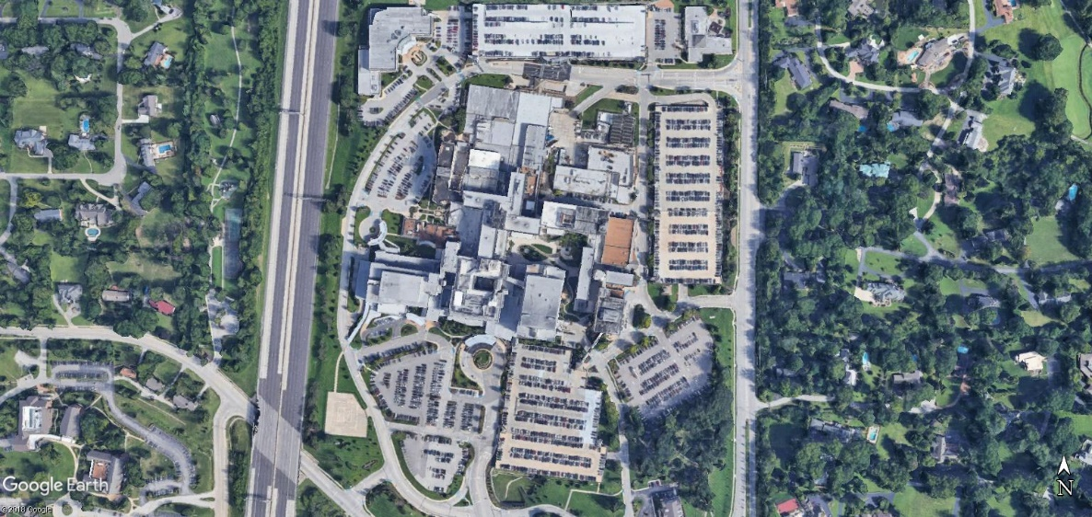


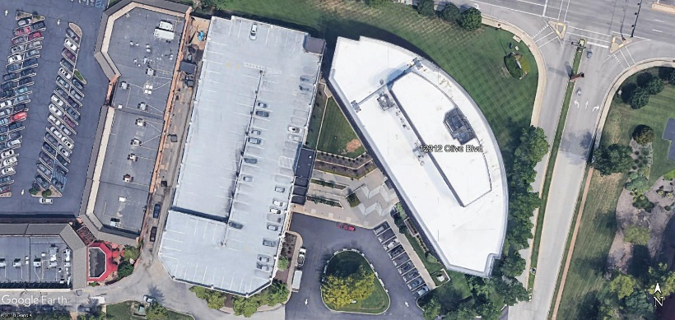
I’m Doing Something Totally Different
I intended to be an aircraft maintenance engineer
  How many of you are doing what you went to school to learn to do?
(Go to https://tinyurl.com/PVequalsmRT for more pictures and videos from the balloon flight)

Slide 26
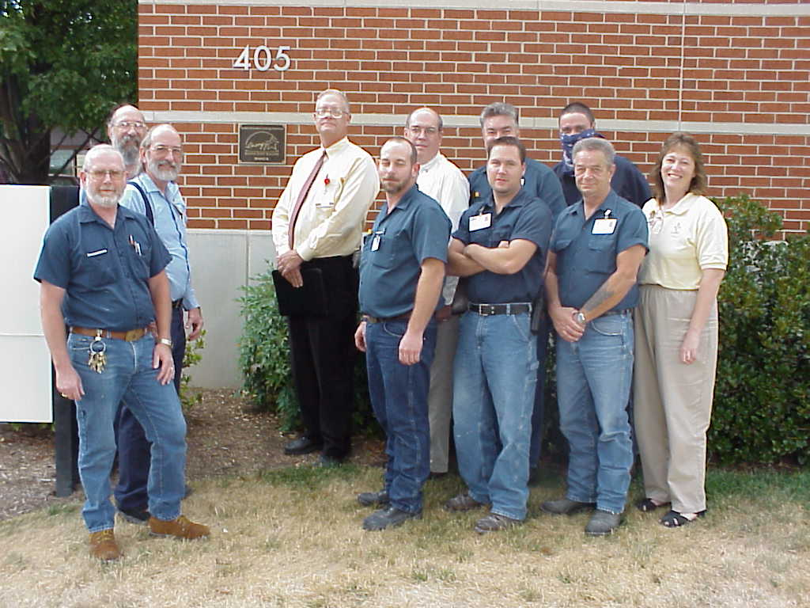
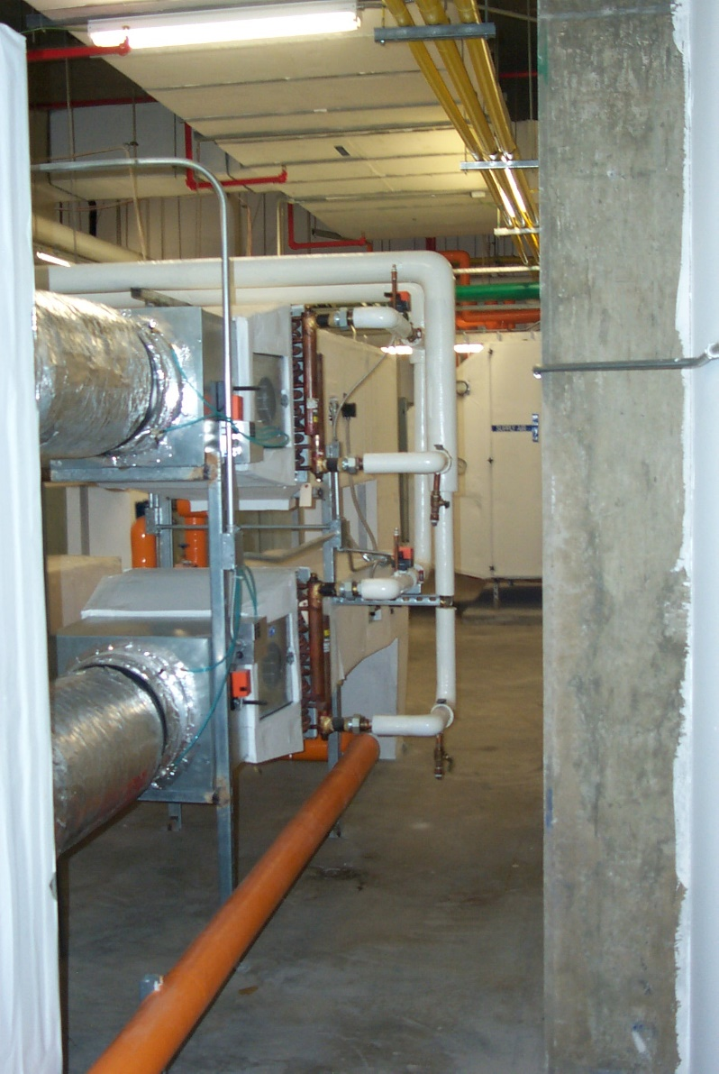
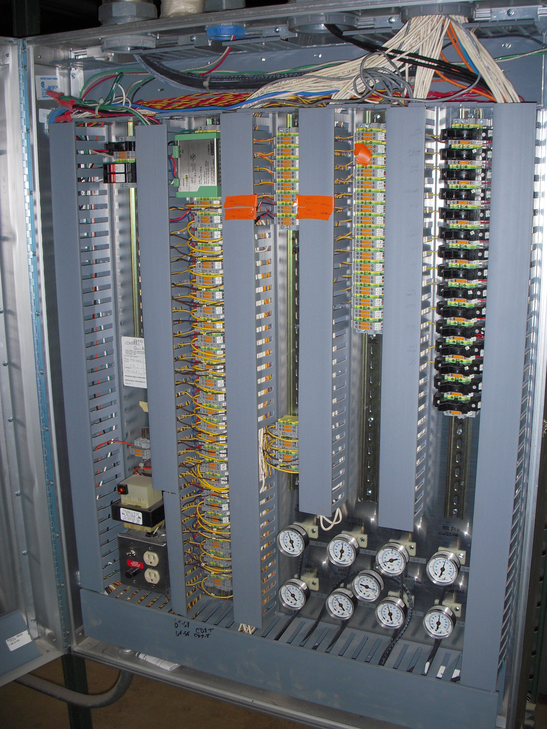


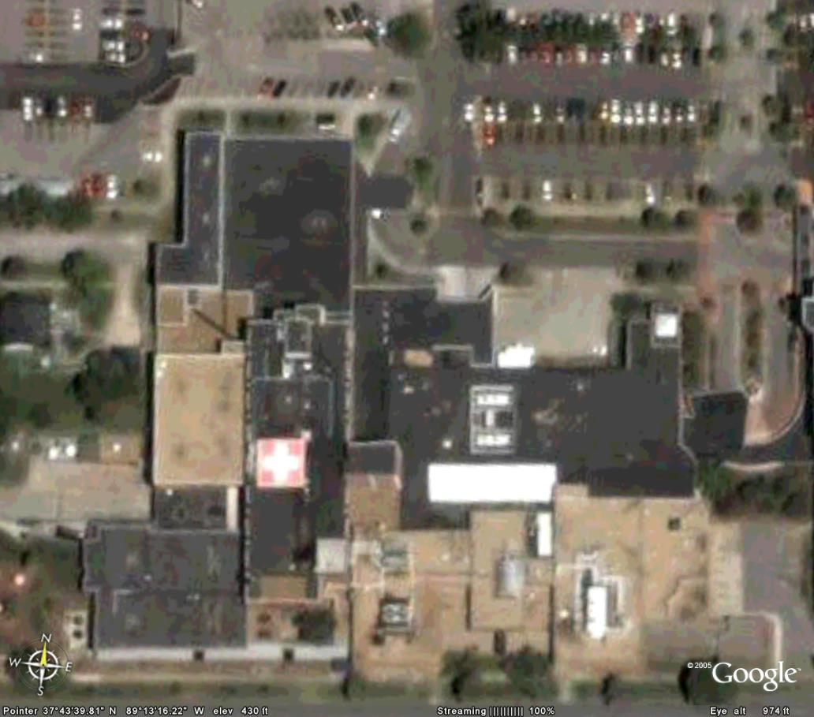
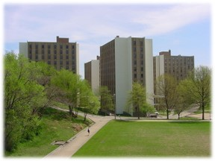
I’m Doing Something Totally Different
I intended to be an aircraft maintenance engineer
  How many of you are doing what you went to school to learn to do?
(Go to https://tinyurl.com/PVequalsmRT for more pictures and videos from the balloon flight)

Slide 27
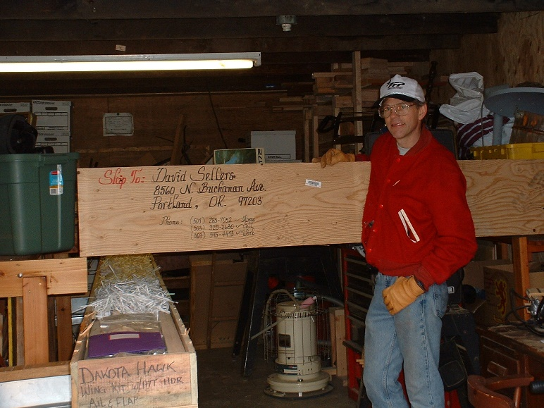

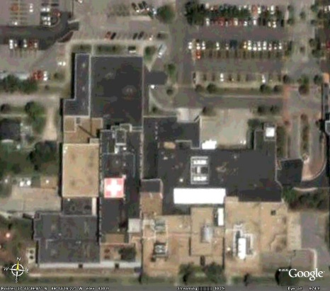


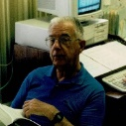
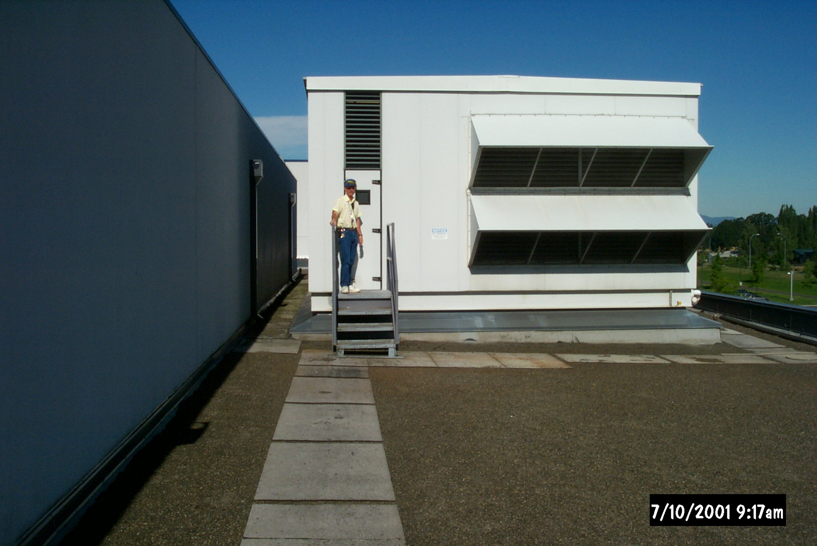
I’m Doing Something Totally Different
I intended to be an aircraft maintenance engineer
  How many of you are doing what you went to school to learn to do?
(Go to https://tinyurl.com/PVequalsmRT for more pictures and videos from the balloon flight)

Slide 28
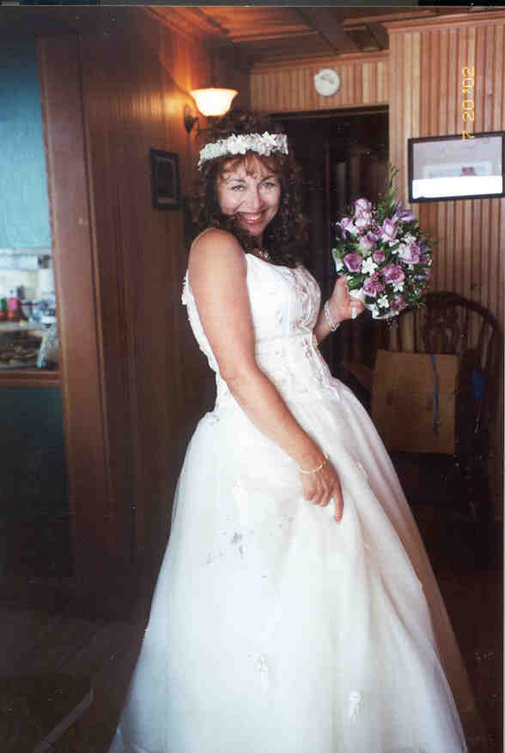

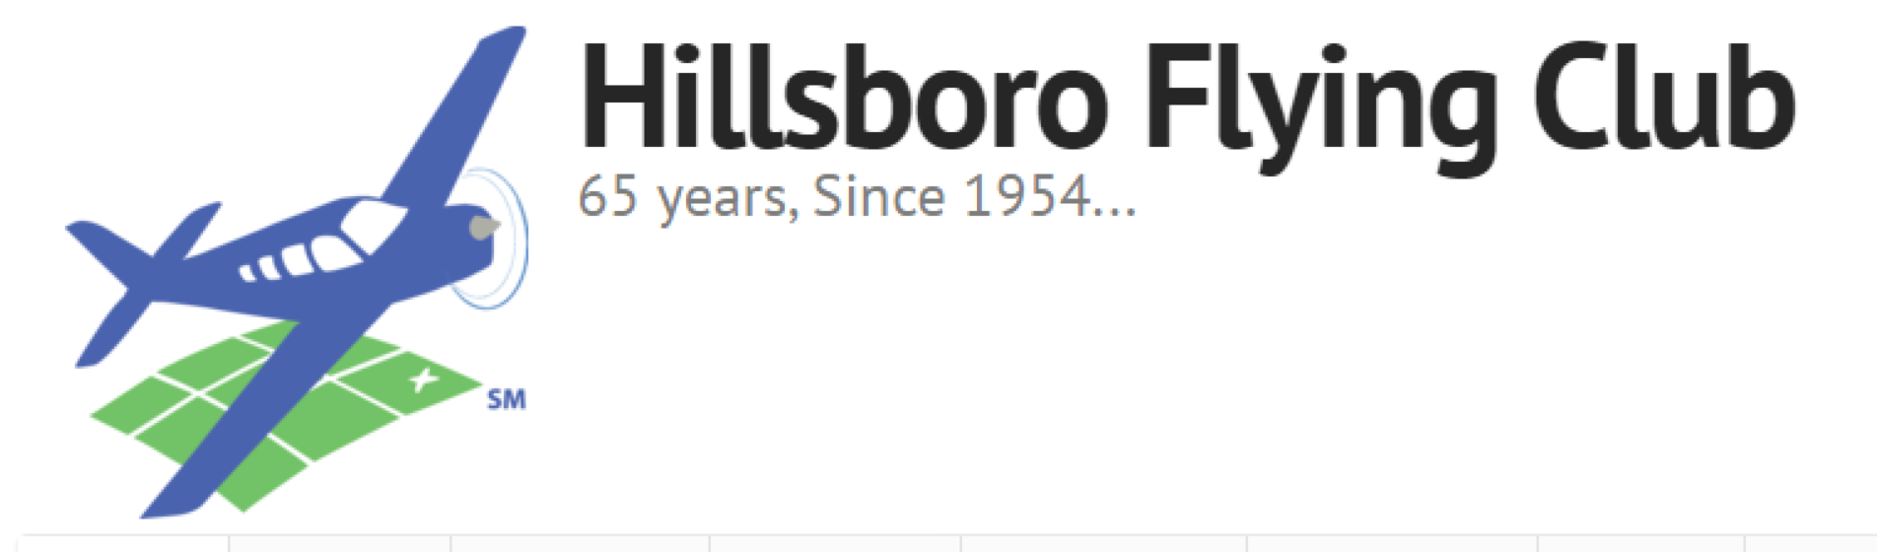

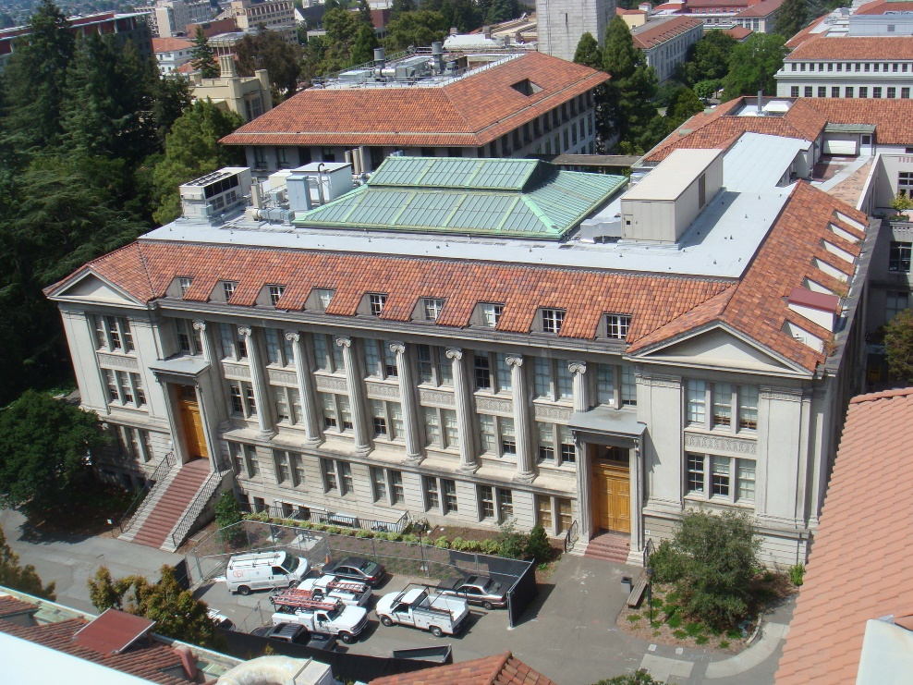

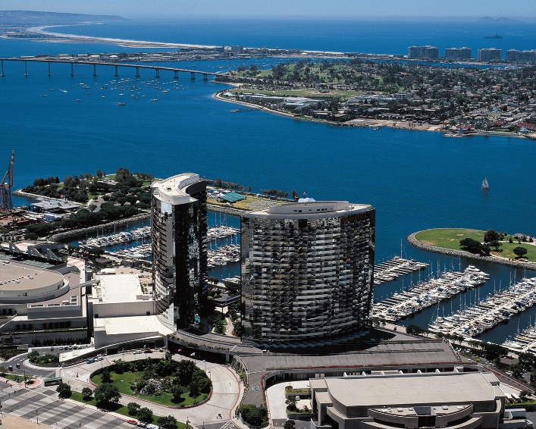

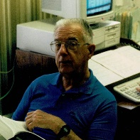
I’m Doing Something Totally Different
I intended to be an aircraft maintenance engineer
  How many of you are doing what you went to school to learn to do?
(Go to https://tinyurl.com/PVequalsmRT for more pictures and videos from the balloon flight)

Slide 29

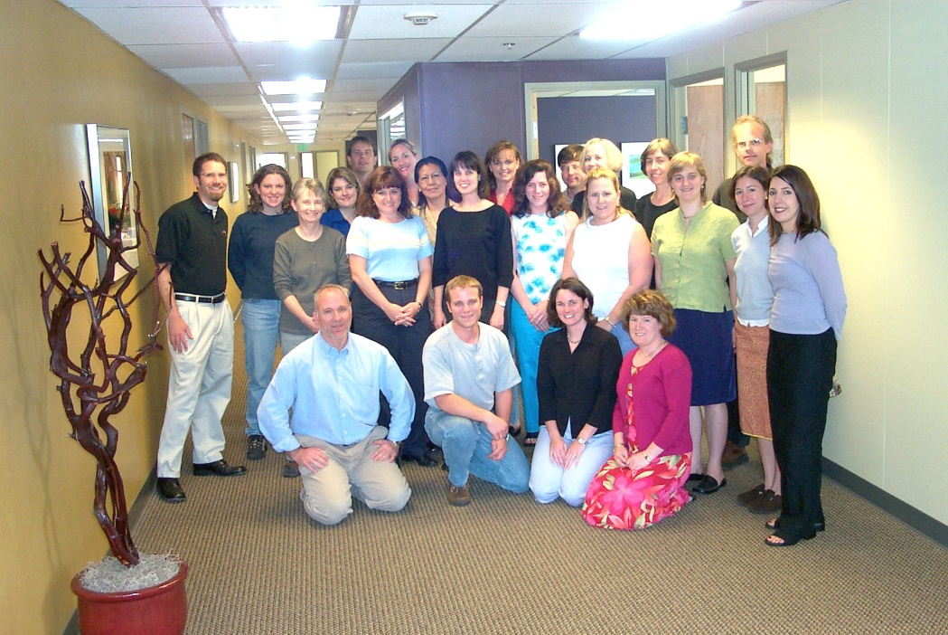

I’m Doing Something Totally Different
I intended to be an aircraft maintenance engineer
  How many of you are doing what you went to school to learn to do?
(Go to https://tinyurl.com/PVequalsmRT for more pictures and videos from the balloon flight)

Slide 30
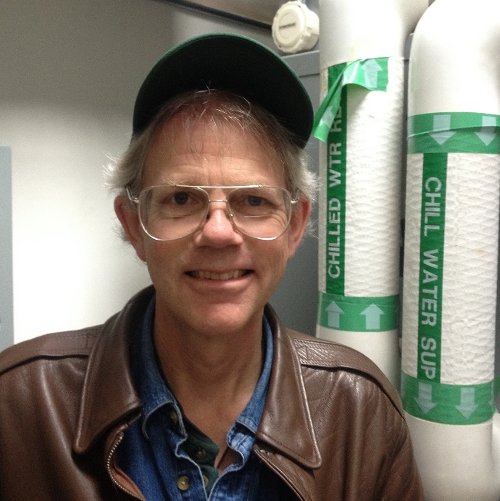




I’m Doing Something Totally Different
I intended to be an aircraft maintenance engineer
  How many of you are doing what you went to school to learn to do?
(Go to https://tinyurl.com/PVequalsmRT for more pictures and videos from the balloon flight)

Slide 31
I’m Doing Something Totally Different
I intended to be an aircraft maintenance engineer
  How many of you are doing what you went to school to learn to do?
(Go to https://tinyurl.com/PVequalsmRT for more pictures and videos from the balloon flight)

Slide 32

I’m Doing Something Totally Different
I intended to be an aircraft maintenance engineer
  How many of you are doing what you went to school to learn to do?
(Go to https://tinyurl.com/PVequalsmRT for more pictures and videos from the balloon flight)
(Go to https://tinyurl.com/PVequalsmRT for more pictures and videos from the balloon flight)

Slide 33
















You Can Too

Slide 34

I’ve Had Great Mentors Along the Way

Slide 35
Let’s Try “Unmuting”
When I call on you, unmute and tell us:
Your name
What is your involvement in the Commissioning Industry
How long you have been involved with the Commissioning Industry
(You don’t have to do this if you are uncomfortable doing it)

Slide 36



How I Taught Field Techniques in the Classroom Previously

Slide 37

Then, Kathy Needed an Art Studio

Slide 38

And I Realized This …

Slide 39
… Could be This

Slide 40

Notes:
Poll Title: Are you comfortable using SketchUp and plan to participate in the exercises that way?
https://www.polleverywhere.com/multiple_choice_polls/whAghiU6fvzb41nr1RKlg?flow=Default&onscreen=persist

Slide 41


Slide 42


Slide 43


Slide 44


Slide 45


Slide 46


Slide 47
Current Conditions
Sacramento, CA location
Foggy; OAT in the low 50°F range
Should burn off mid-afternoon and get up into the 70°F range
Furnace was running when you let your house to visit the site

Slide 48


