Slide 1
Existing Building Commissioning Workshop: Series 17, Session 3
Logic Diagrams and Narrative Sequences
Presented By:
David Sellers
Senior Engineer, Facility Dynamics Engineering

Slide 2
Coming to a Cx Resources Website Near You
Will provide more depth for those who are interested
Our goal today is to introduce you to the logic diagram concept
Introduce logic diagram concepts
Introduce logic diagram symbols
Develop a simple logic diagram

Slide 3
What is a Narrative Control Sequence?
A written description of how a system or piece of equipment is supposed to work

Slide 4
What’s Wrong with This Narrative Control Sequence?
The control system shall stage the chilled water plant in a manner that optimizes its efficiency

Slide 5
Writing it All Down
Documenting your sequence is an Excellent idea
Using the English language to do it may provide a few challenges

Slide 6
wood hollow
Does the text to the left say
Molly Poom
or
Wood Hollow?

Slide 7
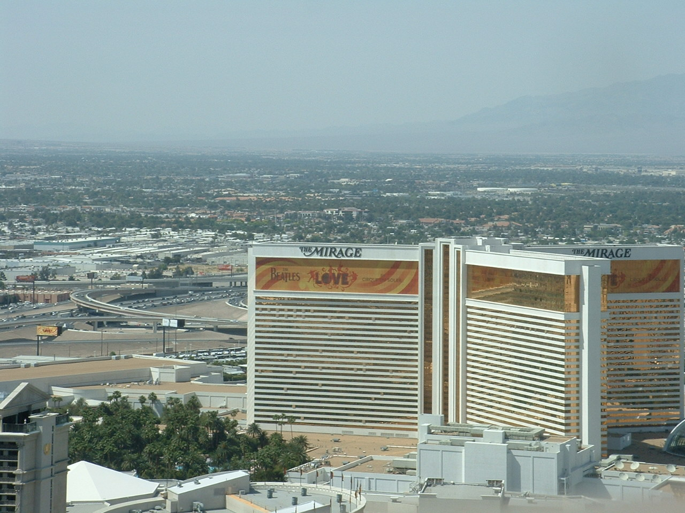
Clear Communication is Important

Slide 8
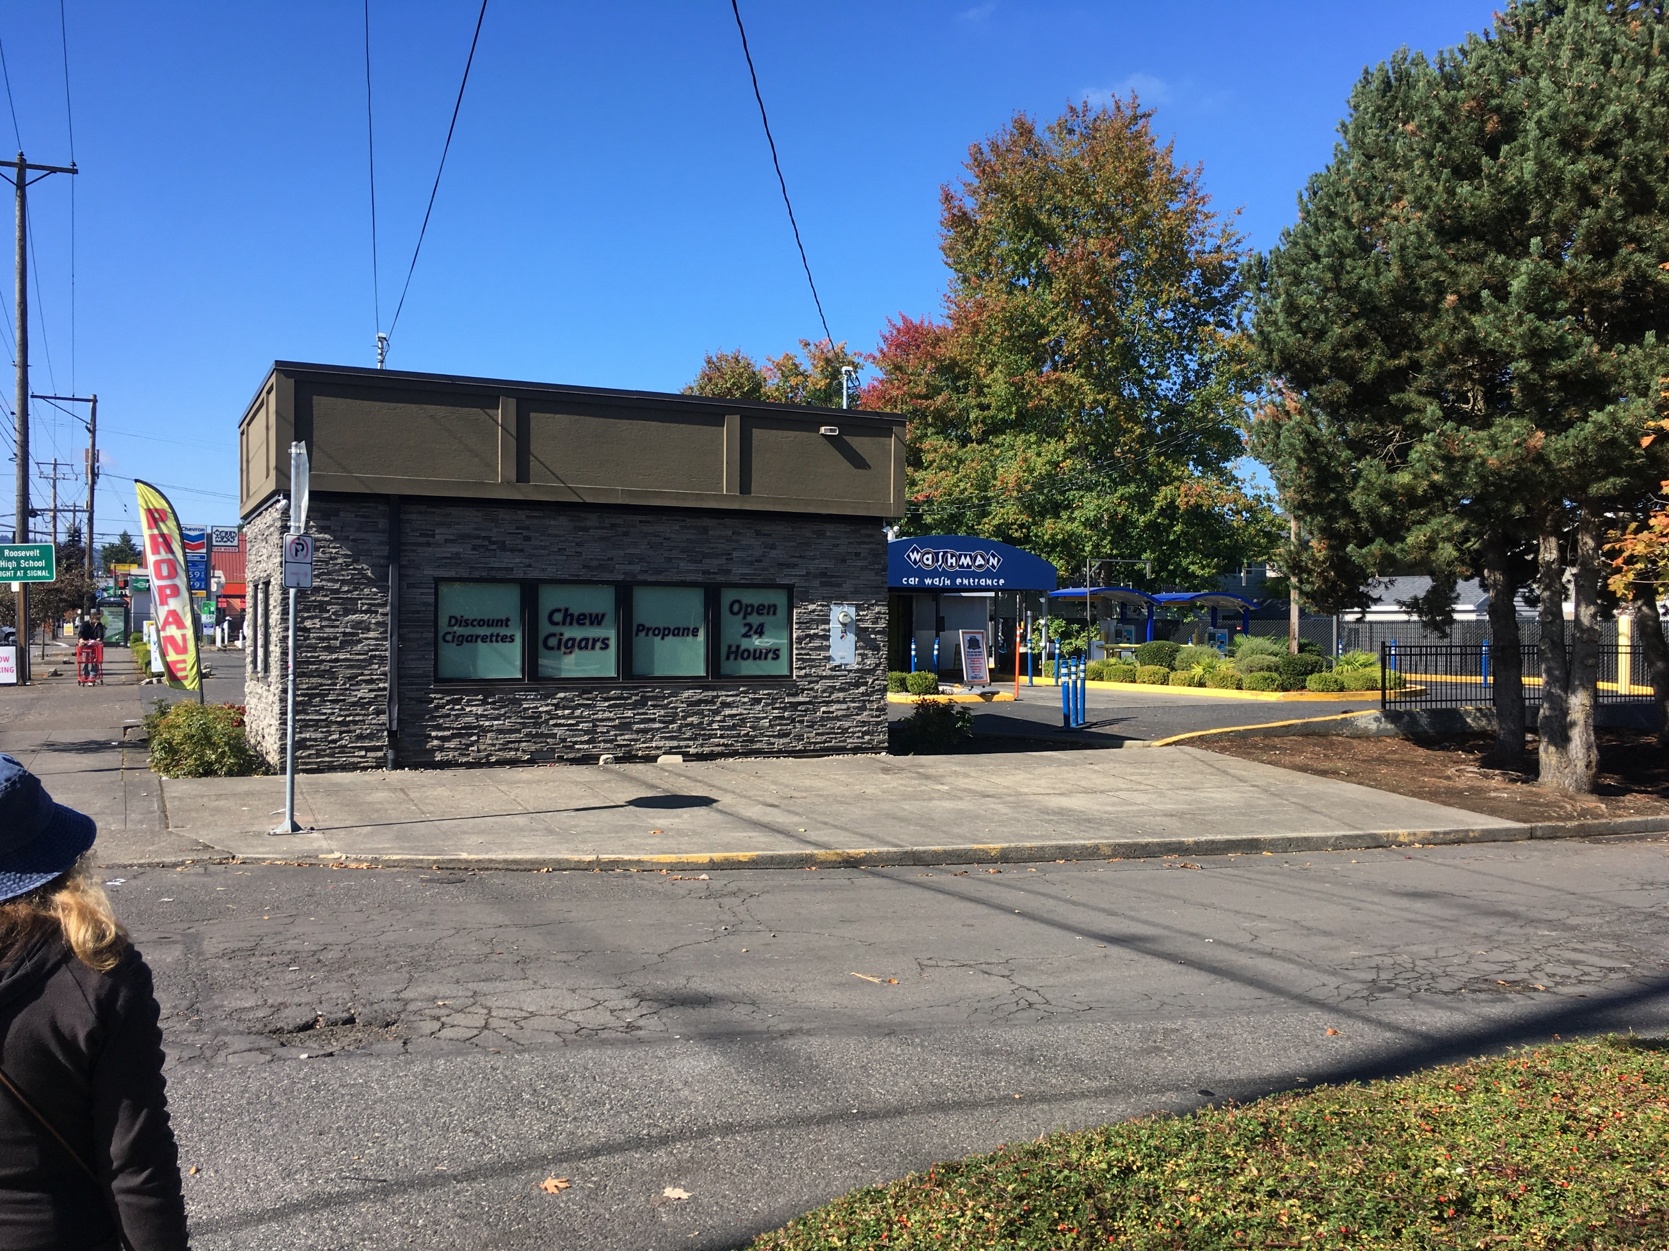
Is This Advocacy or Advertising?

Slide 9
Is This Advocacy or Advertising?

Slide 10
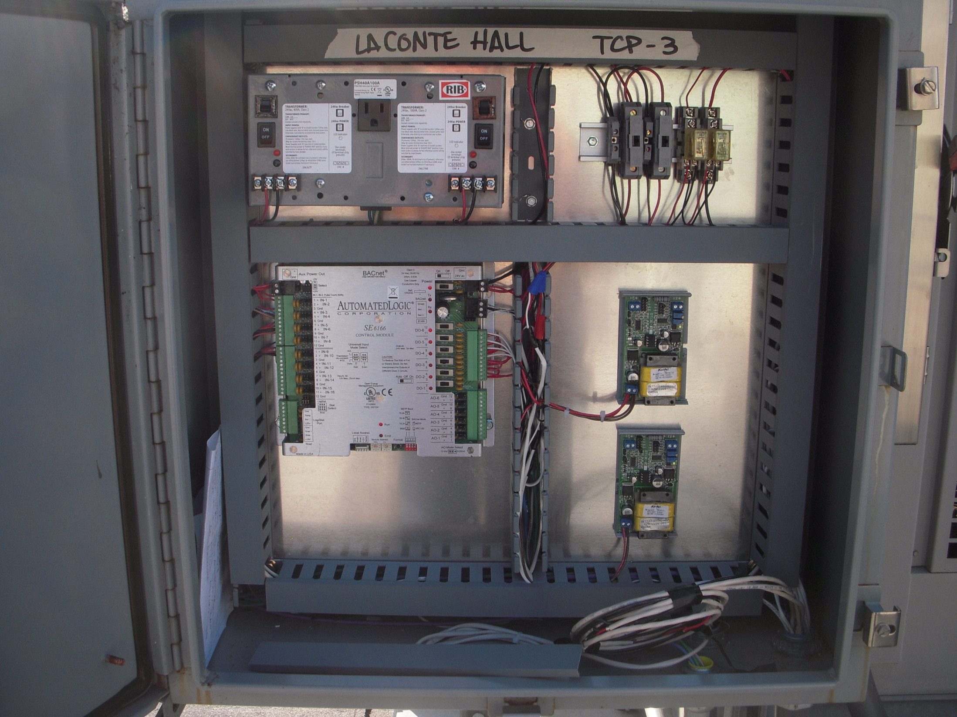
This Control System is Automated Logic

Slide 11
This Control System is Automated Logic

Slide 12
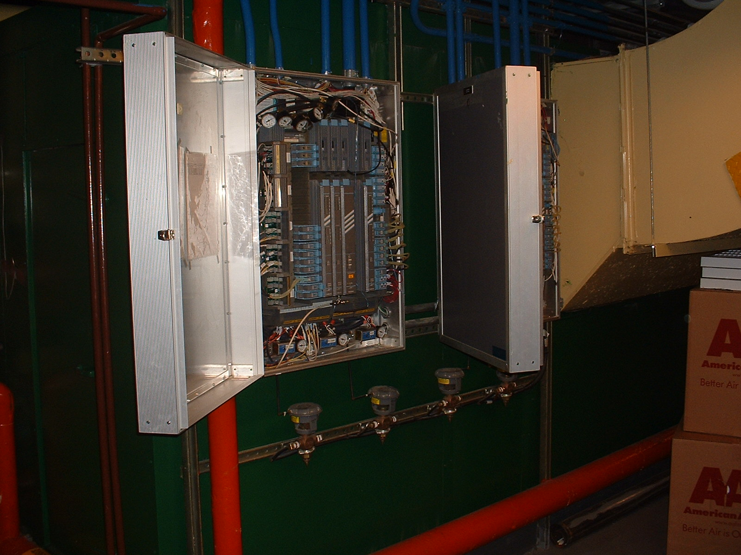
This Control System is Automated Logic But in the general sense, so is this one

Slide 13
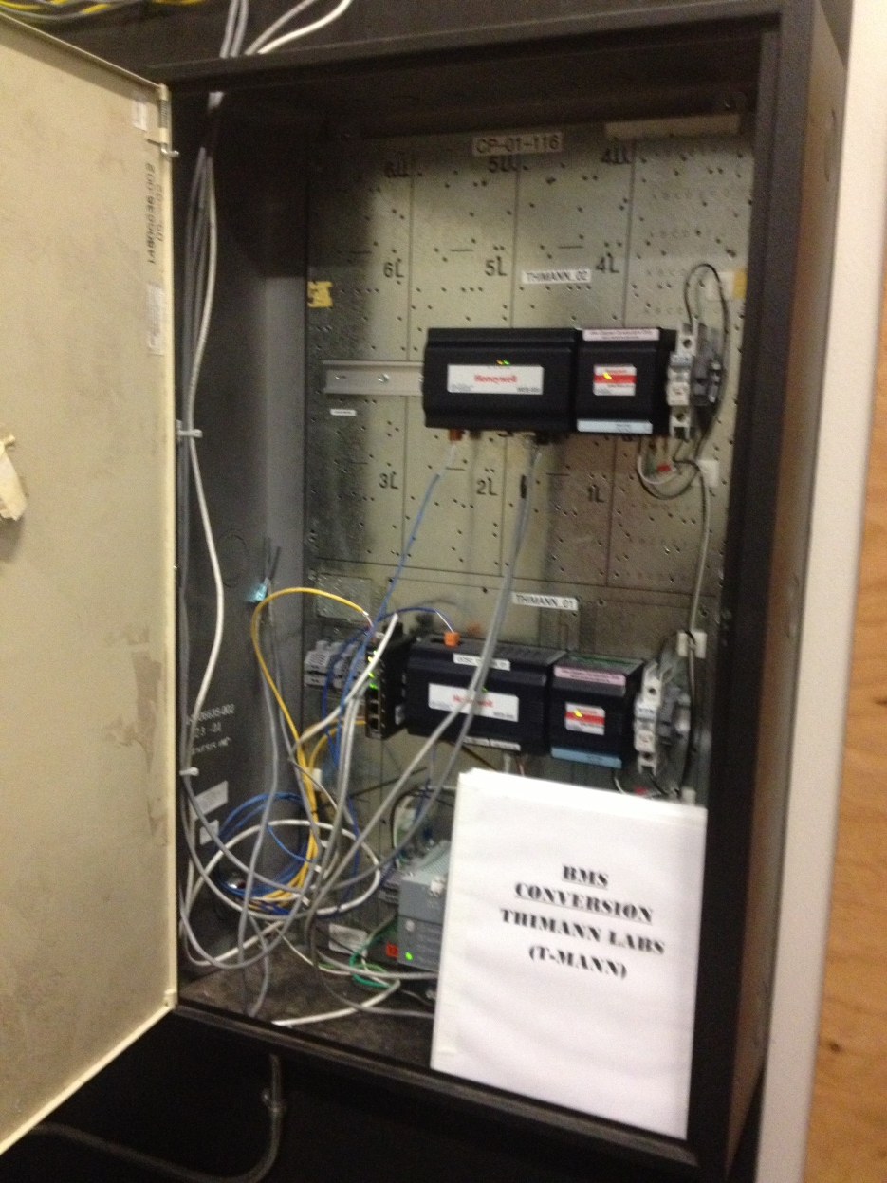
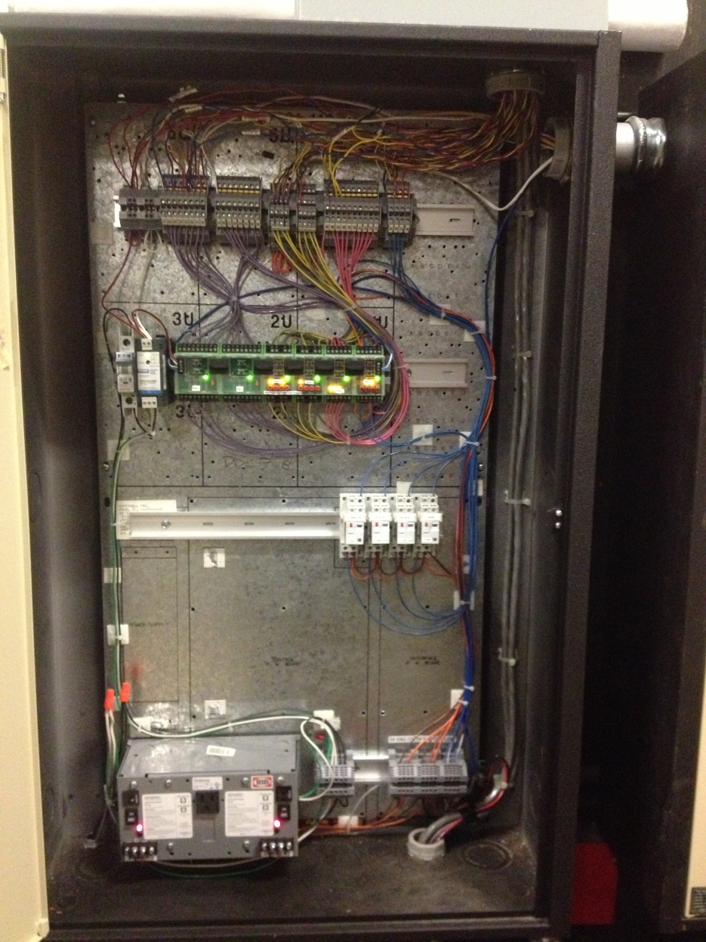
This Control System is Automated Logic But in the general sense, so is this one, and these too

Slide 14
A Few Resources
Logic Diagram Tool with Examples
https://www.av8rdas.com/logic-diagram-tool.html
Examples of Control and Logic Standards
https://www.av8rdas.com/control-and-logic-diagram-standards.html
Articles on Developing Control System Design and Logic Sequences
https://www.av8rdas.com/magazine-articles.html#Controls
https://www.av8rdas.com/magazine-articles.html#Lessons
Logic Diagram Tools with Simulation Capability
https://www.av8rdas.com/eikon-for-educators-and-windlgc.html

